Slide 1
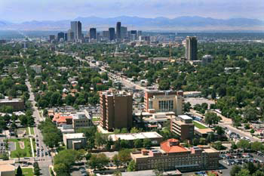
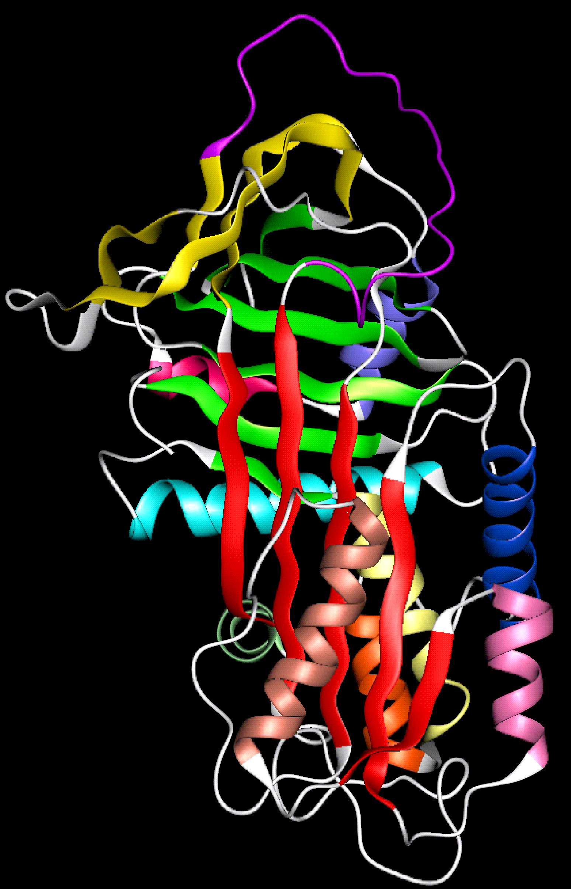
Detección de Déficit A1AT dentro de la población usual con EPOC
Robert A. Sandhaus, MD, PhD, FCCP
National Jewish Health
University of Colorado
Alpha-1 Foundation
AlphaNet

Slide 2
Potential Conflicts
Served on advisory boards and/or have presented at events sponsored by:
Bayer, Grifols, CSL Behring, AstraZeneca, Baxter, Kamada, Tuteur
Receive salary from two not-for-profit organizations that receive industry funding:
Alpha-1 Foundation and AlphaNet

Slide 3
Outline
History of alpha-1 antitrypsin deficiency (AATD)
Genetics of A1AT
Understanding AATD and its treatment
Lessons learned from detection programs

Slide 4
History of AATD
1963 - Alpha₁-Antitrypsin Deficiency first described
1964 - Role of elastase
1967 - Discovery of neutrophil elastase
1969 - Neonatal cirrhosis
1970s - Cigarette smoke capable of destroying AAT function
1980s - Plasma deficiency due to blockage of release AAT from liver
1987-2010 - Prolastin, Aralast, Zemaira and Glassia approved in US

Slide 5
Alpha-1 Antitrypsin (A1AT)
52,000 molecular weight protein coded for by single gene on long arm of chromosome 14
Synthesis predominantly in the liver, but also expressed by other cells
Transported to blood where it bathes all tissues
Prototype SERPIN
Primary target: neutrophil elastase
Acute phase reactant
Anti-inflammatory

Slide 6
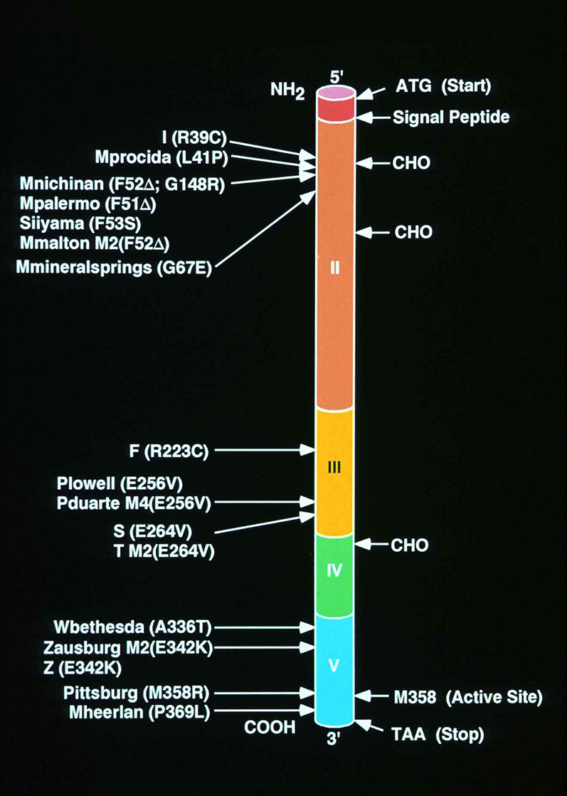
Genetics of A1AT
> 200 mutations of the SERPINA1 gene identified to date
About 1/3 lead to deficiency or dysfunction
>100,000 in U.S. with PiZZ, PiZNull, PiSZ
>20 million with PiMZ or PiMS
Function of as elastase inhibitor persists except in PiF & PiM_{pittsburg}

Slide 7
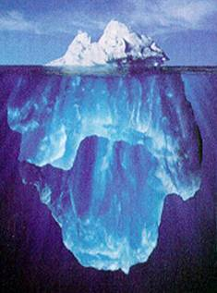
Not Rare?
100,000 with severe deficiency
At least 150,000 with severe deficiency and COPD! (Perhaps as many as 300,000)
About 5% diagnosed
15 Million Patients with COPD
~1% have undiagnosed Alpha-1
> 95% undiagnosed

Slide 8
The “Good” M Phenotype

Slide 9
The “Good” M Phenotype
The “Bad” Z Phenotype

Slide 10
The Genome and Alpha-1
~ 14,000 base pairs
394 amino acids
Co-dominant allelic expression

Slide 11
AATD and disease
People with severe deficiency may never get disease
Gene by environment interactions play major role
Lung disease (emphysema & bronchiectasis) risks factors
Smoking/second hand smoke
Occupational exposures
Frequent lung infections
Liver disease (cirrhosis and liver cancer) risk factors
Liver toxins (EtOH, benzenes)
Infection (hepatitis)

Slide 12
FEV₁ in Swedish PI ZZ Nonsmokers
Piitulainen, Thorax 1997; 53:939

Slide 13
Treatment
Smoking prevention/cessation!
Regular follow-up to detect disease
Reduction of risk factors
Usual therapy for lung and liver disease
Specific therapy for lung disease exists
Intravenous augmentation of AAT protein
In U.S. indicated for those with severe deficiency and emphysema
Expected to slow progression of lung disease

Slide 14
Testing for AATD
Alpha-1 Antitrypsin Deficiency is a Laboratory Diagnosis, not a Clinical Diagnosis
Why test
Reduce risk factors for disease, treat disease if present
Family counseling and testing

Slide 15
Testing methods
Blood level of AAT protein
Inexpensive
Often readily available
Good for detecting severe deficiency
Bad for detecting carriers of a single gene
Because levels of carriers often in normal range
Therefore not recommended for family testing
There are dysfunctional mutations with normal levels
Pi-typing
Electrophoretic evaluation of circulating AAT protein
Can detect rare genotypes but not nulls
Interpretation more an art than a science
Expensive

Slide 16
Testing methods
Genotyping
Logically, should be “gold standard”
Current methodologies rely on PCR probes for most common genotypes (S and Z)
Therefore, will miss rare genotypes and nulls
Becoming quite inexpensive
Highly accurate, especially when accompanied by a level

Slide 17
Testing Methods
Overall:
When screening for severe deficiency
Level testing can be cost-effective
When testing an individual or for family testing
Use at least two methods.
Always confirm positive results

Slide 18
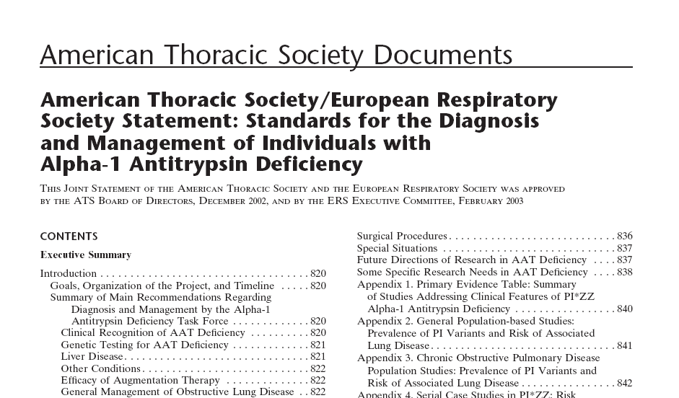

Slide 19
Who to test?
ALL PATIENTS WITH DIAGNOSIS OF COPD/EPOC
People with a strong family history of chronic obstructive pulmonary disease (COPD/EPOC)
People with unexplained liver disease
People with precocious COPD/EPOC
Adults with asthma with significant fixed airflow obstruction
¿Birth screening/newborn testing?

Slide 20
Successes and Failures
Most successful testing program thus far:
Family testing
Least successful testing program thus far:
Setting up a testing station at a shopping mall
Problems with testing all with COPD/EPOC
Prevalence of severe deficiency in COPD ⋍ 1%
Test 100 COPD patients 0 positive results
Need to test about 250 with COPD before you’ll find 1

Slide 21
¿Questions?

