Slide 1
When to use the new LAB + LAMA combinations ?
Antonio Anzueto, MD Professor of Medicine University of Texas San Antonio, Texas, USA
®

Slide 2
Faculty Disclosures
Personal financial interests in commercial entities that are relevant to my presentation:
Boehringer Ingelheim: consultant: advisory board, Current
GlaxoSmithKline: consultant, advisory board, Research Grant to the University, Current
Astra-Zeneca: consultant, advisory board, Current
Bayer-Schering Pharma: consultant, advisory board, Current
Novartis: consultant, advisory board, Current
Forest laboratories: consultant, advisory board, Current
Non-commercial, non-governmental interests relevant to my presentation:
Member of the ATS/ERS Task force on COPD and COPD Exacerbations, Current
Member of Scientific Committee of GOLD, Current member ATS/IDSA CAP Guidelines

Slide 3
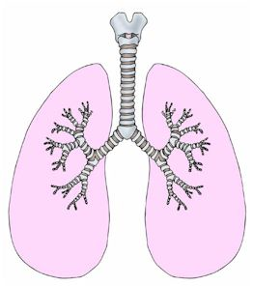
Inflammation
Oxidative stress
BRONCHODILATOR
(pivotal)
Tissue Repair
Expiratory Flow Limitation
Exacerbations
Hyperinflation
Dyspnea
Deconditioning
Inactivity
Decreased
Exercise Capacity
Impaired Quality of Life
Death
Notes:
¿Parámetros clínicos más relevantes?

Slide 4
What is the effect of long- active bronchodilators in COPD?

Slide 5
Effect of long active bronchodilators on FEV₁
Day 1
Day 364
FEV₁ (L)
Tiotropium (n=153)
Ipratropium (n=72)
–60
−5
30
60
120
180
Time after administration (minutes)
P<0.001 vs ipratropium at all time points on Day 364
Vincken et al. Eur Respir J. 2002;19:209-216.
Notes:
Improvement with SPIRIVA HandiHaler was sustained over the course of the 1­year studies.
These data represent FEV₁ values before and for 3 hours after morning administration of SPIRIVA and ipratropium over 1 year of study.
Note the improvement in predose FEV₁ with SPIRIVA.
There was no evidence of tachyphylaxis over time.
Statistical significance was observed (SPIRIVA vs ipratropium) at all time points on day 364.¹
¹Vincken W, van Noord JA, Greefhorst APM, et al. Improved health outcomes in patients with COPD during 1 yr’s treatment with tiotropium. Eur Respir J. 2002;19:209-216.

Slide 6
Change in lung volumes
FVC FEV₁ IC EELV SVC
mL
Celli. Chest 2003; 124:1743-1748

Slide 7
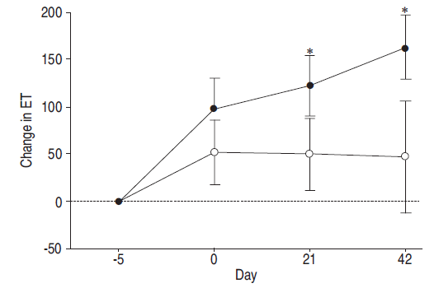
Exercise: Endurance Time
Tiotropium
Placebo
O’Donnell et al Eur Respir J 2004; 23: 832–840

Slide 8
Tiotropium Significantly Reduces Exacerbation Rate and Delays Onset of First Exacerbation
 | Versus | Patient Number | Duration | Exacerbation Number | Patients with >1 Exacerbation | Time to First Exacerbation
Brusasco 2003 | Placebo | 1207 | 6 months | 28% P<0.025 | -18% P=0.06 | P<0.01
Niewoehner 2005* | Placebo | 1829 | 6 months | -19% P=0.031 | -13% P=0.04 | P=0.03
Casaburi 2002 | Placebo | 921 | 1 year | -20% P=0.045 | -14% P<0.05 | P=0.01
Vincken 2002 | Ipratropium | 535 | 1 year | -24% P=0.006 | -11% P=0.01 | P=0.008
Dusser 2006 | Placebo | 1010 | 1 year | -35% P<0.001 | -17% P<0.01 | P<0.001
Powrie 2007 | Placebo | 142 | 1 year | -52% P=0.001 | -33% P=0.01 | P=0.01
Freeman 2007 | Placebo | 395 | 12 weeks | n/a | -47% P=0.01 | n/a
Chan 2007 | Placebo | 913 | 1 year | 4% P=0.599 | + 8% P=0.4 | n/a
Time to First Exacerbation
Means - Prevention
*Primary endpoint: exacerbation
Notes:
Brusasco V et al. Thorax 2003; 58:399-404.
Niewoehner DE et al. Ann Intern Med 2005;143:317-26.
Casaburi R et al. Eur Respir J 2002; 19:217-224.
Vincken W et al. Eur Respir J 2002; 19:209-216.
Dusser D et al. Eur Respir J 2006; 27:547-555.
Powrie DJ et al. Eur Respir J 2007; 30: 1–8.
Freeman D et al. Respiratory Research 2007; 8:45-55.
Chan CK et al. Can Respir J 2007;14:465-72.

Slide 9
Outcomes are correlated with mean change from baseline in trough FEV₁
Average ∆FEV₁ (mL) | Category centred value of ∆FEV₁ (mL) | TDI (n=2,781) | ΔSGRQ (n=3,141) | Exacerbation rate/year (n=3,158)
–500, –50 | –275 | 1.44 | –3.15 | 0.63
–50, 50 | 0 | 1.31 | –3.17 | 0.58
50, 150 | 100 | 1.79 | –3.84 | 0.61
150, 250 | 200 | 2.12 | –5.84 | 0.51
250, 500 | 375 | 2.68 | –7.38 | 0.38
TDI and ΔSGRQ at 12 weeks improved with increasing positive ΔFEV₁ (all P<0.001)
Individual-level correlations: r=0.06–0.18
Cohort-level correlations: r=0.79–0.95
Jones PW. Thorax 2010;65: A141
Notes:
Reference
Jones PW et al. Correlating changes in lung function with patient reported outcomes in COPD. Thorax 2010;65(suppl 4): A141.

Slide 10
Benefits of maximal bronchodilation on clinical outcomes
Correlation between change in FEV₁ and outcomes
5
P<0.0001, r²=8.2%
5
P<0.0001, r²=10%
2
P<0.002, r²=5.6%
4
3
0
TDI
Number of exacerbations per year
2
ΔSGRQ
-5
1
1
0
-10
-1
0
0
-500
-250
0
250
500
-500
-250
0
250
500
-500
-250
0
250
500
ΔFEV₁ (mL)
ΔFEV₁ (mL)
ΔFEV₁ (mL)
ICS severe
ICS moderate
No ICS severe
No ICS moderate
Correlation analysis of pooled data from three indacaterol studies (N=3313)
FEV₁, forced expiratory volume in 1 second; SGRQ, St George’s Respiratory Questionnaire; TDI, Transition Dyspnoea Index
Jones PW et al, Respir Res 2011;12:161.
Notes:
Reference
Jones PW, Donahue JF, Nedelman J, Pascoe S, Pinault G, Lassen C. Correlating changes in lung function with patient outcomes in chronic obstructive pulmonary disease: a pooled analysis. Respir Res 2011; 12: 151.

Slide 11
What can we expect from a combination of bronchodilators in COPD?

Slide 12
Rationale for combination
LAMA monotherapy
LABA monotherapy
LAMA + LABA
Further benefits expected in
Lung function
Symptoms
Exercise tolerance
Similar safety profile as individual therapies anticipated
Increased convenience: patient only needs 1 inhaler

Slide 13
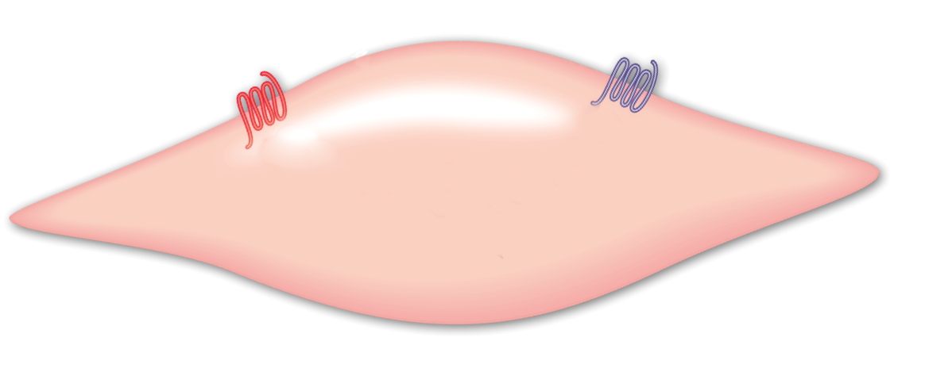
Mechanisms of action of bronchodilators on airway smooth muscle
Beta Agonists
(LABA)
Antocholinergics
(LAMA)
β₂-adrenergic
receptors
M3- muscarinic
receptors
SMC contraction
SMC relaxation
Proskocil BJ et al. Proc Am Thorac Soc. 2005;2(4):305-310.

Slide 14
Serching for Maximal Bronchodilation
1.5
FEV₁ Peak
¿ceilling effect?
1.4
*
AUC
FEV₁ trough
*
*
*
*
1.3
*
*
*
*
*
FEV₁ (L)
1.2
*
*
*
*
1.1
1.0
0.9
-2
0
2
4
6
8
10
12
14
16
18
20
22
24
09:00 h
15:00 h
21:00 h
03:00 h
09:00 h
Time (hours)

Slide 15
Blocking cholinergic stimulation of M3 receptors with tiotropium prevents β₂-receptor downregulation
Rationale for using both dual bronchodilators
Casarosa P, et al. Poster A6373, ATS 2010.
Notes:
M3–β₂-receptor cross-talk in cholinergic cells stably expressing these human receptors

Slide 16
In chronic obstructive lung disease, the combination of ipratropium and albuterol is more effective than either agent alone.
COMBIVENT Inhalation Aerosol Study Group. Chest 1994;105;1411-1419

Slide 17
Combination of short-actingBD’s
100
Albuterol
Ipratropium + Albuterol
Ipratropium
90
80
% Responding
70
60
50
40
0
15
30
45
60
75
90
105
120
Minutes post-drug administration
Dorinsky PM, et al. Chest. 1999;115:966–971.

Slide 18
Combining tiotropium and formoterol (dosed once or twice daily): FEV1
1.5
Tiotropium qd + formoterol qd
Tiotropium qd + formoterol bid
1.4
Tiotropium qd + placebo bid
24-hour base
1.3
1.2
FEV₁ (L)
1.1
1.0
0.9
0
2
4
6
8
10
12
14
16
18
20
22
24
9 AM
3 PM
9 PM
3 AM
9 AM
Time (hours)
van Noord JA et al. Chest 2006;129:509-17

Slide 19
Effects of tiotropium and formoterol on dynamic hyperinflation and exercise endurance in COPD
Time to exercise intolerance
FEV₁
p=0.55
p=0.02
p=0.74
p=0.04
250
50
*
*
200
40
150
30
Tlim (% change from baseline)
*
FEV₁ (% change from baseline)
100
20
50
10
0
0
Baseline
FOR-PLA
Baseline
FOR-TIO
Baseline
FOR-PLA
Baseline
FOR-TIO
Berton et al. Respir Med 2010;104:1288-96

Slide 20
The present and future
Fixed - Combinations
- Olodaterol/tiotropium
- Indacaterol/ glycopyrronium
Umeclidinium/ vilanterol
Formoterol/aclidinium
Formoterol/glycopyrrolate
LAMAs
LABAs
Tiotropium
Glycopyrronium (NVA237)
Umeclidinium bromide
Aclidinium bromide
Olodaterol
Indacaterol
Vilanterol
Carmoterol
Formoterol
Salmeterol

Slide 21
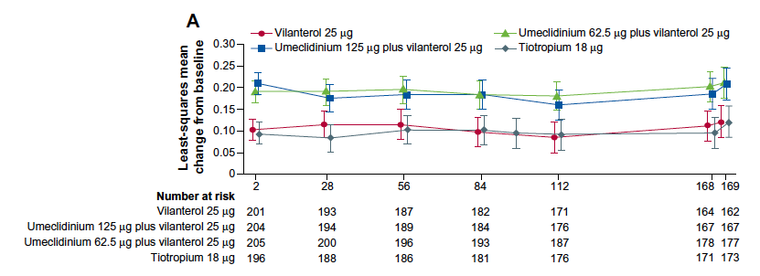
Umeclidinium/vilanterol: Phase III Studies
Donohue et al. Respir Res 2014; 15:78

Slide 22
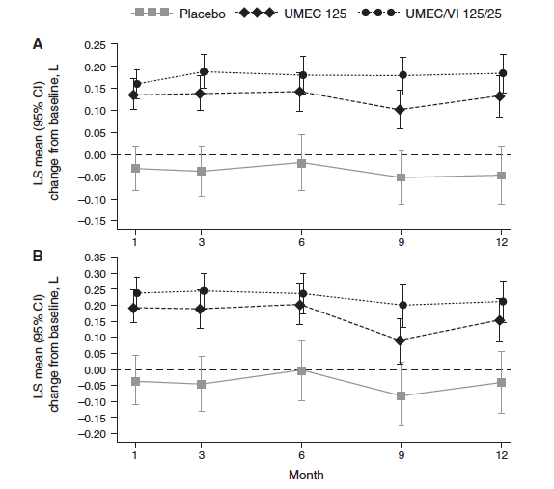
Umeclidinium/vilanterol: Phase III Studies
FEV₁
FVC
Donohue et al. Respir Res 2014; 15:78

Slide 23
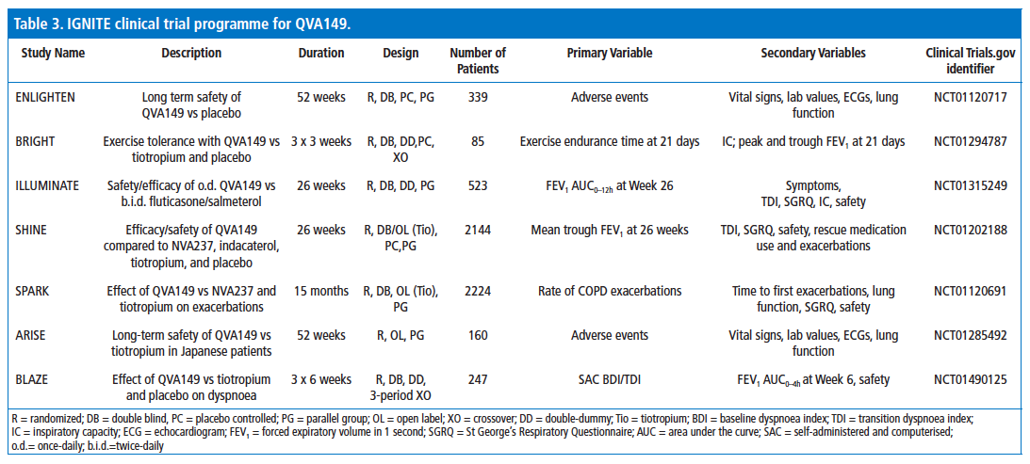
Glycopyrronium + Indecaterol fixed combination

Slide 24
Improved lung function with FDC glycopyrronium / indacaterol qd versus monotherapy and placebo
0.08***
0.09***
0.07***
Trough FEV₁ at Week 26 (L)
Open-label tiotropium 18 μg qd
Glyco-pyrronium 50 μg qd
Indacaterol 150 μg qd
QVA149 110/50 μg qd
Placebo
0.13***
***P<0.001 QVA149, glycopyrronium plus indacaterol
0.12***
0.13***
0.20***
26-week randomized, controlled SHINE study in patients with moderate-to-severe COPD (n=2144)
Bateman et al, Eur Resp J 2013 [Epub ahead of print]
Notes:
Reference
Bateman ED, Ferguson GT, Barnes N et al. Dual bronchodilation with once-daily QVA149 versus single bronchodilator therapy: the SHINE study. Eur Resp J 2013; In press.

Slide 25
LAMA / LABA Effect on lung function (SHINE study)
1.60
QVA149 (n=59)
1.55
Indacaterol (n=55)
1.50
Glycopyrronium (n=63)
Tiotropium (n=66)
1.45
Placebo (n=27)
1.40
1.35
Least Square Mean of FEV₁ (L)
1.30
1.25
1.20
1.15
1.10
1.05
1.00
5m
1h
2h
4h
8h
12h
16h
22h
23h 45m
Serial spirometry substudy
QVA110/50μg, indacaterol 150 μg, glycopyrronium 50 μg, and tiotropium 18 μg, all administered once daily
Notes:
This slide shows that, despite differences in FEV₁ favouring QVA149 vs placebo and QVA149 vs tiotropium, results from the SHINE study show that glycopyrronium and tiotropium have very similar 24-hour profiles.
Reference
Bateman E, et al. Benefits of dual bronchodilation with QVA149 once daily versus placebo, indacaterol, NVA237 and tiotropium in patients with COPD: The SHINE study. Poster presented at ERS 2012; P2810.

Slide 26
LABA + LAMA compared to ICS+ LABA
Pre-dose through
FEV₁ AUC_{0-12 h}
No history of exacerbations
QVA 149
SFC
1.8
120 mL***
70 mL***
120 mL***
1.7
FEV₁ AUC _{0-12h} (L)
1.6
1.5
1.4
Día 1
Semana 12
Semana 26
*** p<0.001
Vogelmeier C, et al. www.thelancet.com/respiratory
http://dx.doi.org/10.1016/ S2213-2600(12)70052-8

Slide 27
TOviTO™: Phase IIIa clinical trial programme
52-week studies
Exercise
Comprehensive lung function
1237.5 and 1237.6
52 weeks
FEV₁ / SGRQ / TDI
2 doses (T) FDC
vs O mono (5 µg), T mono (5 and 2.5 µg)
1237.20
6 weeks
24-h lung function (FEV₁ / FVC)
4-way incomplete crossover
2 doses (T) FDC
vs 2 doses T mono, 1 dose O mono, placebo
1237.13 and 1237.14
6 weeks
Exercise (CWRCE)
4-way incomplete crossover
2 doses (T) FDC
vs T (5 µg), placebo
1237.22
52 weeks
FEV₁
Parallel group
2 doses (T) FDC
vs O mono, placebo
1237.15
12 weeks
CWRCE vs ESWT
Parallel group
2 doses (T) FDC
vs placebo
CWRCE= constant work rate cycle ergometry; ESWT= endurance shuttle walking test; FPI= functional performance inventory.
Notes:
Key point: Tiotropium and olodaterol FDC will be investigated in a comprehensive Phase 3 clinical research programme referred to as TOviTO
There are several trials involved in the Phase 3, TOviTO programme including the pivotal trials TOnado 1 & 2 and studies investigating lung function parameters
Target enrollment is 2500 patients for each TOnado trial (5000 in total) in more than 40 countries, with 500 patients in each of the five treatment groups/trial arms
HRQoL, exacerbation endpoints (Phase 3b) and exercise endurance time in patients with COPD are investigated in additional studies of the TOviTO Phase 3 programme

Slide 28
FEV₁ improved over 24 hours after 24 weeks’ treatment for T+O FDC 5/5 and 2.5/5 µg versus monotherapy
1.50
1.45
1.40
1.35
1.30
FEV₁ (L)
1.25
1.20
1.15
1.10
-2
0
2
4
6
8
10
12
18
24
Time relative to dosing (hours)
Olodaterol 5 μg
Tiotropium+olodaterol FDC 2.5/5 μg
Tiotropium+olodaterol FDC 5/5 μg
Tiotropium 2.5 μg
Tiotropium 5 μg

Slide 29
TOviTO™: Phase IIIb clinical trial programme
Promotable /Label Claim
Profiling
Active
1237.19/21
Exacerbation Studies
64 – 72 wks (event driven)
Exacerbations
T+O FDC (1 dose)
vs. Tio (5 µg)
1+2
1237.11
6 weeks cross over
24 hr FEV1–time profile
T+O FDC vs. Advair/Seretide
1237.16
12 / 24 wks
“Exercise Capacity”
“Physical activity”
T+O FDC + exercise training + education
T+ O FDC + education
Placebo + Exercise training + education
1237.25/26
Maximum Effect size
12 wks
FEV1 / SGRQ
T+O FDC [1 / 2 dose(s)]
vs. Tio (5 µg)
vs. Pbo
Notes:
Key point: Tiotropium and olodaterol FDC will be investigated in a comprehensive Phase 3 clinical research programme referred to as TOviTO
There are several trials involved in the Phase 3, TOviTO programme including the pivotal trials TOnado 1 & 2 and studies investigating lung function parameters
Target enrollment is 2500 patients for each TOnado trial (5000 in total) in more than 40 countries, with 500 patients in each of the five treatment groups/trial arms
HRQoL, exacerbation endpoints (Phase 3b) and exercise endurance time in patients with COPD are investigated in additional studies of the TOviTO Phase 3 programme

Slide 30
Adjusted mean IC, TLC, FRC and RV response (L) at 22:30 post dose after 6 weeks’ treatment
22:30 hours after dosing
*
*
*
*
*
*
FDC always superior over placebo except for TLC.
*Indicates additional superiority over at least one of the monotherapies.
Data on file. Study 1237.20
Derom E. et al. Am J Respir Crit Care Med. 2014;189.1:A6727 (Abstract).
Notes:
Sub-set of 143 patients; P, 86; O, 90; T2.5, 92; T5, 94; T+O 2.5/5, 93; T+O 5/5, 94.
FRC, functional residual capacity; IC, inspiratory capacity; RV, residual volume; TLC, total lung capacity

Slide 31
TONADO™ 1+2: Efficacy summary
Lung function
T+O FDC 5/5 µg and 2.5/5 µg showed significant improvements versus tiotropium 5 µg, olodaterol 5 µg and placebo
T+O FDC 5/5 µg versus 2.5/5 µg: small, consistent increases in FEV₁
Quality of life
All compounds have a clinically meaningful change from baseline
T+O FDC 5/5 µg: significantly improved SGRQ versus tiotropium 5 µg, olodaterol 5 µg
T+O FDC 2.5/5 µg: non-significant differences for SGRQ versus tiotropium 5 µg and 2.5 µg
T+O FDC 5/5µg versus 2.5/5 µg: small improvement in SGRQ
Dyspnoea
T+O 5/5 µg showed slightly but consistently better efficacy versus T+O 2.5/5 µg for TDI outcomes
Exacerbations
T+O FDC showed slightly but consistently better efficacy versus monocomponents in exacerbations outcomes

Slide 32
Formoterol/aclidinium: Phase III programme underway
Two Phase IIb dose-ranging studies of formoterol/aclidinium administered twice daily demonstrated:¹
Statistically significant improvements in FEV₁ AUC_{0–12h} vs placebo
Improved bronchodilation vs its monocomponents
Started Phase III trials in September 2011
The first study is due to complete in November 2012²
1. Forest Laboratories Press Release, 2011; 2. UKMi, 2012.
Notes:
Reference :
1. Almirall and Forest Announce Positive Results from the ATTAIN Phase III Study of Aclidinium Bromide and the Phase IIb Studies with the Fixed Dose Combination with Formoterol in Moderate to Severe COPD Patients http://www.frx.com/news/PressRelease.aspx?ID=1512675
2. UKMi: http://www.ukmi.nhs.uk (information processed on January 6th, 2012)

Slide 33
COPD:Therapeutic Approach
Escalating Therapy
De-Escalating Therapy
Reflumilast, Theo.
Antibiotics
+
+
ICS
-
+
LABA + LAMA
-
Long Active Bronchodilators
LAMA or LABA
COPD

Slide 34
Can we
withdraw ICS ?

Slide 35
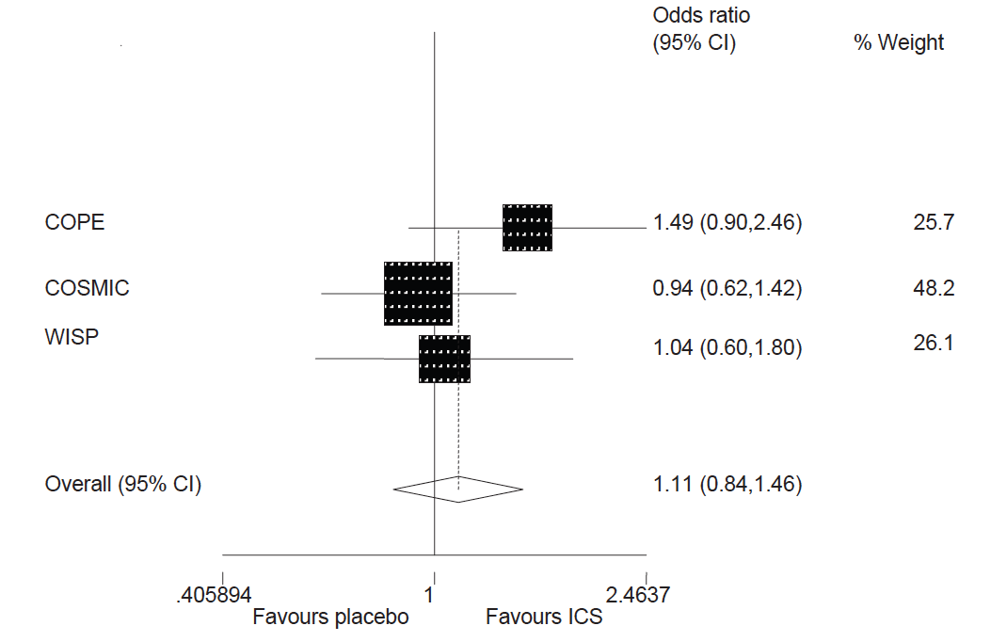
Effect of ICS withdrawal
Nadeem et al. Respir Res 2011; 12: 107
Notes:
35

Slide 36
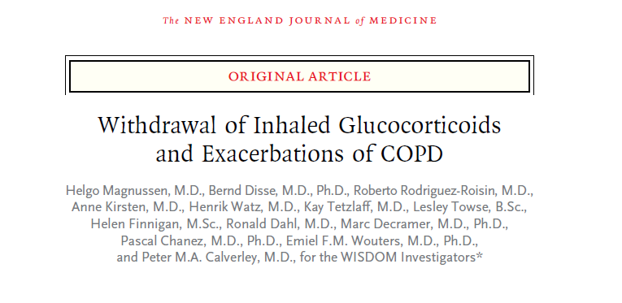
Magnussen et al NEJM 2014

Slide 37
WISDOM: Study design
Run-in
Treatment
S
C
R
E
E
N
I
N
G
Triple therapy
R
A
N
D
O
M
I
S
A
T
I
O
N
ICS
(remained on triple therapy from run-in)
Stepwise ICS withdrawal
(remained on dual bronchodilator)
Week
-7
-6
0
6
12
18
52
ICS stepwise withdrawal
Stable treatment
Triple therapy regimen
Fluticasone propionate 12-week withdrawal schedule
Tiotropium 18 µg QD
Salmeterol 50 µg BID
Fluticasone propionate 500 µg BID
500 µg BID
Reduced to 250 µg BID
Reduced to 100 µg BID
Reduced to 0 µg (placebo)
Notes:
QD, once daily; BID, twice daily

Slide 38
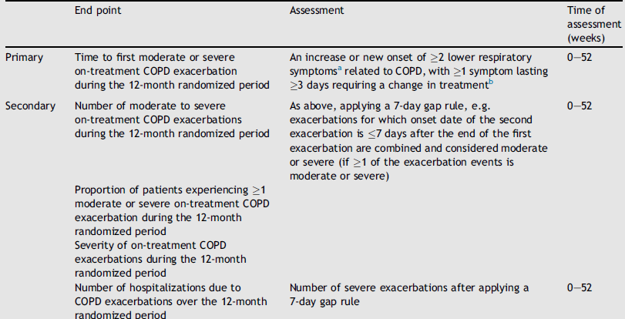
WISDOM Trial
Magnussen et al Respiratory Medicine 2014;108:93-99
Magnussen et al NEJM 2014

Slide 39
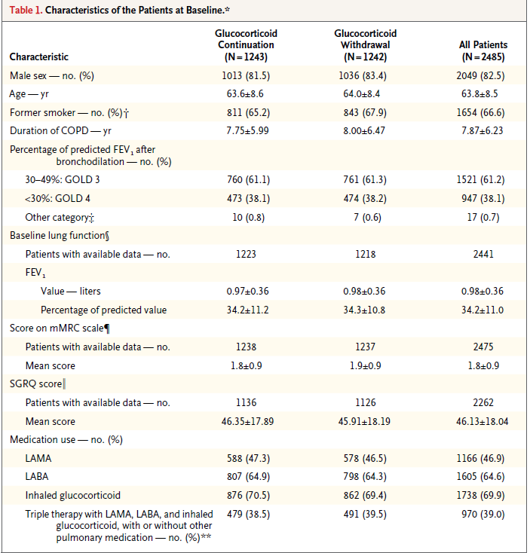

Slide 40
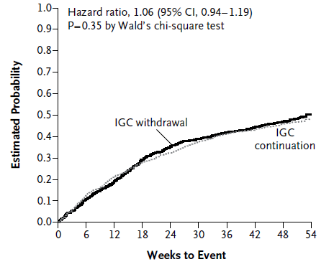
WISDOM Trial
Magnussen et al NEJM 2014

Slide 41
Time to first severe and any severity on-treatment COPD exacerbation
Time to first severe
COPD exacerbation
0.975
1.202
1.482
Time to first
COPD exacerbation
(any severity)
Hazard ratio
Favours withdrawal
Favours ICS
Magnussen H et al. N Engl J Med DOI 10.1056/NEJMoal407154

Slide 42
Time to first moderate or severe COPD exacerbation by subgroup
Factors
Patients, n
Hazard ratio
Total
2441
1.058
Age group, years
<55
345
1.041
>55 and <65
945
0.951
>65 and <75
883
1.192
Sex
>75
268
1.061
Male
2010
1.075
Female
431
1.015
Smoking status
Ex-smoker
1630
1.095
Current smoker
811
0.993
Baseline body mass index, kg/m²
<20
368
0.942
>20 and <25
912
1.174
>25 and <30
771
1.054
>30
390
0.964
ICS at screening*
Yes
1724
1.080
No
717
1.004
Xanthines at screening*
Yes
567
1.145
No
1874
1.034
Chronic bronchitis (eCRF)*
Yes
1548
1.114
No
891
0.950
GOLD stage at screening*
3
1491
1.120
4
934
0.996
GOLD categories at baseline*
C
819
1.146
D
1612
1.010
Previous courses of antibiotics or steroids*
<2
1537
1.031
>2
903
1.110
*Post hoc analyses eCRF, electronic case report form
2.0
0.5
1.0
Favours ICS withdrawal
Favours ICS

Slide 43
Mean change from baseline in lung function: FEV₁
ICS withdrawal
250 µg BID
100 µg BID
0 µg (placebo)
Week
Adjusted mean (SE) change from baseline in FEV₁ (mL)
38 mL
ICS
43 mL
ICS withdrawal
***
**
n ICS withdrawal ICS
1223 1218
1135 1135
1114 1092
1077 1058
970 935
**p<0.01; ***p<0.0001 vs ICS; restricted maximum likelihood repeated measures model; baseline values 970 mL for ICS, 981 mL for ICS withdrawal
Notes:
SE, standard error

Slide 44
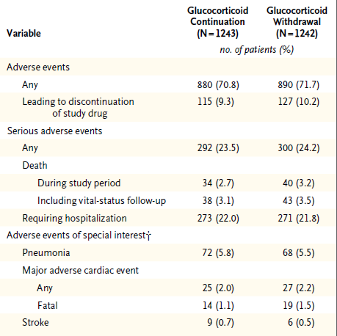
WISDOM: Adverse Events
Magnussen et al NEJM 2014

Slide 45
Summary
In patients with severe but stable COPD receiving combination therapy with tiotropium, salmeterol and ICS a stepwise withdrawal of ICS was non-inferior to the continuation of ICS in respect to the risk of moderate or severe exacerbation.
Magnussen H et al. N Engl J Med DOI 10.1056/NEJMoal407154

Slide 46
Conclusions
These data provide clear support for the concept that LABA/LAMA combinations in patients with few or no exacerbations (GOLD B), consistent with current GOLD recommendations
GOLD 2014

Slide 47
When I will be using fixed LAMA + LABA combination ?
First-line therapy for patients that are symptomatic with preserve lung function (GOLD B – Stage II)
Patients with worsening lung function relative few symptoms (GOLD C – Stage III)
Adjunctive therapy in Patients with more severe disease (GOLD D)
Global Initiative for Chronic Obstructive Lung Disease (GOLD) 2011.
Accessed at http://www.goldcopd.org/uploads/users/files/GOLD_Report_2011_Feb21.pdf

Slide 48
Pharmacological management of stable COPD: FUTURE
C
D
GOLD 4
LAMA+LABA or
LAMA+PDE4I or
LABA+PDE4l
ICS+LABA+LAMA or
ICS+LABA+PDE4l or LAMA+LABA or
LAMA+PDE4l
>2
GOLD 3
Exacerbations per year
A
B
GOLD 2
LAMA or
LABA or
SABA+SAMA
1
LAMA+LABA
GOLD 1
0
mMRC 0-1 CAT <10
mMRC ≥2 CAT ≥10
CAT, COPD Assessment Test; GOLD, Global initiative for chronic Obstructive Lung Disease; ICS, inhaled corticosteroid; LABA, long-acting β₂-agonist; LAMA, long-acting muscarinic antagonist; mMRC, modified Medical Research Council; PDE4, phosphodiesterase-4 inhibitor; SABA, short-acting β₂-agonist; SAMA, short-acting muscarinic antagonist
Global Strategy for the Diagnosis, Management and Prevention of COPD, Global Initiative for Chronic Obstructive Lung Disease (GOLD) 2013. Available from: http://www.goldcopd.org/.

Slide 49
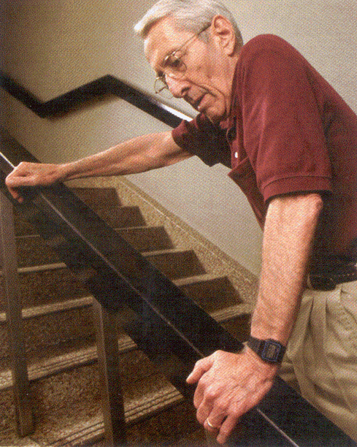
What is the impact of LAMA+ LABA combination ?

Slide 50
Muchas Gracias!!!!!

