Slide 1
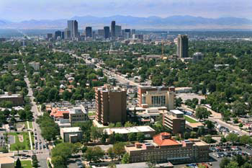
Comó manejar la deficiencia de A1AT: manteniendo sano a su paciente
Robert A. Sandhaus, MD, PhD, FCCP
National Jewish Health
University of Colorado
Alpha-1 Foundation
AlphaNet

Slide 2
Potential Conflicts
Served on advisory boards and/or have presented at events sponsored by:
Bayer, Grifols, CSL Behring, AstraZeneca, Baxter, Kamada, Tuteur
Receive salary from two not-for-profit organizations that receive industry funding:
Alpha-1 Foundation and AlphaNet

Slide 3
Outline – the AlphaNet model
This talk will assume a basic knowledge of Alpha-1
The healthy individual with Alpha-1
Liver affected individuals
Skin affected individuals
Lung affected individuals
Other manifestations

Slide 4
What is AlphaNet?
Not-for-profit, disease management organization
Founded in 1995 by three patients with Alpha-1
Board of Directors – majority are patients with Alpha-1
40 Alpha-1 patients work full-time for AlphaNet
Over the years, has donated nearly US$40 million to Alpha-1 Foundation to support research
Administers Alpha-1 clinical research programs
Currently follows over 5,100 Alpha-1 patients in four different programs
“Alphas serving Alphas”

Slide 5
The Healthy Individual with Alpha-1 REACH: Risk Evaluation to Assure Continued Health
Focus on risk factor reduction
Cigarette smoke exposure
Live toxin exposure
Aggressive treatment of lung infections
Possible occupational changes
Immunization
Regular monitoring of lung and liver function
Family testing
Education of affected individual and family (and perhaps his/her physician)
Mayer, A. et al.: Am J Respir Crit Care Med, 2000; 162:553

Slide 6
Liver-affected Adults
Abstinence from alcoholic beverages
Evaluate for other risks
Usual therapy for liver disease, based on severity
Control complications of portal hypertension
Currently no specific Alpha-1-related therapy
Every 6-12 months: Liver ultrasound
Monitor for hepatocellular carcinoma
Liver transplantation
Cures AATD!

Slide 7
Skin-affected Individuals
Necrotizing panniculitis
Vasculitis of the panniculus adiposus of the skin
Painful, discolored, oozing, scarifying, discoloring
In other words – not subtle
Diagnosis by biopsy
Rare
Alpha-1 antitrypsin augmentation therapy can be highly effected
Often high doses required
Off-label
Gross B., Dermatology 2009;218:370

Slide 8
Lung-affected Individuals
Remove from environmental exposures
Smoking cessation (both patient and spouse)
Occupational analysis
Remove from dusts and fumes
Usual COPD therapy (see next slide)
Monitor liver function
Aggressive treatment of lung infections
Evaluate and treat pulmonary hypertension
Consider for augmentation therapy
Surgical approaches
Lung volume reduction surgery
Valves/coils/glue
Bullectomy
Lung transplantation

Slide 9
Alpha-1 COPD is Treatable!
Reduce
Risk
Smoking cessation
Immunize
Reduce other exposures
Education
Reduce
Symptoms
Bronchodilators
Inhaled steroids
Pulmonary rehabilitation
Education
Reduce
Complications
Education
Treat exacerbations
Supplemental oxygen
Modified from Pauwels RA, et al. Am J Resp Crit Care Med 2001:163;1256
= therapies shown to improve survival

Slide 10
Alpha-1 COPD is Treatable!
Reduce
Risk
Smoking cessation
Immunize
Reduce other exposures
Education
Reduce
Symptoms
Bronchodilators
Inhaled steroids
Pulmonary rehabilitation
Education
Reduce
Complications
Education
Treat exacerbations
Supplemental oxygen
Reduce Lung Destruction
Education
Augmentation therapy
Modified from Pauwels RA, et al. Am J Resp Crit Care Med 2001:163;1256
= therapies shown to improve survival

Slide 11
Other conditions
Non-tuberculous mycobacterial disease (NTM)
Anecdotal cases of response
Placebo controlled trials needed
Granulomatosis with polyangiitis (GPA) (formerly Wegener’s)
Rational for augmentation therapy (Proteinase 3)
No clinical trial results

Slide 12
AlphaNet, Inc.
Not-For-Profit 501(c)3 Florida Corporation
Founded in 1995 by 3 Alphas
9 Member Board of Directors, 6 Alphas
Provides Health Management Services to Alpha-1 Antitrypsin Deficiency-Affected Individuals
4 RN’s, 1 LPN, Medical Director
Licensed Florida Wholesale Pharmacy
Employs 40 Alphas Nationwide
Proprietary, HIPAA Compliant, Contact Management and Research Software

Slide 13
History of AlphaNet Health Management
Initially aimed at physicians
Re-aimed at patients and their families

Slide 14
Alpha-1 Disease Management and Prevention Program
ADMAPP is. . .
Paper, Web, App and CD-based document (The BFRG)
Nurse training and testing
Coordinator training and testing
Patient and Professional Education
Treatment planning and review
Patient Worksheets
AlphaNet Coordinator Follow-up
Outcome measurement
Disease Management Advisory Committee (DMAC)

Slide 15
www.BRFG.org

Slide 16
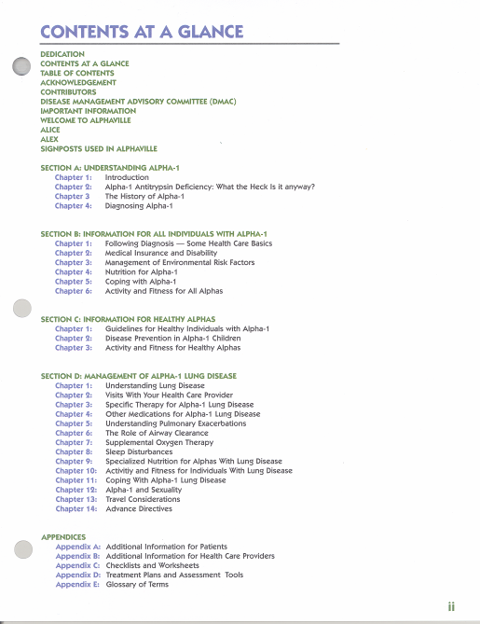

Slide 17
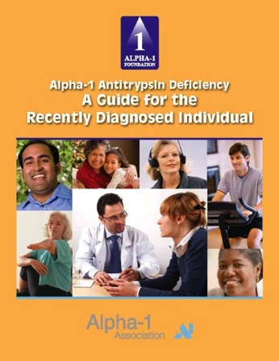
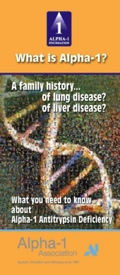
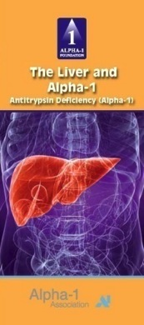
Educational Brochures

Slide 18
iPad/iPhone App

Slide 19
AlphaNet
The AlphaNet Model:
Enroll patients – variety of methods
Assign to an AlphaNet Coordinator (ANC)
Introduce to the Big Fat Reference Guide (BFRG)
Complete Baseline Questionnaire and 5-yr Health Plan
Monthly (minimum) contact with ANC
Feedback to AlphaNetters on progress and news
Nurse certification, RT certification, MD CME

Slide 20
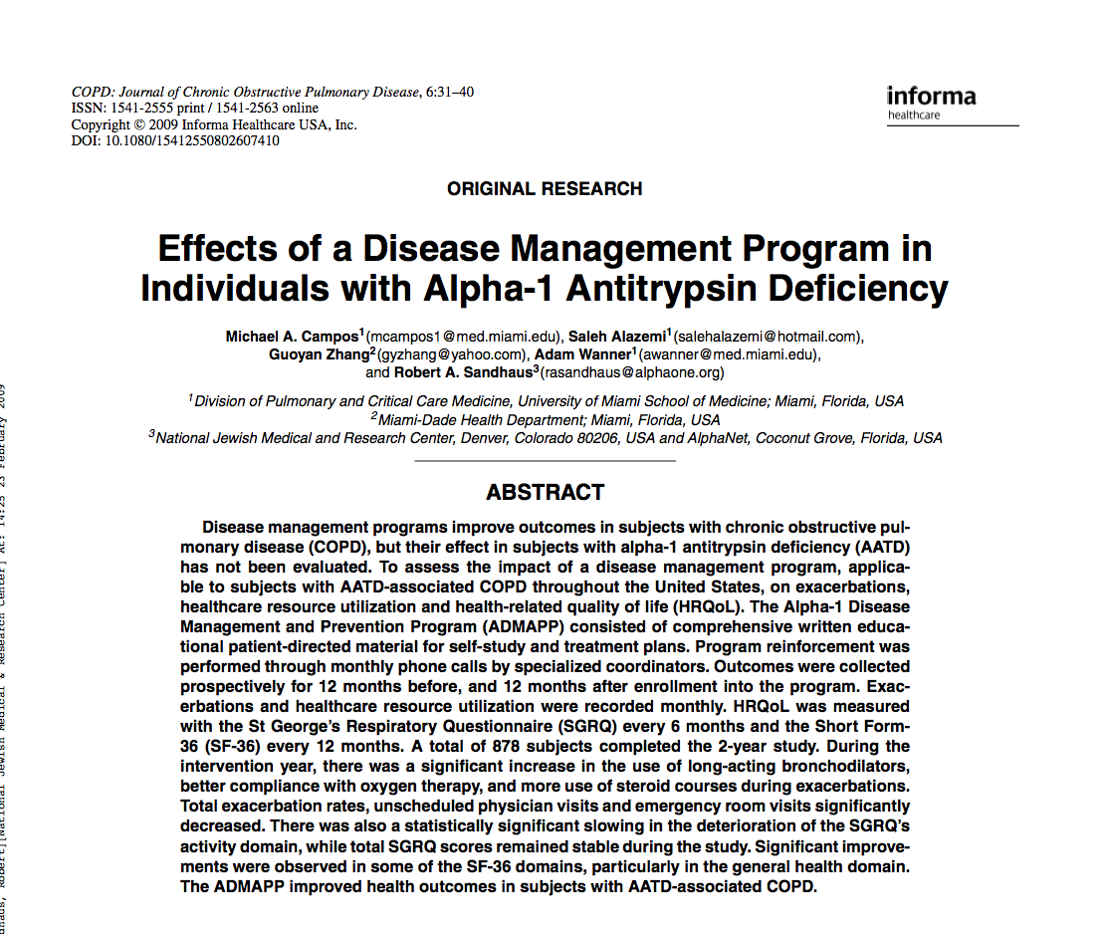

Slide 21
19 Peer-Reviewed Publications to Date

Slide 22
Alpha-1 COPD Patients Healthcare Utilization per 1,000 patients entered into ADMAP
 | Year 1 (Control) | Year 2 (Intervention) | Number Decrease in Year 2 | Percent Decrease in Year 2
Hospital Admissions | 208 | 185 | 23 | 11%
ER Visits | 369 | 288 | 81 | 22%
MD Visits | 6,446 | 5,872 | 574 | 9%
Antibiotic Days | 27,309 | 24,335 | 2,974 | 11%

Slide 23
Alpha-1 COPD Patients Healthcare Utilization per 1,000 patients entered into ADMAP
 | Year 1 (Control) | Year 2 (Intervention) | Number Decrease in Year 2 | Percent Decrease in Year 2
Hospital Admissions | 208 | 185 | 23 | 11%
ER Visits | 369 | 288 | 81 | 22%
MD Visits | 6,446 | 5,872 | 574 | 9%
Antibiotic Days | 27,309 | 24,335 | 2,974 | 11%

Slide 24
Survival Improvements in Alpha-1 Antitrypsin Deficiency
Robert A. Sandhaus, MD PhD^{1,2} & Heather Van Duker, MS²
¹National Jewish Health, Denver, CO; ²AlphaNet, Miami, FL

Slide 25
Background
Most publications regarding the survival of patients with AATD reference a single Danish publication (Thorax 1994;94:695) from Seersholm et al. which calculated the following survival numbers based on the evaluation of 397 individuals with severe AATD:
54.5 years for all evaluated subjects
49.4 years for index cases (n=252)
no difference between smokers and non-smokers or males and females

Slide 26
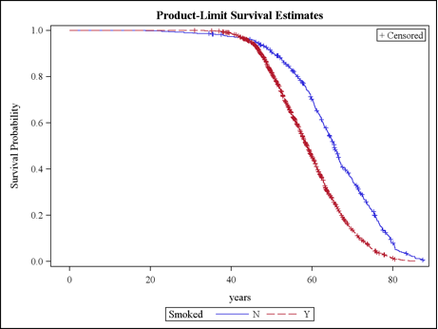
Survival by Smoking History
N = 2,365

Slide 27
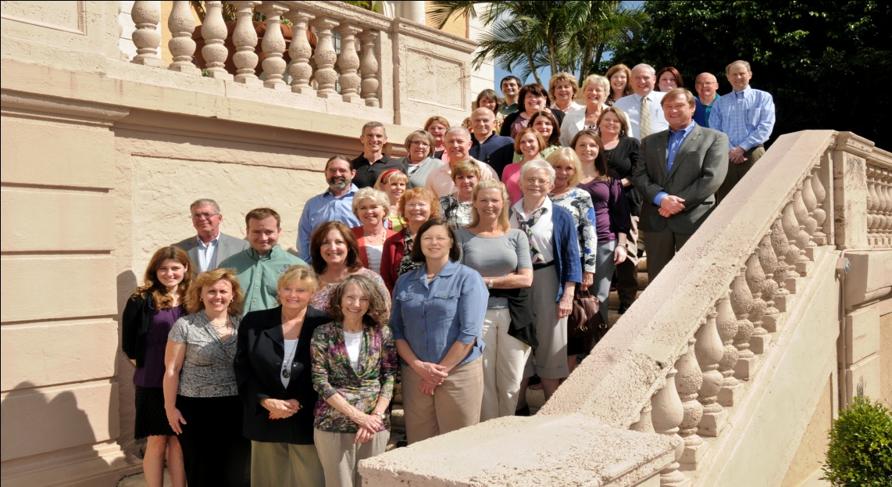

Slide 28
¿Questions?

