Slide 1


OSA, Driving Risk and Interventions to Improve Driving Safety
Barbara Phillips, MS, MSPH, FCCP
CHEST President, 2015-2016
Professor, University of Kentucky College of Medicine
11 October, 2014

Slide 2
Conflict of Interest Disclosures for Speakers
I have the following relationships with entities producing, marketing, re-selling, or distributing health care goods or services consumed by, or used on, patients:
Type of Potential Conflict | Details of Potential Conflict
Grant/Research Support
Consultant | Member of the FMCSA Medical Advisory Board 2008-2011, expert witness Clayton and Beveridge
Speakers’ Bureaus
Financial support
Other | Leadership positions, American College of Chest Physicians National Board of Respiratory Care Board of Registered Polysomnographic Technologists
The material presented in this lecture has no relationship with any of these potential conflicts

Slide 3
Objectives
List risk factors for crash among drivers with obstructive sleep apnea.
Discuss why commercial drivers are held to a different standard than are non-commercial drivers.
List factors besides sleep apnea that increase crash risk.
Discuss interventions to reduce crash risk in drivers.

Slide 4
Overview
OSA and driving risk
OSA and commercial drivers
OSA and amateur drivers
Factors besides OSA that increase driving risk
Interventions

Slide 5
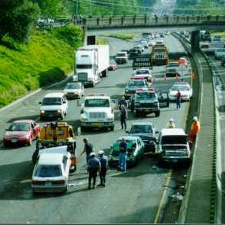

Slide 6
OSA Increases Crash Risk (FMCSA 2007; Tregear S JCSM 2009)
As a group, drivers with OSA are at an increased risk for a motor vehicle crash when compared with comparable drivers who do not have the disorder.

Slide 7
Car Crashes and OSA
Untreated patients with OSA have higher vehicle collision rate than controls¹
Patients with AHI > 15 (n = 102) have 8.1-fold increased risk of motor vehicle crash compared to matched controls (n = 152)²
Patients with AHI > 34 (n = 78) have 15-fold increased risk of motor vehicle crash than matched controls (n = 160)³
Over 3 years, collision rate in OSA patients treated with CPAP declined to levels similar to those of control subjects¹
1. George CF. Thorax 2001;56:508-512. 2. Teran-Santos J, et al. N Engl J Med 1999;340:847-851. 3. Horstmann S, et al. Sleep 2000;23:383-389.
Notes:
1. George CF. Reduction in motor vehicle collisions following treatment of sleep apnoea with nasal CPAP. Thorax 2001;56:508-512.
BACKGROUND: Patients with untreated obstructive sleep apnoea (OSA) have increased motor vehicle collisions (MVCs). When successfully treated, they report improved driving and fewer mishaps, but there are few objective data to confirm this. A study was therefore undertaken to examine actual MVC data in a large group of patients with OSA before and after treatment with continuous positive airway pressure (CPAP) compared with a control group matched for age, sex, and type of driver's licence (commercial or non-commercial). METHODS: Two hundred and ten patients of mean (SD) age 52 (11) years, body mass index (BMI) 35.5 (10) kg/m(2), apnoea/hypopnoea index (AHI) 54 (29) events/h were treated with CPAP for at least 3 years. MVC records were obtained from the Ontario Ministry of Transportation (MTO) database for patients and an equal number of randomly selected control drivers. MVC rates were compared for 3 years before and after CPAP therapy for patients and for the corresponding time frames for controls. RESULTS: Untreated patients with OSA had more MVCs than controls (mean (SD) MVCs/driver/year 0.18 (0.29) v 0.06 (0.17), p<0.001). Following CPAP treatment the number of MVCs/driver/year fell to normal (0.06 (0.17)) while, in controls, the MVC rate was unchanged over time (0.06 (0.17) v 0.07 (0.18), p=NS). Thus, the change in MVCs over time between the groups was very significant (change = -0.12 (95% CI -0.17 to -0.06), p<0.001)). The MVC rate in untreated patients (n=27) remained high over time. Driving exposure was not different following CPAP. CONCLUSIONS: The risk of MVCs due to OSA is removed when patients are treated with CPAP. As such, any restrictions on driving because of OSA could be safely removed after treatment.
2. Teran-Santos J, Jimenez-Gomez A, Cordero-Guevara J. The association between sleep apnea and the risk of traffic accidents. Cooperative Group Burgos-Santander. N Engl J Med 1999;340:847-851.
BACKGROUND AND METHODS: Drowsiness and lack of concentration may contribute to traffic accidents. We conducted a case-control study of the relation between sleep apnea and the risk of traffic accidents. The case patients were 102 drivers who received emergency treatment at hospitals in Burgos or Santander, Spain, after highway traffic accidents between April and December 1995. The controls were 152 patients randomly selected from primary care centers in the same cities and matched with the case patients for age and sex. Respiratory polygraphy was used to screen the patients for sleep apnea at home, and conventional polysomnography was used to confirm the diagnosis. The apnea-hypopnea index (the total number of episodes of apnea and hypopnea divided by the number of hours of sleep) was calculated for each participant. RESULTS: The mean age of the participants was 44 years; 77 percent were men. As compared with those without sleep apnea, patients with an apnea-hypopnea index of 10 or higher had an odds ratio of 6.3 (95 percent confidence interval, 2.4 to 16.2) for having a traffic accident. This relation remained significant after adjustment for potential confounders, such as alcohol consumption, visual-refraction disorders, body-mass index, years of driving, age, history with respect to traffic accidents, use of medications causing drowsiness, and sleep schedule. Among subjects with an apnea-hypopnea index of 10 or more, the risk of an accident was higher among those who had consumed alcohol on the day of the accident than among those who had not. CONCLUSIONS: There is a strong association between sleep apnea, as measured by the apnea-hypopnea index, and the risk of traffic accidents.
3. Horstmann S, Hess CW, Bassetti C, Gugger M, Mathis J. Sleepiness-related accidents in sleep apnea patients. Sleep 2000;23:383-389.
The frequency of motor vehicle and working accidents was analyzed by means of a strictly anonymous questionnaire in 156 patients with sleep apnea syndrome (SAS) and in 160 age-gender matched controls. In the SAS group 12.4% of all drivers had motor vehicle accidents as compared to 2.9% in the control group (p<0.005). The motor vehicle accident rate was 13.0 per million km in patients with more severe SAS (AHI > 34/h, n=78) as compared to 1.1 in patients with milder SAS (AHI 10-34/h, n=78) (p<0.05), and 0.78 in control group (p<0.005), respectively. The accident rates in both patients and the control group were also greater than the rate of 0.02 "accidents due to sleepiness" per one million km in the Swiss driving population as reported by official statistics. During treatment with nasal continuous airway pressure (nCPAP) in 85 SAS patients, the motor vehicle accident rate dropped from 10.6 to 2.7 per million km (p<0.05). We conclude that patients with moderate to severe SAS have an up to fifteen-fold risk increase of motor vehicle accidents that constitutes a serious and often underestimated hazard on the roads, which can be reduced by adequate treatment.
FC

Slide 8
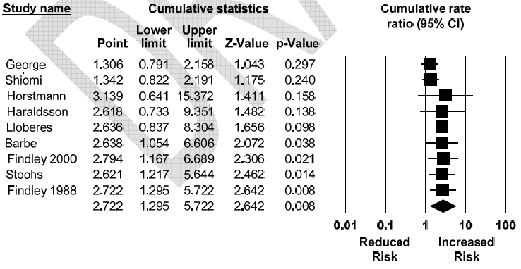
Increased Risk of Crash with OSA (FMCSA, 2007)
OSA and Crash
(FMCSA 2007; Tregear S JCSM 2009)

Slide 9
Four Factors Associated with Increased Crash Risk (FMCSA 2007;Tregear S JCSM 2009)
1.the presence and degree of daytime sleepiness (as measured using the ESS, but not Multiple Sleep Latency Test or Maintenance of Wakefulness);
2. severity of disordered respiration during sleep (as measured by the Apnea-Hypopnea Index [AHI] or the Respiratory Disturbance Index[RDI]); there is an inflection point at an AHI of about 20/hr.
3. blood SaO₂ levels (strongest predictor)
4. BMI (independent of OSA)

Slide 10
The Epworth Sleepiness Scale
How likely are you to doze off or fall asleep in the following situations, in contrast to
just feeling tired? This refers to your usual way of life in recent times. Even if you
have not done some of these things recently, try to work out how they would have
affected you. Use the following scale to chose the most appropriate number for each situation:
0=would never doze
1=slight chance of dozing
2= moderate chance of dozing
3=high chance of dozing
Situation Chance of Dozing
Sitting and reading _____
Watching TV _____
Sitting, inactive, in a public place _____
As a passenger in a car for an hour _____
Lying down in the afternoon _____
Sitting and talking to someone _____
Sitting quietly after a lunch without alcohol _____
In a car, while stopped for a few minutes in traffic _____

Slide 11
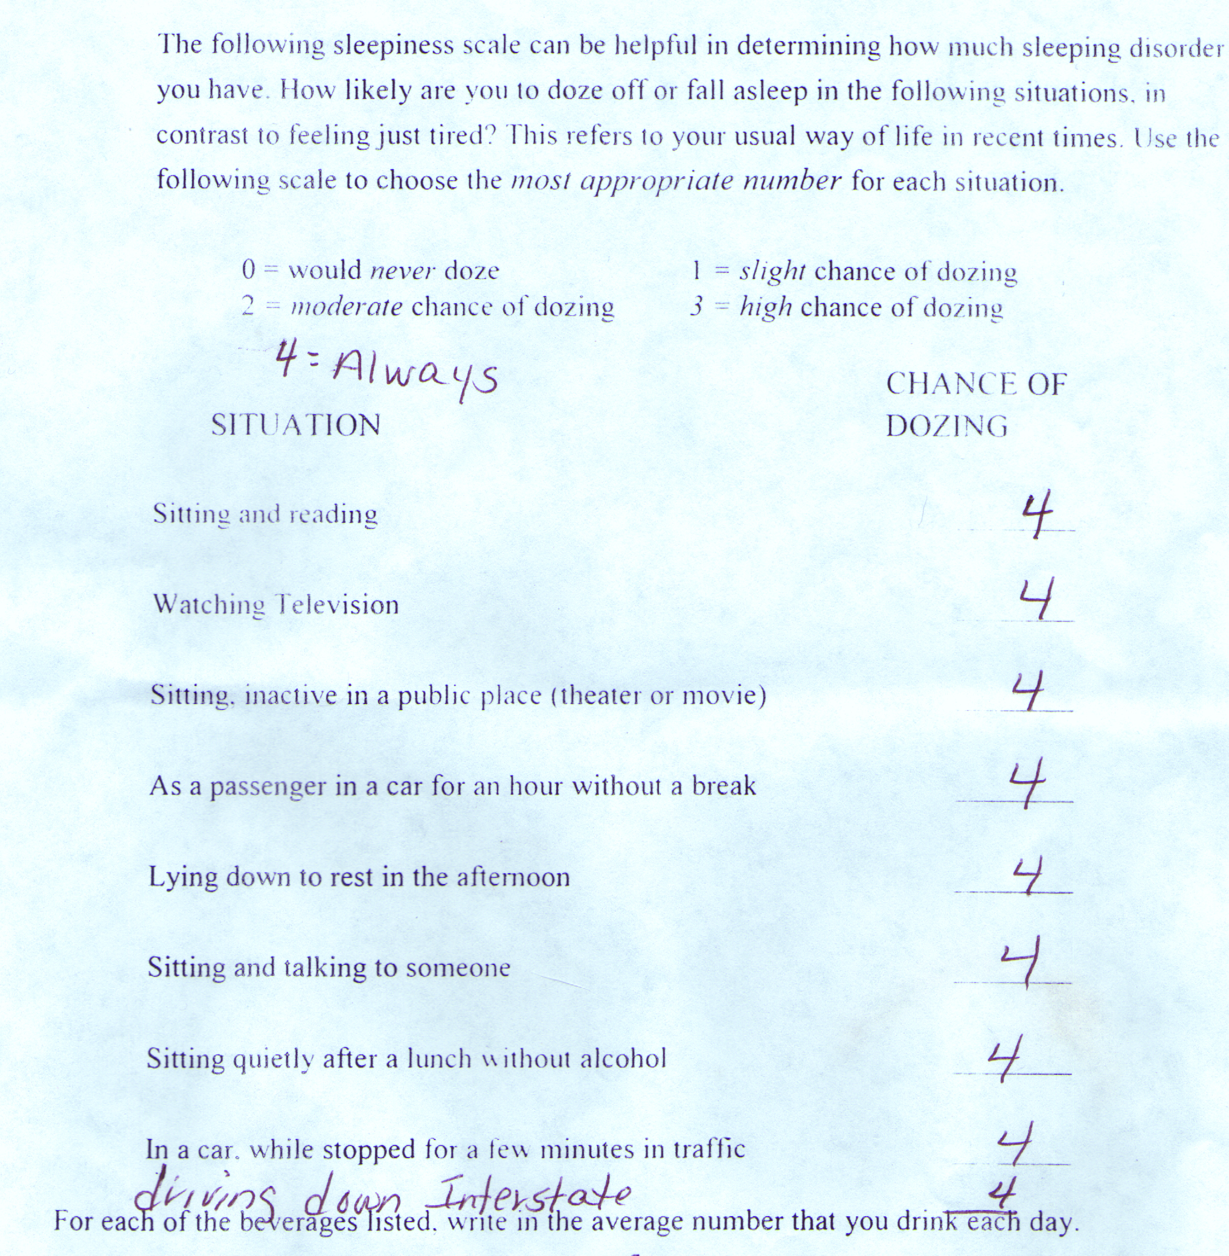

Slide 12
Do At-Risk Drivers Know? (FMCSA 2007; Tregear S JCSM 2009)
Individuals with OSA may not be aware of the extent to which they are affected by daytime sleepiness

Slide 13
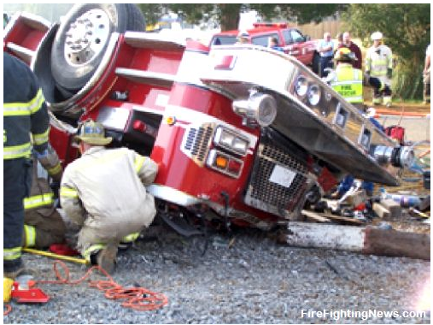

Slide 14
Overview
OSA and driving risk
OSA and commercial drivers
OSA and amateur drivers
Factors besides OSA that increase driving risk
Interventions

Slide 15
Obstructive Sleep Apnea (OSA) and Commercial Drivers (CDs)
Approximately 5,600 people are killed every year in crashes with commercial motor vehicles (CMV’s) in the US
Between 20 and 30% of crashes with CMV’s are sleep-related (Akerstedt T J Sleep Res 2000)
At least 25% of CD’s have OSA (Pack A AJRCCM 2006)

Slide 16
Commercial Drivers Carry Increased Risk for Crash
They may
operate larger vehicles
transport hazardous materials
carry multiple passengers
operate for longer stretches of time
have an economic incentive to continue driving when private drivers may choose to stop for a medical reason or road conditions.

Slide 17
Workers in Safety-sensitive Positions Are Held to a Higher Standard
The US Preventive Services Task Force notes that “…considerations other than benefit to the patient may favor screening” because this may increase the margin of safety for the public.(US Preventive Services Task Force. Guide to Clinical Preventive Services, second edition, Williams & Wilkins. Baltimore 1996.)
The Americans with Disabilities Act (ADA) states that Federal Medical Standards take precedent over the ADA, and this has been supported by case law Sutton v. United Air Lines, inc. (97-1943) 527 us 471,1999

Slide 18
Medical Expert Panel Members 2008: Sonia Ancoli-Israel PhD Charles A Czeisler, MD, PhD Charles FP George, MD, FRCPC Christian Guilleminault, MD, BiolD Allan I Pack, MB, ChB, PhD These individuals made specific recommendations to FMCSA that were endorsed by its Medical Advisory Panel, and were never enacted. Years later….

Slide 19
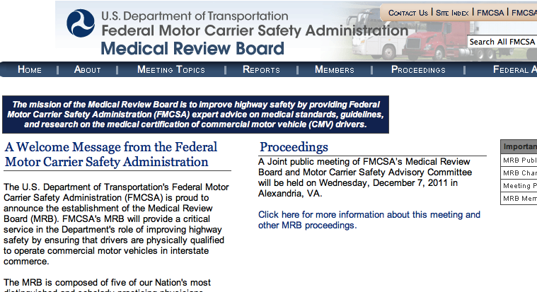

Slide 20
Recommendations of the MRB to the FMCSA, 2011
FMCSA shall issue new guidance for medical examiners that drivers with a Body Mass Index (BMI) of greater than 35 need to be evaluated for obstructive sleep apnea(OSA) using an objective test
http://www.mrb.fmcsa.dot.gov/documents/Meetings2012/Task11-05FinalCoverLetterandReport_2-21-12.docx. Last accessed April5th,2012.

Slide 21
Recommendations of the MRB to the FMCSA, 2011
A driver diagnosed with OSA may maintain certification with evidence of appropriate treatment (if any) and effective compliance and if the examiner determines that the condition does not affect the driver’s ability to safely operate a commercial motor vehicle (CMV).
The driver may be given a 60 day conditional certification during the evaluation and treatment process.
1) Subsequent certification should be no longer than one year term
2) Future certification should depend on proof of continued compliance with treatment

Slide 22
Recommendations of the MRB to the FMCSA, 2011 Drivers who should be immediately disqualified
a. Individuals who report that they have experienced excessive sleepiness while driving
b. Individuals who have experienced a crash associated with falling asleep
c. Individuals with an AHI > 20, until such an individual has been adherent to CPAP. They can be conditionally certified based on the criteria for CPAP compliance
d. Individuals who have undergone surgery and who are pending the findings of postoperative evaluation
e. Individuals who have been found to be effectively non-compliant with their CPAP treatment.
…..and then…

Slide 23
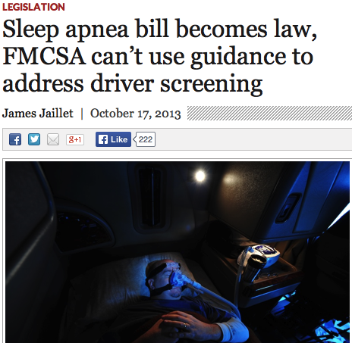
HR 3095
Signed into law during the government shutdown last fall limits FMCSA’s ability to screen commercial drivers. FAA has similar legislation in progress.

Slide 24
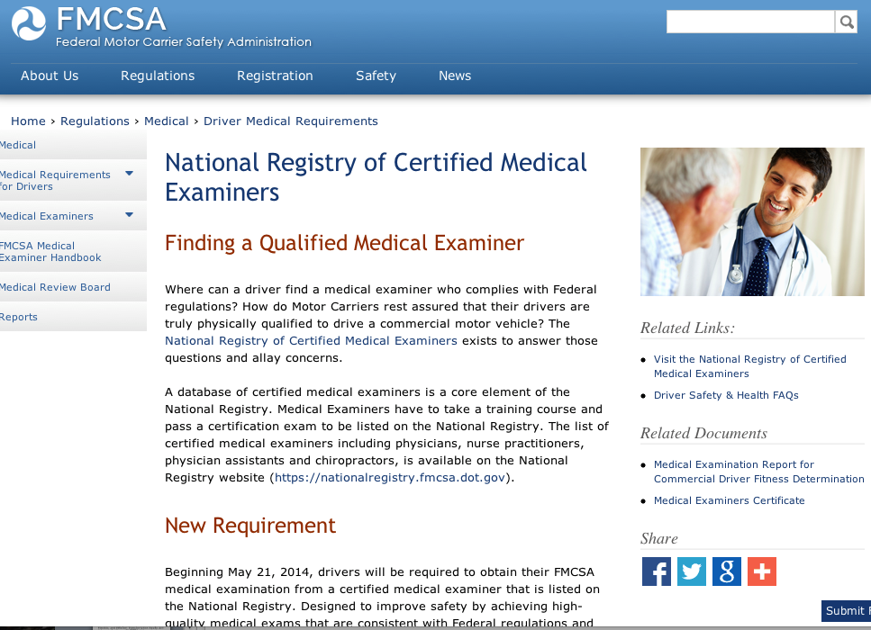

Slide 25
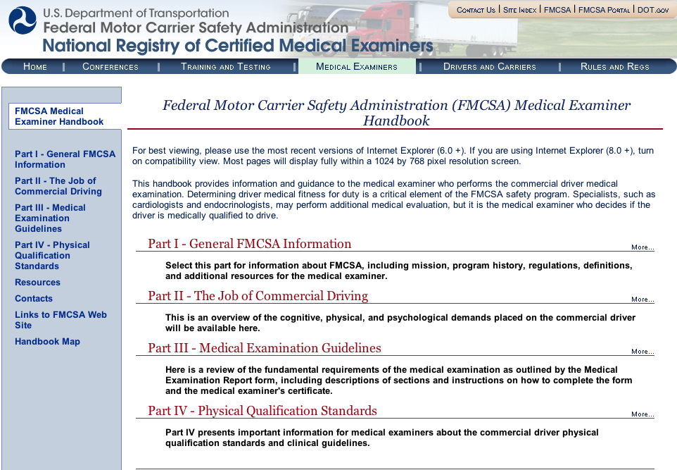

Slide 26
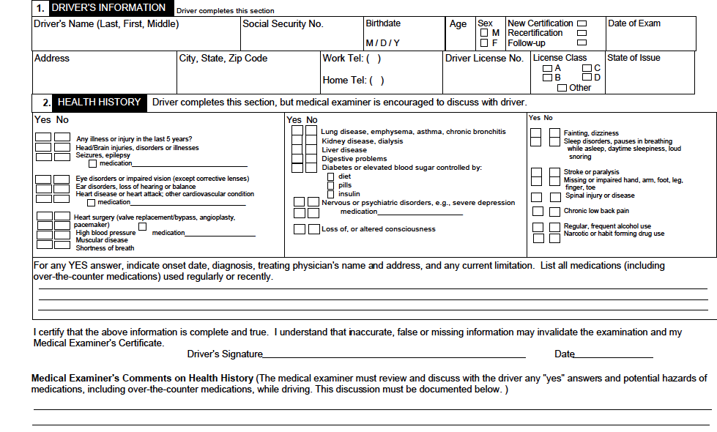

Slide 27
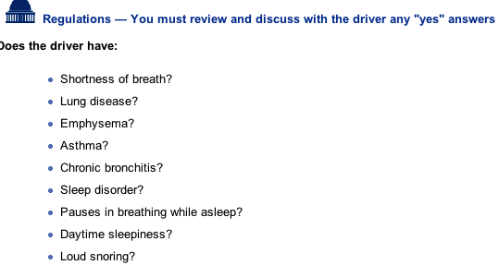

Slide 29
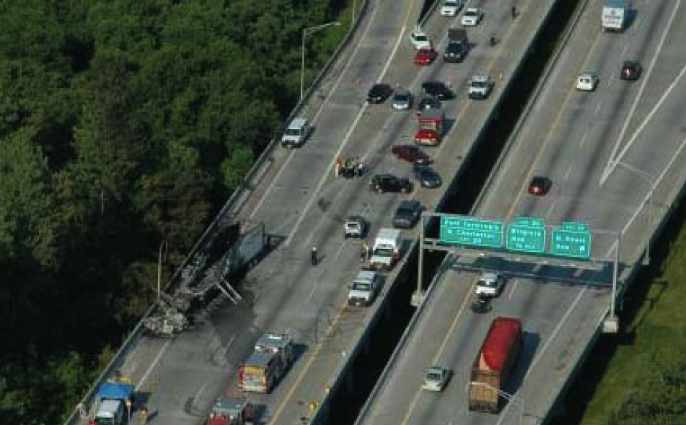

Slide 30
Overview
OSA and driving risk
OSA and commercial drivers
OSA and amateur drivers
Factors besides OSA that increase driving risk
Interventions

Slide 31
ATS Statement of Sleep Apnea, Sleepiness and Driving Risk (Strohl KP Am J Respir Crit Care Med 2013
OSA versus non-OSA is associated with a two- to three times increased overall risk for motor vehicle crashes, but prediction of risk in an individual is imprecise.
A high-risk driver is defined as one who has moderate to severe daytime sleepiness and a recent unintended motor vehicle crash or a near-miss attributable to sleepiness, fatigue,or inattention.
There is no compelling evidence to restrict driving privileges in patients with sleep apnea if there has not been a motor vehicle crash or an equivalent event.
Timely diagnostic evaluation and treatment and education of the patient and family are likely to decrease the prevalence of sleepiness-related crashes in patients with OSA who are high-risk drivers.

Slide 32
ATS Statement of Sleep Apnea, Sleepiness and Driving Risk (Strohl KP Am J Respir Crit Care Med 2013
For patients in whom there is a high clinical suspicion of OSA and who have been deemed high-risk drivers, we suggest that polysomnography be performed and, if indicated, treatment initiated as soon as possible….for appropriately selected patients (high clinical suspicion for OSA), at-home portable monitoring is a reasonable alternative to polysomnography.
We suggest NOT using empiric continuous positive airway pressure (CPAP) for the sole purpose of reducing driving risk.
We suggest NOT using stimulant medications for the sole purpose of reducing driving risk.

Slide 33
Overview
OSA and driving risk
OSA and commercial drivers
OSA and amateur drivers
Factors besides OSA that increase driving risk
Interventions

Slide 34
Factors Besides OSA that Increase Risk of Crash-Summary
Sleep deprivation (Pack A Am J Respir Crit Care Med 2006)
Inexperience/youth (Stevenson MR Am J Ep 2014)
Night driving (Stevenson MR Am J Ep 2014)
Failure to take breaks (probably q 4 hours) (Stevenson MR Am J Ep 2014)
Vehicles that are empty, lack cruise control or lack antilock breaks (Stevenson MR Am J Ep 2014)
Snoring (Howard ME Am J Respir Crit Care Med 2004)
Taking
antidepressants (Catarino R Sleep Breath 2014)
sleeping pills (Gustaven I sleep Med 2008)
antihistamines (Howard ME Am J Respir Crit Care Med 2004)
narcotics (Howard ME Am J Respir Crit Care Med 2004)

Slide 35
OSA and Sleep Duration In Drivers
(Pack AJRCCM 2006)
Both sleep apnea and cumulative partial sleep deprivation degrade performance in commercial drivers.
The effects of severe sleep apnea (AHI >30 episodes/hour) and a sleep duration of less than 5 hours are approximately equivalent.
A sleep duration of less than 5 hours occurred in 13.5% of this sample
Severe sleep apnea occurred in 4.7% of this sample.

Slide 36
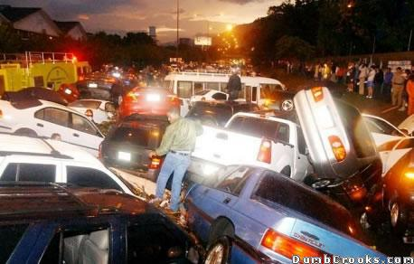

Slide 37
Overview
OSA and driving risk
OSA and amateur drivers
OSA and commercial drivers
Factors besides OSA that increase driving risk
Interventions

Slide 38
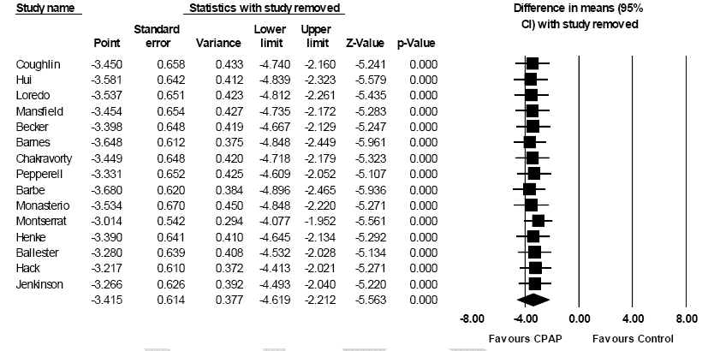
CPAP Treatment Reduces ESS (FMCSA 2007, Tregear Sleep 2010)

Slide 39
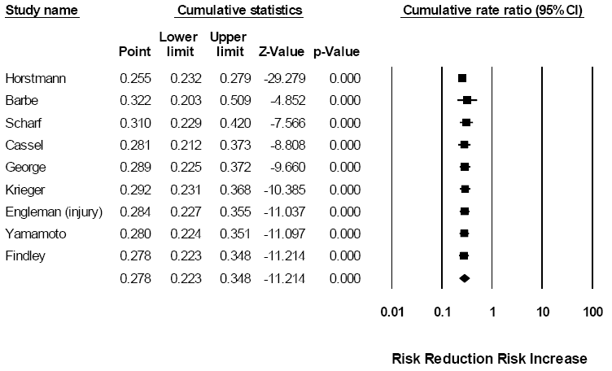
CPAP Treatment Reduces Crash Risk (FMCSA 2007, Tregear Sleep 2010)

Slide 40
How Long Does it Take? FMCSA 2010
The impact that CPAP has on crash-risk reduction among individuals with OSA can be seen after as little as one night of treatment.
Cessation of CPAP leads to a decrease in simulated driving ability and increases in both OSA severity and daytime sleepiness. The rate at which this deterioration occurs cannot be determined; however, this deterioration may occur as soon as 24 hours following cessation of treatment

Slide 41
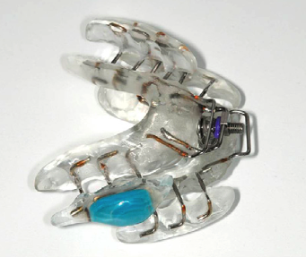
Oral Appliances and Adherence
Though not widely available, technology exists to track oral appliance adherence.
One-year objectively-measured oral appliance correlates well with self-reported compliance, with a systematic overestimate of about 30 minutes. About 10% of patients discontinued oral appliances at 1 year. (Dieltjens M Chest 2013).
Oral appliance therapy and CPAP improved simulated driving performance (and several other health outcomes) similarly after 1 month of treatment (Phillips CL Am J Respir Crit Care Med 2013).

Slide 42
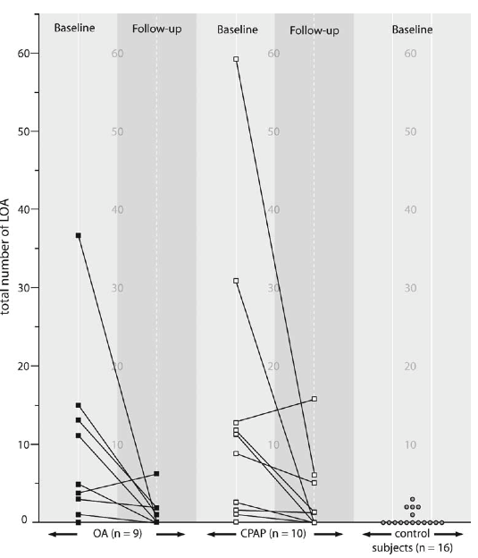
Oral appliances improved simulated driving as well as CPAP in a small group of patients. (Hoekama A Sleep Breath 2007)
LOA=lapse of attention

Slide 43
CDs Who Drink Caffeine Are Less Likely to Crash (Sharwood LN BMJ 2013)
3 year study of 1047 CDs (half of whom had crashed half as matched controls).
Self-reported intake of caffeinated beverages or pills
43% consumed caffeine (3% use amphetamines)
Those who used caffeine had a 63% reduced likelihood of crashing.

Slide 44
Summary
Untreated OSA increases crash risk about 2 fold.
Severity of OSA, degree of oxygen desaturation, self-reported sleepiness, and BMI increase the risk of crash in OSA.
CPAP reduces crash risk; data is insufficient for other treatments
Sleep loss, medications and driving conditions also affect crash risk
Commercial drivers are at increased risk and are held to a higher standard.
Chest physicians may be on the “front lines” of this public health problem.

Slide 45
More than 300 general sessions
Postgraduate courses
Simulation program
Original investigation presentations
chestmeeting.chestnet.org

Slide 46

Call for Abstracts and Case Reports
Submission deadline: April 1
chestmeeting.chestnet.org

