Slide 1
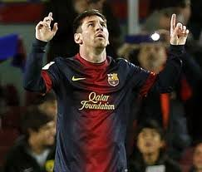
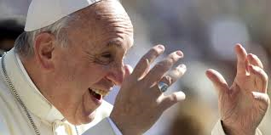
Arm Exercise: Rationale and Efficacy in COPD an Example of the Present and Future of PR
Bartolome R. Celli, M.D.
Professor of Medicine.
Harvard Medical School
Brigham and Women’s Hospital
Boston. MA

Slide 2
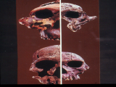
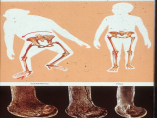
Humans versus Apes
Brain Size
Upright Posture
Use of Hands

Slide 3
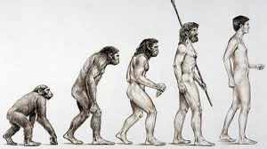
Humans versus Apes

Slide 4
Arm Exercise: Review.
Functional Anatomy
Response to Exercise: - Arm Ergometry - UAE
Arms and Ventilation
Arm Exercise and COPD
Upper Extremity Exercise as Therapy

Slide 5
Arm Exercise: Review.
Functional Anatomy
Response to Exercise: - Arm Ergometry - UAE
Arms and Ventilation
Arm Exercise and COPD
Upper Extremity Exercise as Therapy

Slide 6
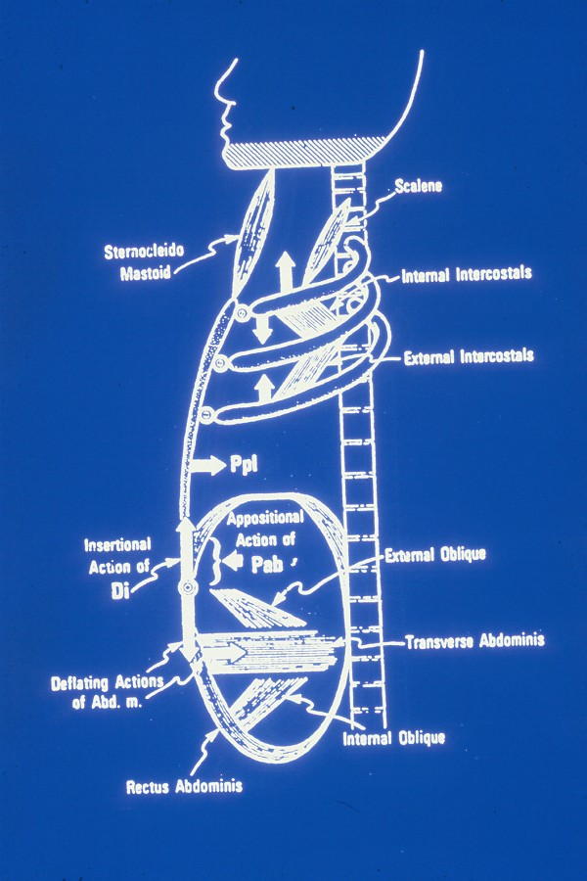
Respiratory
Muscles
Accessories
Diaphragm
Abdominal

Slide 7
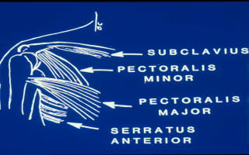
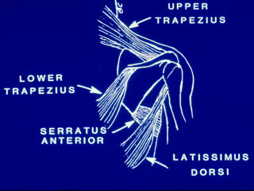
Shoulder Girdle Functional Anatomy
Anterior
Posterior

Slide 8
Arm Exercise: Review
Functional Anatomy.
Response to Exercise: - Arm Ergometry - UAE
Arms and Ventilation.
Arm Exercise and COPD.
Upper Extremity Exercise as Therapy.

Slide 9
Leg and Arm Cycling.

Slide 10
Arm and Leg Cycling
Beats x min. L/min

Slide 11
Arm Exercise: Review.
Functional Anatomy.
Response to Exercise: - Arm Ergometry. - UAE.
Arms and Ventilation.
Arm Exercise and COPD.
Upper Extremity Exercise as Therapy.

Slide 12
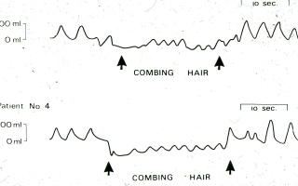
Arms and ADL
Tangri & Wolf Chest 1973; 63:126

Slide 13
Effect of Arm Elevation on VO2 and VCO2
VO2
*
VCO2
Couser CHEST 1993:103:37

Slide 14
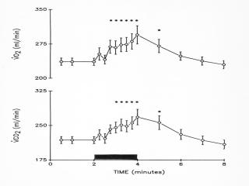
Arm Elevation and COPD
Martinez AJRCCM 1991;143:476

Slide 15
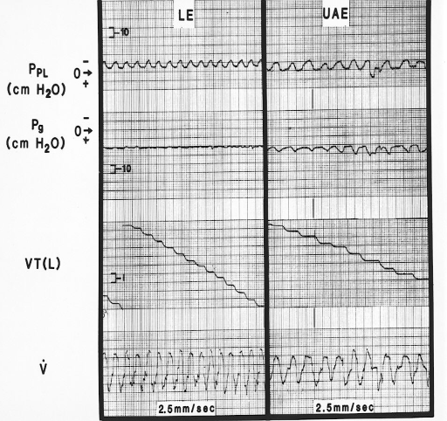
COPD: Arm vs Leg Exercise.
Criner & Celli ARRD 1988;138856

Slide 16
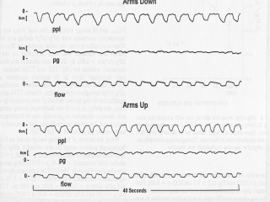
Arm Elevation and RM
Epstein AJRCCM 1995;152:211

Slide 17
Arm Exercise: Review.
Functional Anatomy.
Response to Exercise: - Arm Ergometry. - UAE.
Arms and Ventilation.
Arm Exercise and COPD.
Upper Extremity Exercise as Therapy.

Slide 18
Arm Biomolecular Composition.
COPD = 11 and Controls = 9
Non dominant arm Deltoid biopsy.
Handgrip strength.
Exercise Capacity (Leg ergometry).
Gea et al AJRCCM 1999;159:A579

Slide 19
Arm Biomolecular Composition
ns
P = 0.01
Gea et al AJRCCM 1999;159:A579

Slide 20
Arm Biomolecular Composition.
*
Gea et al AJRCCM 1999;159:A579

Slide 21
EELV: Arm and Leg Exercise N=22 CF and 8 Controls
‡
‡
*
*
*
*Different from rest. ‡ Different from control
Alison AJRCCM 98;1581450

Slide 22
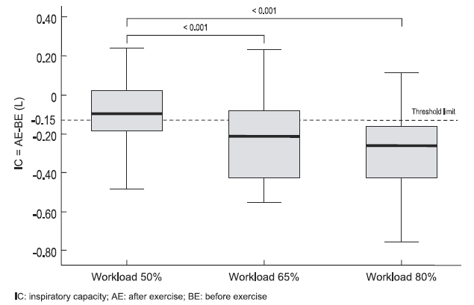
COPD: UEE and Association With COPD
24 patients. 64 years
FEV1 = 35% predicted
Exercise at 3 levels
50% 65% and 80%
Physiological outcomes
Colluci M et al CHEST 2010; 136:39

Slide 23
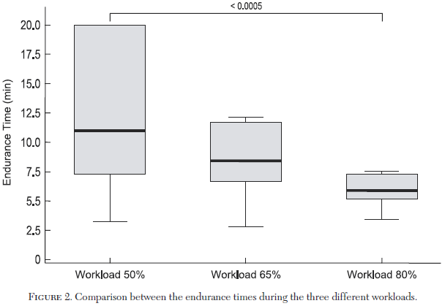
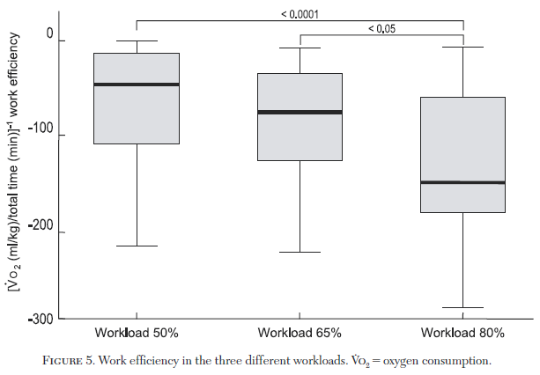
COPD: UEE and Association With COPD
Colluci M et al CHEST 2010; 136:39

Slide 24
Arm Exercise: Review.
Functional Anatomy.
Response to Exercise: - Arm Ergometry. - UAE.
Arms and Ventilation.
Arm Exercise and COPD.
Upper Extremity Exercise as Therapy.

Slide 25
Upper Extremity Exercise.
Arm elevation increases VO2 , VCO2 and VE.
Arm muscles can pull on the ribcage.
May generate dyspnea associated with dyssynchronous RC/Abd movement.

Slide 26
Effect of UA Training on Arm Elevation VO2
Pre- Rehab
Post- Rehab
Couser CHEST 1993

Slide 27
SAE vs UAE in PR of COPD. N = 36
Martinez CHEST 1993;103:1397

Slide 28
Effects of UA training
*
*
*
Epstein et al J Cardiopulm Rehab 97;17:171

Slide 29
Arm Exercise in P.R.
Studies: 6.
Patients n=132
Age 63+6 ys.
FEV1 0.92 L
Gender 76% men.
Training: Arm Erg. 2 UAE 4
Duration 6-10 weeks
Change %

Slide 30
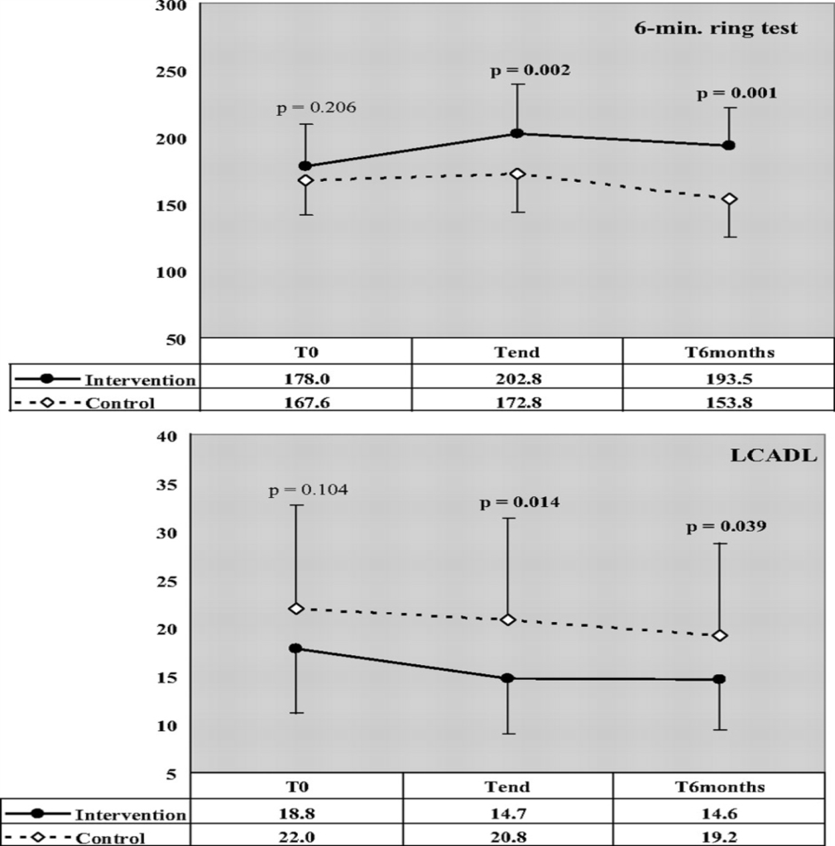
Effects of UAEET in COPD
Randomized 50 pts
3 weeks inpatient
UEET + PR vs PR
Outcomes the 6-min ring test (6MRT), ADL field test (four shuttle stations), mMRC, the London Chest Activity of Daily Living scale (LCADL), and 6MWD.
At 6-months repeat the 6MRT and the LCADL
6MRT
ADL
Costi S et al CHEST 2009; 136:387

Slide 31
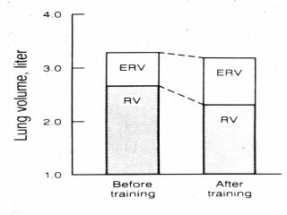
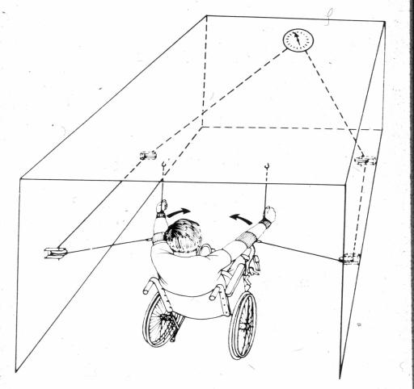
Arm Training and RM.
Estenne ARRD 1989;139:1218

Slide 32
Conclusions
Arm exercise ccompromises ventilatory function
AE training increases Endurance, Decreases VE and VO2 for similar work.
Form of training is variable.
May have effect on RM function.
Evidence Type B
ACCP/AACVPR Chest 1997.

Slide 33
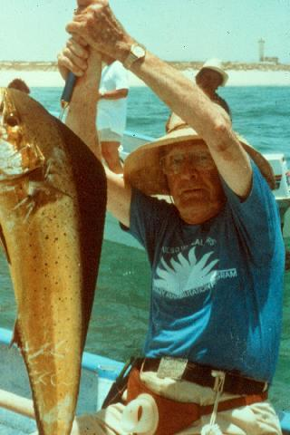
P.R. Arm Exercise. QoL.
62 yr old man.
FEV1 = 0.67 L
Chief Complaint: “I miss fishing.”
Began P.R. with exercise including upper extremities.

Slide 34
AE: Future Directions.
Standardize tests of arm endurance.
Study mechanisms of dyspnea with AE.
Can we train specific muscles?
Does arm training improve RM?
Does arm training improve outcomes?

Slide 35
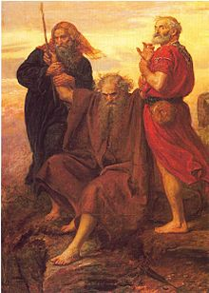
Exodus 17:12
The Defeat of the Amalekites
…So it came about when Moses held his hand up, that Israel prevailed, and when he let his hand down, Amalek prevailed. But Moses' hands were heavy. Then they took a stone and put it under him, and he sat on it; and Aaron and Hur supported his hands, one on one side and one on the other. Thus his hands were steady until the sun set. So Joshua overwhelmed Amalek and his people with the edge of the sword.…
Moses and arm fatigue!!!!

Slide 36
Gracias

