Slide 1

OSA and COPD
Barbara Phillips, MS, MSPH, FCCP
CHEST President 2015-2016
Professor, University of Kentucky College of Medicine

Slide 2
Conflict of Interest Disclosures for Speakers
I have the following relationships with entities producing, marketing, re-selling, or distributing health care goods or services consumed by, or used on, patients:
Type of Potential Conflict | Details of Potential Conflict
Grant/Research Support
Consultant | Member of the FMCSA Medical Advisory Board 2008-2011, expert witness Clayton and Beveridge
Speakers’ Bureaus
Financial support
Other | Leadership positions, American College of Chest Physicians, National Board of Respiratory Care Board of Registered Polysomnographic Technologists
The material presented in this lecture has no relationship with any of these potential conflicts

Slide 3
Overview
Effects of sleep on breathing
Sleep in COPD
The Overlap Syndrome
Treatment of the Overlap Syndrome

Slide 4
States of Being
Wake
REM Sleep
NREM Sleep

Slide 5
REM vs. NonREM Sleep
Physiologic Variable
Heart rate
Respiratory rate
Blood pressure
Skeletal muscle tone
Brain 02 consumption
Ventilatory response
Temperature
Sexual changes
NREM REM
Regular Irregular
Regular Irregular
Regular Variable
Preserved Absent
Reduced Increased
Normal Reduced
Normal Poikilothermic
Rare Frequent

Slide 6
Respiratory Response to Sa02 During Normal Sleep
Awake
15
3/4
2
Ventilation (L/min)
10
REM
Douglas NJ Clin Chest Med 1985;6:564
5
100
90
80
Oxygen Saturation (%)

Slide 7
Respiratory Response to CO₂ During Normal Sleep
Ventilatory response to CO₂ is depressed during NREM sleep
20
10
Awake
Slope of response line is depressed further in REM sleep
Stage 3/4
Ventilation (L/min)
Stage 2
REM
Set point for response to CO₂ increases during NREM sleep and further in REM sleep
    -Requires a higher PaCO₂ to stimulate respiration
30 40 50
End-tidal PCO(mmHg)
Douglas NJ Clin Chest Med 1985

Slide 8
Overall Changes in Breathing
During Sleep
Decrease in minute ventilation 0.5-1.5 L
Increase in airway resistance
Decrease in metabolic rate (CO₂) production 10-15%
Decrease in chemosensitivity 20-50%
PaO₂ 3-10 mmHg
SaO₂ 2%
PaCO₂ 2-8 mmHg
Mohsenin, Semin Resp Crit Care Med 2005;26:109

Slide 9
Overview
Effects of sleep on breathing
Sleep in COPD
The Overlap Syndrome
Treatment of the Overlap Syndrome

Slide 10
Effects of COPD on Sleep
Cough and wheezing interrupt and delay sleep (Klink M Chest 1987)
Sleep is more fragmented, with increased arousals and reduced amounts of deep nREM and REM sleep (McSharry DG, Respirology 2012)
Severity of COPD correlates with severity of subjective sleep complaints (Omachi TI Sleep Med 2012), but not with objectively measured sleep variables (Hynninen MJ Sleep Med 2013).

Slide 11
Effects of COPD on Sleep
(McNicholas WT Sleep Breath 2013)
Daytime sleepiness (by Epworth) and poor quality sleep (by PSQI) compared to that of matched controls (Zohal A Glo J Health Sci 2013).
Increased prevalence of insomnia complaints
Increased use of hypnotics

Slide 12
Effects of Sleep on Patients with COPD
Patients with COPD are most profoundly hypoxemic at night (McNicholas WT, Chest 2000).
COPD patients are more likely to die at night (McNicholas WT Br Med J 1984).
Oxygen desaturation is greater during sleep than during exercise in COPD, and wake Sa0₂ predicts nocturnal desaturation better than exercise Sa0₂ or wake PaC0₂ (Mulloy E, Chest 1996)

Slide 13
COPD and Poor Sleep: A Two Way Street
(Kent BD, Sleep Med 2014)
How does sleep impact COPD?
  Reduced chemosensitivity
  Reduced pulmonary function
  Impaired muscle performance
  Systemic inflammation
How does COPD impact sleep?
  Symptoms cause sleep disturbance
  Hypoxemia and hypercarbia disturb sleep

Slide 14
Smoking, Nicotine, and Sleep
(Zhang L Chest 2008; Phillips BA Arch Intern Med 1995)
Cigarette smoking is associated with
  Impaired sleep quality
  Increased risk of snoring
  Increased risk of sleep apnea
  Insomnia
  Daytime sleepiness
  Restless legs syndrome
  Increased caffeine intake

Slide 15
Overview
Effects of sleep on breathing
Sleep in COPD
The Overlap Syndrome
Treatment of the Overlap Syndrome

Slide 16
OSA + COPD= Overlap Syndrome
Definitions of COPD and OSA vary, so..
Prevalence estimates of the Overlap Syndrome vary.
  As many as 15% of COPD patients have co-existent OSA (Carratu P ERJ 2008)
  In patients with OSA, prevalence of COPD is 7.6% (compared to patients without OSA, where prevalence is 3.7%) (Greenberg-Dotan S, Sleep Breath 2013)
  For patients with GOLD stage 4 COPD, the prevalence of OSA is 43% (Areias V, Rev Prt Pneumol 2014)

Slide 17
How is the Overlap Syndrome
Different than COPD or OSA?
Patients with the Overlap Syndrome have increased risk of complications compared to those with COPD or OSA alone (Gan WQ Thorax, 2004, Greenberg-Dotan S, Sleep Breath 2013)
  Respiratory failure
  Pulmonary hypertension
  Hypoventilation
  More severe hypoxemia
  Diabetes
  Obesity
  Death

Slide 18
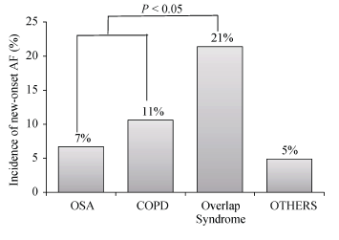
Overlap Patients at Greater Risk for A Fib
Than OSA or COPD (Ganga HV JACC 2013)

Slide 19
Overview
Effects of sleep on breathing
Sleep in COPD
The Overlap Syndrome
Treatment of the Overlap Syndrome

Slide 20
Potential Treatments for Sleep Disorders in COPD
Medications
Hypnotics
Cognitive Behavioral Therapy
Pulmonary Rehabilitation
Nocturnal oxygen
Positive airway pressure
  CPAP
  Bilevel PAP
  NIPPV

Slide 21
Treatment of COPD and Sleep
Disturbance/Disorders
COPD Medications
    Theophylline (a xanthine) has the potential to impair sleep, but data are conflicting
    Other COPD meds appear to improve symptoms without impairing sleep

Slide 22
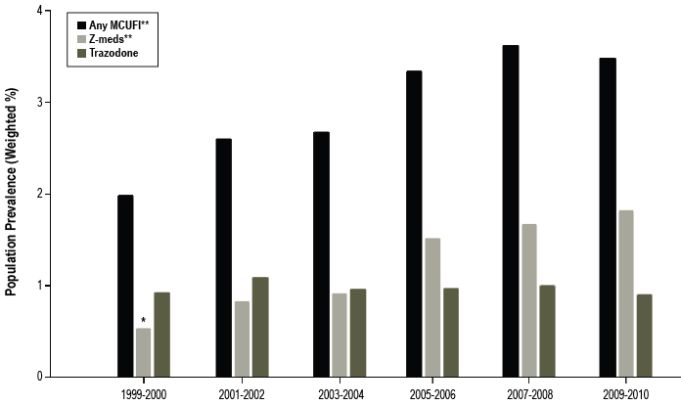
Increasing Use of Medications Commonly-Used for Insomnia (MCUFI) Bertisch SM Sleep 2014

Slide 23
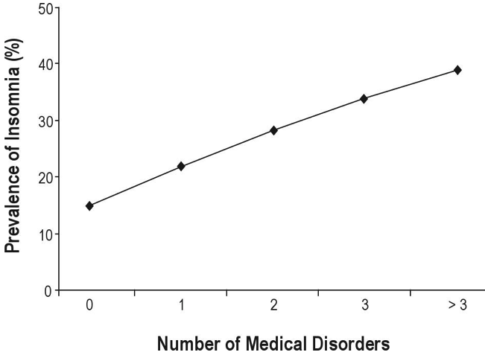
Insomnia and Illness
Budhiraja Sleep 2011

Slide 24
Odds Ratios (OR) for Insomnia
(Phillips and Mannino, Sleep 2005)
Female gender (vs. male) 1.7 (1.42-2.22)
Annual income: < $50,000 1.23 (1.09,1.40)
Depression 5.05 (4.60-5.55)
Heart disease 1.89 (1.67-2.14)
Severe airflow obstruction 1.61 (1.17-2.22)
Pulmonary symptoms 1.71 (1.5-1.95)
Restrictive lung disease 1.27 (1.10-1.47)

Slide 25
Hypnotic Use and Correlates
(Vozoris NT Sleep 2011, n=134,072)
Characteristic | Adjusted OR
Female Gender | 1.4
Smoker | Former 1.42 Current 1.61
Mood disorder | 3.46
Anxiety disorder | 1.82

Slide 26
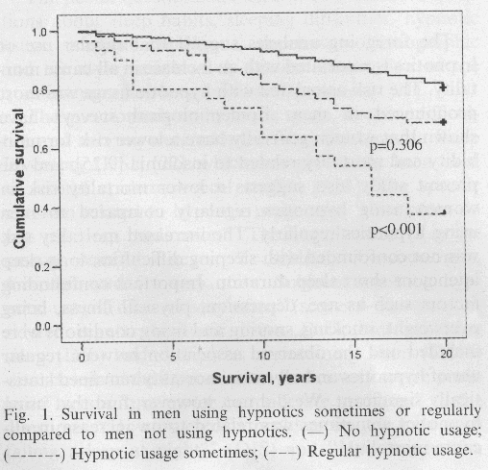
Hypnotics and Survival in Men
(Mallon, Sleep Med 2009)

Slide 27
Hypnotics and Crash
(Gustavsen I, Sleep Medicine, 2008)
Hypnotic | Zopiclone | Zolpidem | Nitrazepam | Flunitrazepam
Number crashes | 129 | 21 | 27 | 18
Standardized Incidence Ratio for Crash | 2.3* | 2.2* | 2.7* | 4.0*

Slide 28
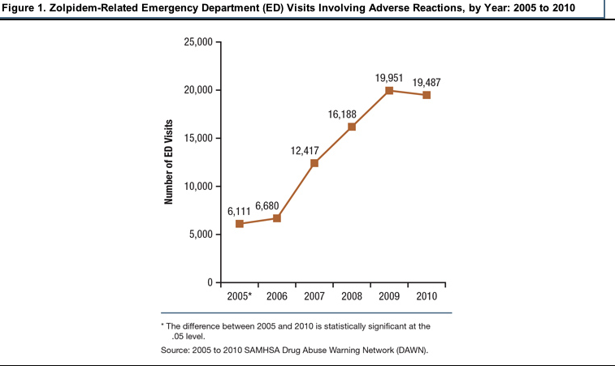
Zolpidem and ED Visits
Substance Abuse and Mental Health Services Administration,
Center for Behavioral Health Statistics and Quality. (May 1, 2013).

Slide 29
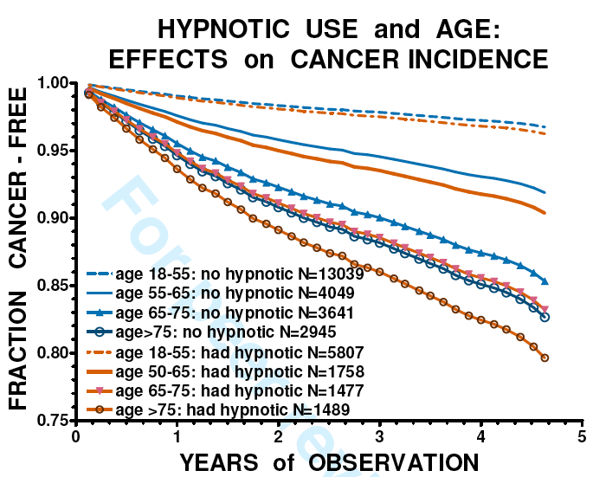
Hypnotic Use and Cancer
(Kripke D BMJ Open, 2012)

Slide 30
Insomnia, Outcomes and Hypnotics
The evidence that chronic use of hypnotics is dangerous is much more compelling than the evidence that hypnotics improve any important objective outcome.
This is probably particularly true in patients with lung disease, including COPD.
Short-term use of BDZ hypnotics only for acute problems is probably the most appropriate way to use sleeping pills in patients with COPD.

Slide 31
CBT (NIH, 2005)
“Behavioral and cognitive-behavioral therapies (CBTs) have demonstrated efficacy in RCTs. … When these cognitive methods have been added to the behavioral methods to compose a cognitive-behavioral treatment package, it has been found to be as effective as prescription medications are for brief treatment of chronic insomnia. Moreover, there are indications that the beneficial effects of CBT, in contrast to those produced by medications, may last well beyond the termination of treatment.”

Slide 32


Slide 33
Pulmonary Rehab Improves Sleep In COPD
(Soler X, COPD 2013)
Exercise is known to promote and to consolidate sleep.
In this study of 64 patients with severe COPD (FEV1% 53), 8 weeks of pulmonary rehab improved Pittsburgh Sleep Quality Index (PSQI) and Health-relatedQuality of Life (HRQoL).

Slide 34
Nocturnal Oxygen
Nocturnal oxygen for COPD
    The goal is Sa02s>90%
    Titration is useful, but risk of hypercarbia may be overstated (Moloney ED Lancet 2001).
    Benefits of supplemental 02 for those with modest daytime hypoxemia (Pa0₂ 55-60) mmHg is still unclear
      38% of COPD subjects with a daytime Pa02 of 56–69 mm Hg (mean 65 mm Hg) spent 30% of the night with an oxygen saturation 90%. (Lacasse Y Respir Med 2011).
    In the US, nocturnal oxygen is generally covered if nocturnal Sa0₂ is <89% for at least 5 minutes.

Slide 35
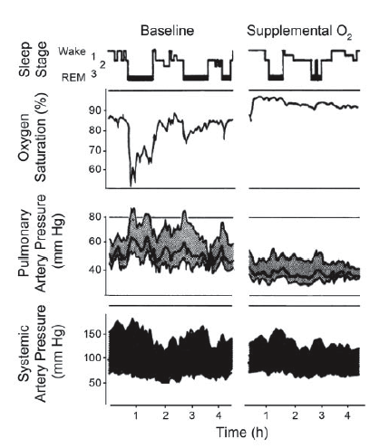
Effect of nocturnal nasal oxygen on Sa0₂,
systemic and pulmonary
artery pressures. (Clement
ID Respir Physiol 1992.)

Slide 36
Nocturnal Oxygen for COPD
  The NOTT and MRC studies demonstrated that patients with Pa0₂ < 55 or Pa0₂ < 59 with cor pulmonale had better survival if they received nocturnal oxygen, and even better survival if they received continuous oxygen.
  NOTT recommended 2 l/min during day, 3 l/min at night (which is largely ignored).

Slide 37
Nocturnal Oxygen for COPD
  The benefit of nocturnal oxygen for those with only nocturnal hypoxemia has not been demonstrated, though work is underway.
  There is a theoretical concern that nocturnal nasal oxygen could worsen outcomes (increased C0₂, increased V/Q mismatch, worsened C0₂ excretion, reduced cardiac output and/or reduced coronary blood flow (Owens RL Respir Med 2013)

Slide 38
Oxygen for OSA
Improves Sa02, but not sleep quality (Loredo JS, Sleep 2006) compared with CPAP
Improves Sa02, but does not lower blood pressure compared with CPAP (Norman D, Hypertension 2006)
Improves Sa02 and neuropsych, but does not improve MSLT compared with CPAP (Phillips B, Chest, 1988)

Slide 39
Nocturnal Oxygen for the
Overlap Syndrome
Improved oxygenation, but increased apnea duration and PC0₂ in 20 patients with the overlap syndrome (Fletcher EC Chest 1986)

Slide 40
CPAP for the Overlap Syndrome
  Reduces risk of death and of exacerbations
  Improves walking capacity (Wang T Respiratory Research 2013).

Slide 41
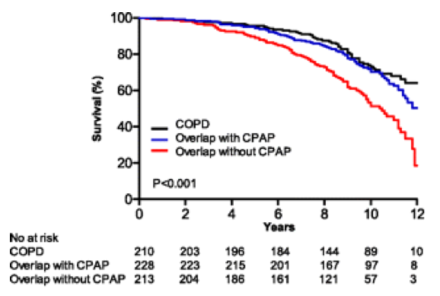
CPAP Reduces Death Rates
Marin JM Am Rev Respir Crit Care Med 2010

Slide 42
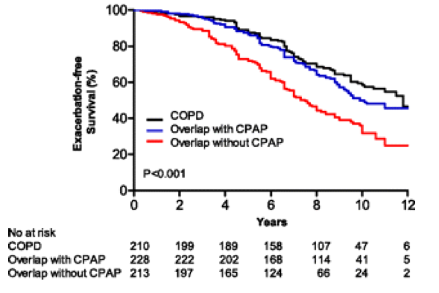
CPAP Reduces Exacerbation Rates
(Marin JM Am Rev Respir Crit Care Med 2010)

Slide 43
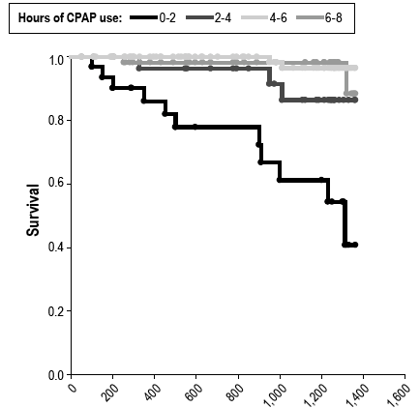
CPAP use is associated with
reduced mortality in the Overlap Syndrome, and
some use (2-4 hours) is better than none.
(Stanchina ML, JCSM 2013, N=227)

Slide 44
CPAP for Overlap Syndrome
In patients with the Overlap Syndrome CPAP reverses the increased mortality (above that of COPD alone). (McNicholas WT Eur Respir J 2013)
In patients who chose between LTOT and CPAP+LTOT, 5 year survival was
  26% for LTOT alone
  71% for LTOT+ CPAP (Machado MCL Eur Respir J 2010)

Slide 45
Can CPAP Help Insomnia in OSA?
(Bjorndottir E Sleep 2013, n=705)
Patients with OSA and insomnia were evaluated before and 2 years after starting CPAP.
Middle-of-the-night awakening was the most prevalent kind of insomnia, and improved significantly among PAP users (59% to 30%).
Sleep-onset insomnia was not affected by CPAP
Early morning awakening was more likely to improve in those who were not adherent.
Sleep-onset and early morning insomnia strongly predicted predicted CPAP non-adherence.

Slide 46
NIV for COPD
Can improve gas exchange during wakefulness
Can improve sleep quality (Meecham Jones DJ Am J Respir Crit Care Med 1995)
Can be withdrawn for up to 2 weeks without deterioration in daytime ABGs (Masa Jimenez JF Chest 1995)
Can reduce need for intubation and mechanical ventilation in COPD exacerbations (Brochard L NEJM 1995)
May improve dyspnea and QoL (Bhatt SP Int Jour COPD)
Is associated with improved mortality in retrospective trials, but not RCTs.
Controversy exists about whether to use high-intensity (rate) or high pressure settings.

Slide 47
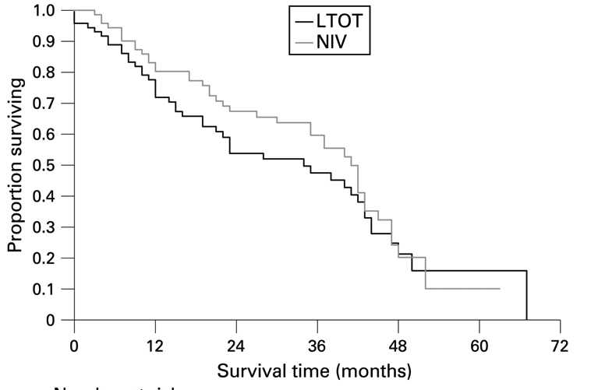
NIV had improved survival compared with LTOT, but worse QoL in an RCT (McEvoy RD Thorax 2009, n=144)

Slide 48
RCTs are Rare and Small
(Bhett SP Int J COPD 2013)
30 COPD patients (FEV₁ < 50% pred and PaCO₂ < 52mmHg) randomized. (OSA was excluded)
Active treatment: Bilevel 15/5 cm H₂0 vs usual care
Outcomes:
  Dyspnea (by TDI) was more improved in the NPPV arm at 6 wks and 3 mos, but not 6 mos.
  QoL slightly improved in one domain in NPPV arm
  Pa0₂ increased (+ 2.1 mmHg) in treatment arm, but decreased (-7.2 mmHg) in control arm.
  No difference in PaC0₂, 6-minute walk, FEV_{1,} number of exacerbations, or sleep quality (PSQI)

Slide 49
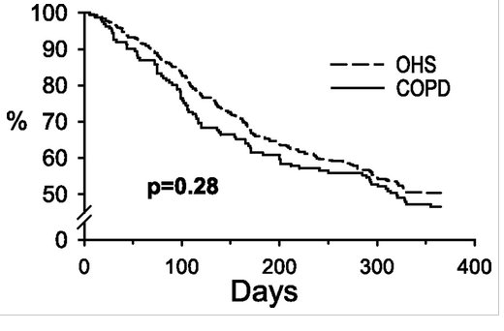

Noninvasive Ventilation (NIV) is Equally
Effective for COPD and OHS
(Carillo A Am J Respir Crit Care Med 2013, n=716)
(Hospital-Free)

Slide 50
Results of a Meta-Analysis
(Struik FM Respir Med 2014)
Careful search of multiple databases up to Aug 2012, with study duration either 3 months or 12 months
7 trial (n=245 patients) met criteria, all of moderate to high quality.
In comparison of NIPPV and control at 3 or 12 months, there were no differences in
  PaC0₂ or Pa0₂ (tho there was a change in Pac0₂ at 3 mos)
  6 minute walk
  Maximal inspiratory pressure
  Sleep efficiency

Slide 51
Results of a Meta-Analysis
(Struik FM Respir Med 2014)
“At present, there is insufficient evidence to support the application of routine NIPPV in patients with stable COPD. However, higher IPAP levels, better compliance and higher baseline PaCO2 seem to improve PaCO₂.”

Slide 52
Bilevel PAP for OSA or Overlap
Bilevel pressure has not been well-studied and has not been demonstrated to improve adherence or meaningful outcomes in OSA
“Patients with the overlap syndrome should also be treated by nocturnal pressure support ….In cases where OSA predominates, CPAP may be most appropriate, whereas …where there is…significant nocturnal hypoventilation with associated periods of sustained hypoxaemia, bilevel positive airway pressure may be more appropriate. “ (McNicholas WT Eur Respir J 2013)

Slide 53
Summary/Conclusions
Sleep and COPD have adverse effects on each other.
COPD + insomnia treatment probably should not involve hypnotics
COPD + OSA (Overlap Syndrome) is best treated with CPAP
NIV shows promise, but is still poorly studied and expensive.
Come to Austin in October!

Slide 54

Call for Abstracts and Case Reports
Submission deadline: April 1
chestmeeting.chestnet.org

Slide 55
More than 300 general sessions
Postgraduate courses
Simulation program
Original investigation presentations
chestmeeting.chestnet.org

