Slide 1
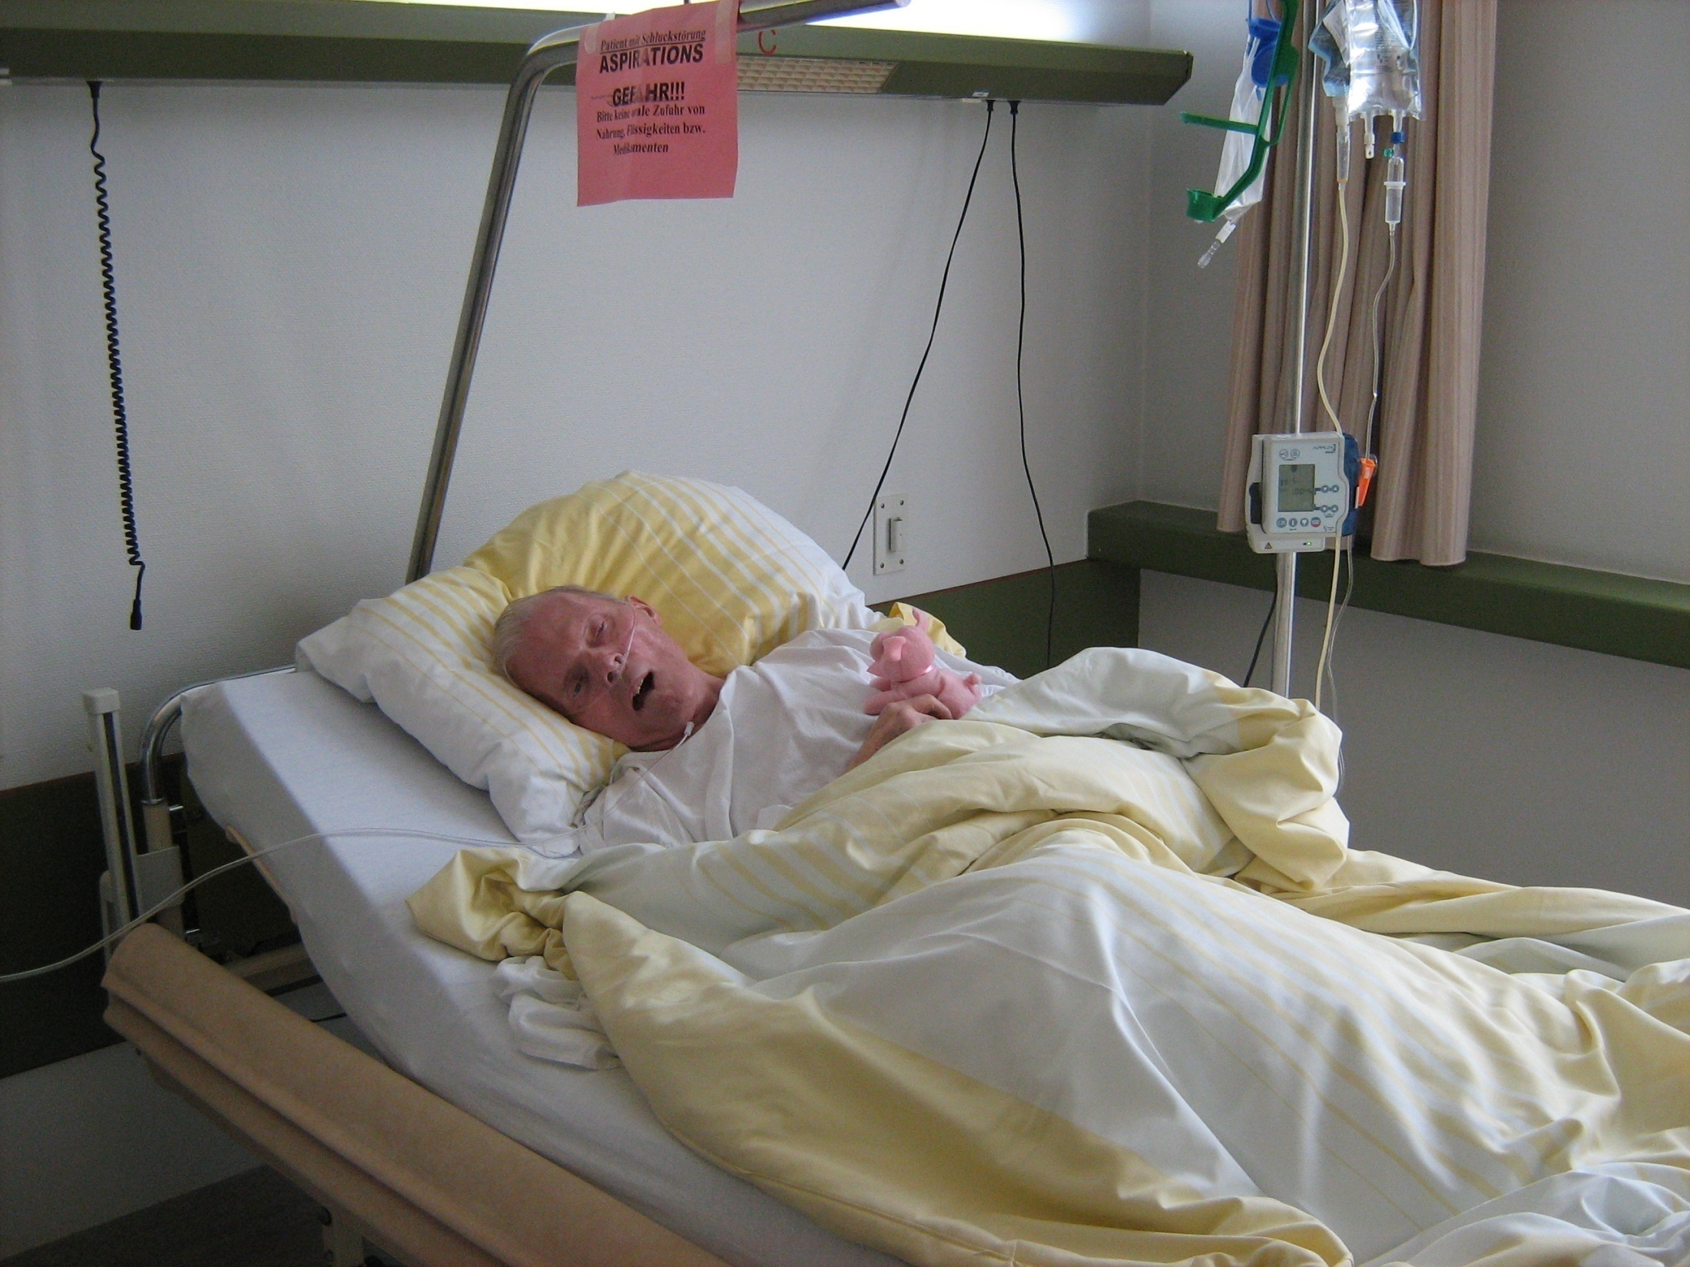
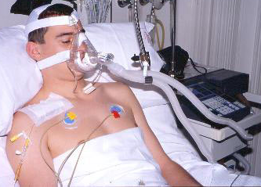
ARE CAP AND HCAP TWO SEPARATE ENTITIES?
Francesco Blasi
Department Pathophysiology and Transplantation,
University of Milan, Italy

Slide 2
Disclosures
I have accepted grants, speaking and conference invitations from Almirall, Angelini, AstraZeneca, Bayer, Chiesi, GSK, Guidotti-Malesci, Menarini, Novartis, Pfizer, and Zambon
I have had recent or ongoing consultancy with Almirall, Angelini, AstraZeneca, GSK, Menarini, Mundipharma and Novartis

Slide 3
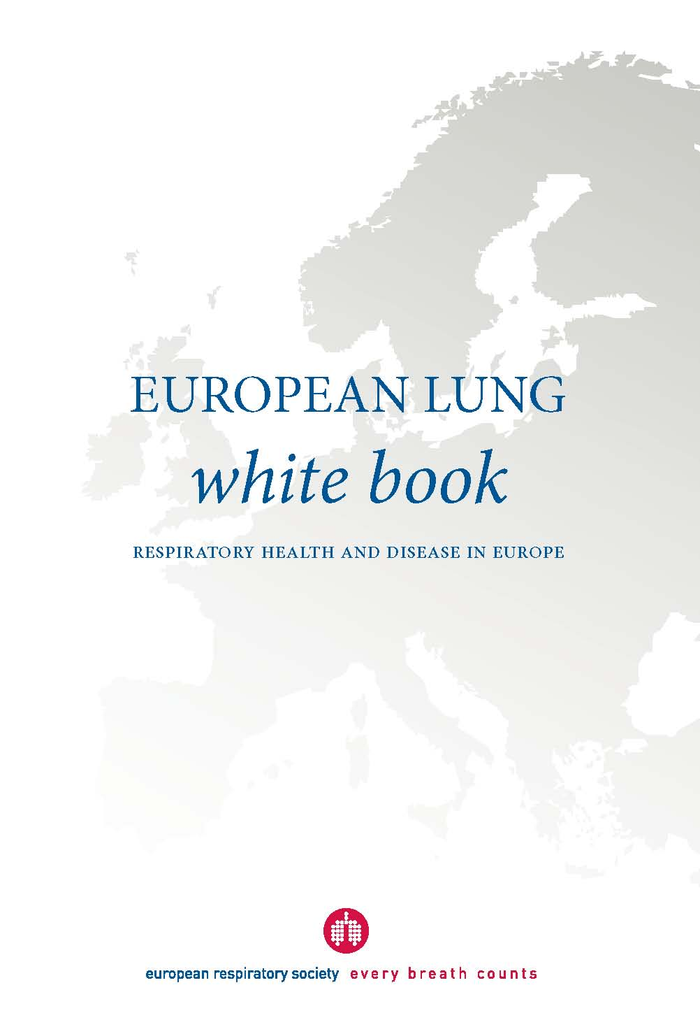
European Lung White Book
http://www.erswhitebook.org

Slide 4
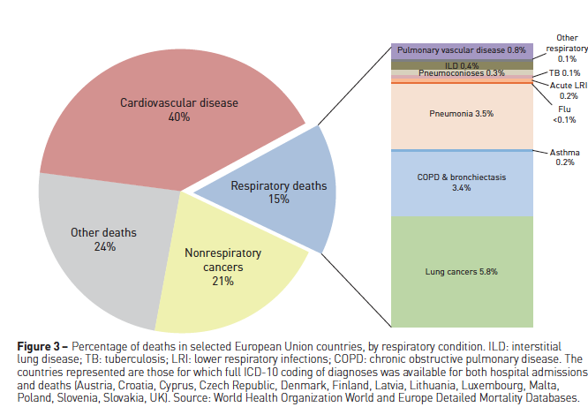

Slide 5
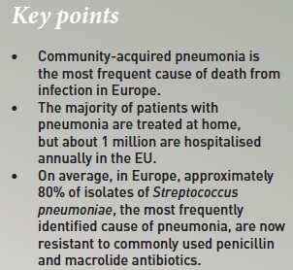
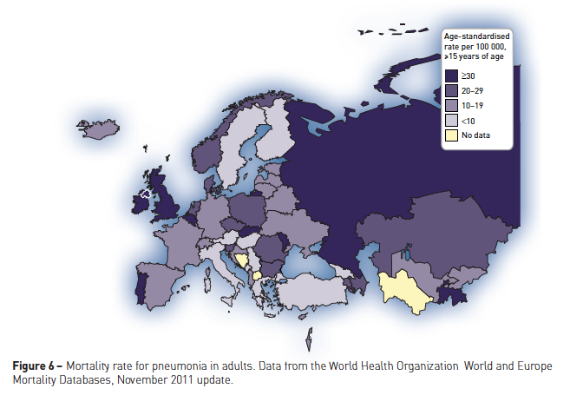

Slide 6
HEALTH CARE – ASSOCIATED STATUS The evolution of MDR pathogens as a dynamic process

Slide 7
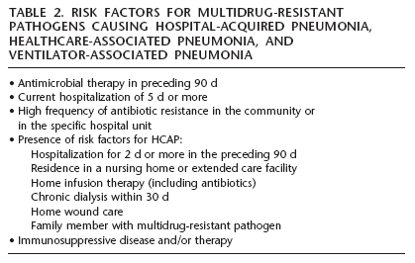
HCAP: original definition
HCAP health care associated pneumonia
ATS / IDSA guidelines for HA, VAP and HCAP, Am J Respir Crit Care Med 2005

Slide 8
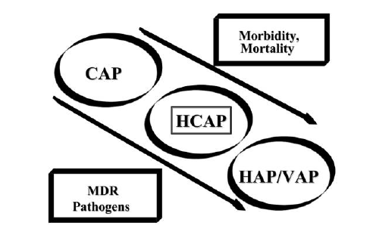
HCAP health care associated pneumonia
CAP community acquired pneumonia
VAP ventilator associated pneumonia
Kollef MH, et al. Clin Inf Dis 2008;46:S296-334

Slide 9

HCAP: what is behind ?

Slide 10
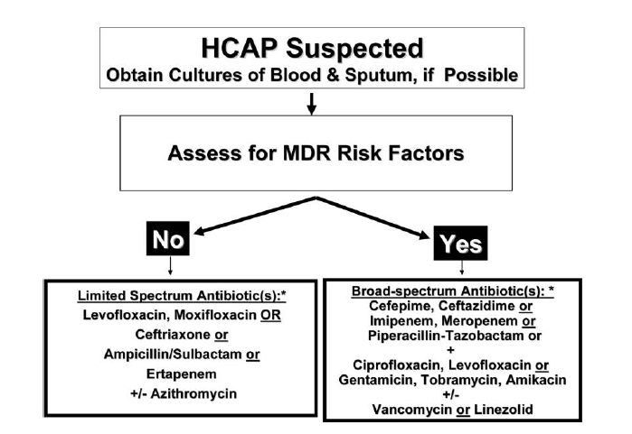
HCAP: the original concept
HCAP Health care associated pneumonia
MDR multi drug resistant
ATS / IDSA guidelines for HA, VAP and HCAP, Am J Respir Crit Care Med 2005

Slide 11
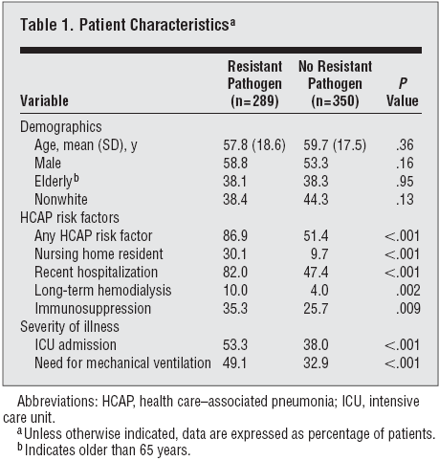
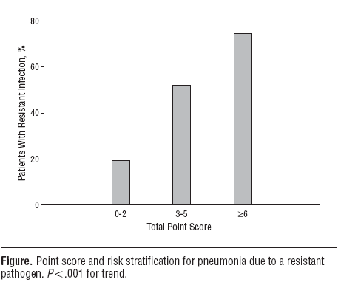
When HCAP = resistant pathogens,
predictive values of HCAP are poor
Shorr AF et al., Arch Intern Med. 2008;168(20):2205-10.
(Zilberberg, Micek, Kollef)
HCAP health care associated pneumonia

Slide 12

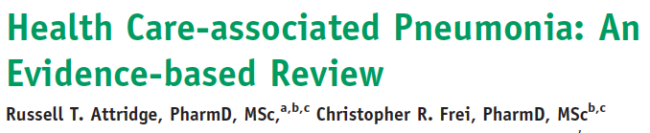
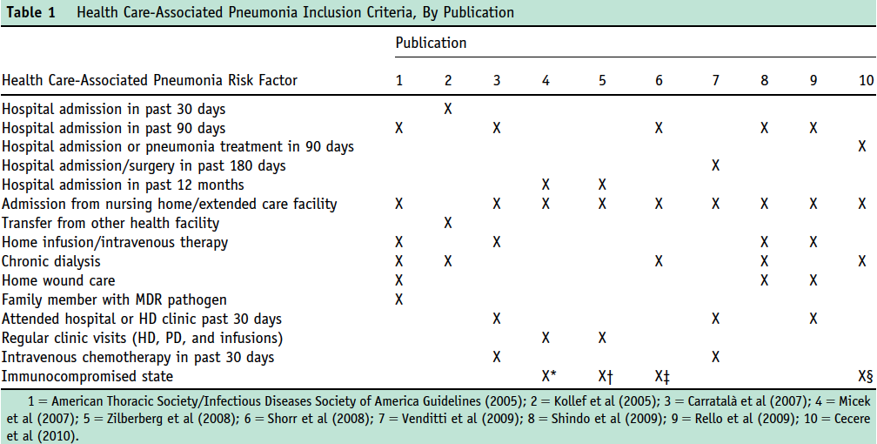
Attidge RT, Frei CR. Am J Med. 2011;124: 689-97.

Slide 13
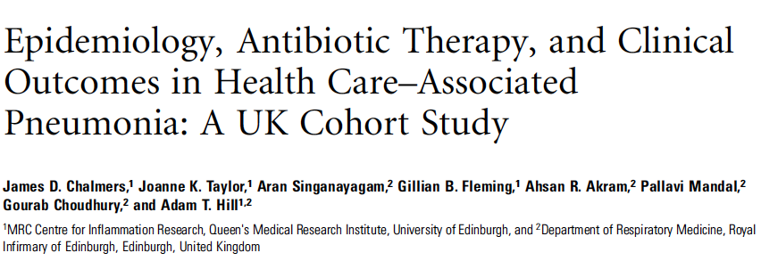
Chalmers JD, et al. CID. 2011;53(2):107-13

Slide 14
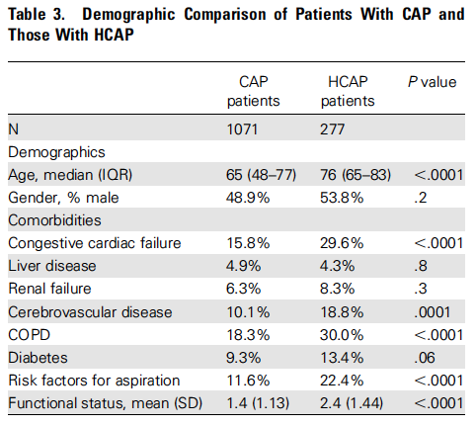
HCAP health care associated pneumonia
CAP community acquired pneumonia
COPD chronic obstructive pulmonary disease
Chalmers JD, et al. CID. 2011;53(2):107-13

Slide 15
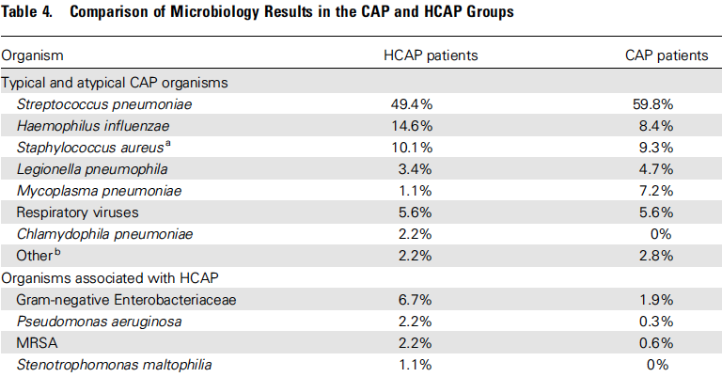
HCAP health care associated pneumonia
CAP community acquired pneumonia
Chalmers JD, et al. CID. 2011;53(2):107-13

Slide 16
HCAP is common in the United Kingdom and is associated with a high mortality.
This increased mortality was primarily related to underlying patient-related factors rather than the presence of antibiotic-resistant pathogens
This study did not establish a clear indication to change prescribing practices in a UK cohort
HCAP health care associated pneumonia
Chalmers JD, et al. CID. 2011;53(2):107-13

Slide 17
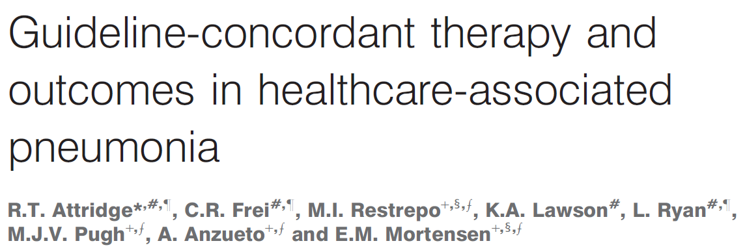

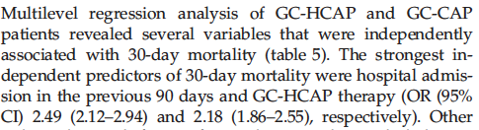
HEALTH CARE-ASSOCIATED PNEUMONIA:
Does therapy modify the outcome?
GC guideline-concordant
HCAP health care associated pneumonia
CAP community acquired pneumonia
Attridge RT et al. Eur Resp J 2011;38:878-87

Slide 18
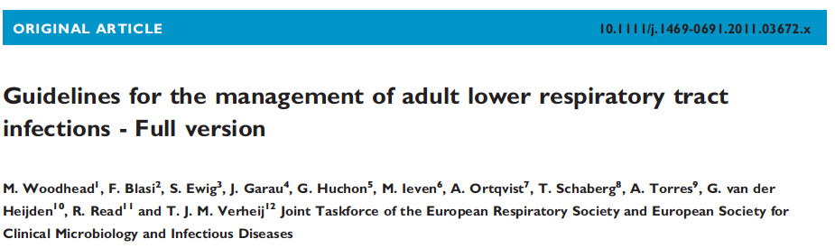
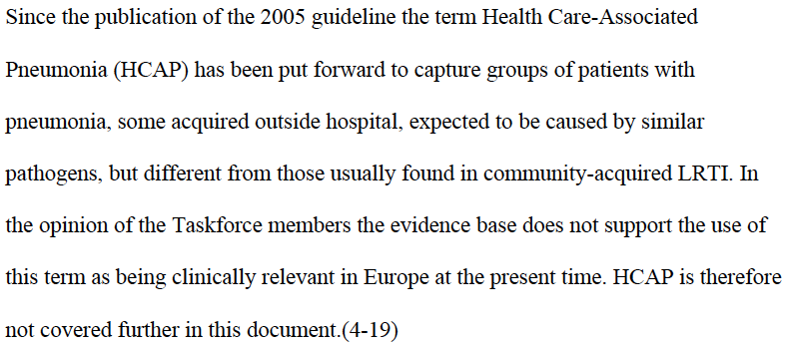
HAP
CAP
CAP community acquired pneumonia
HAP hospital acquired pneumonia
Woodhead M, et al.Clin Microbiol Infect 2011; 17(Suppl. 6): E1–E59.

Slide 19
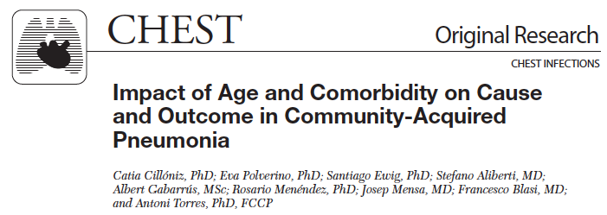
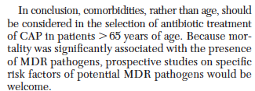
CAP community acquired pneumonia
MDR multi drug resistant
Cilloniz C et al. Chest. 2013;144(3):999-1007

Slide 20
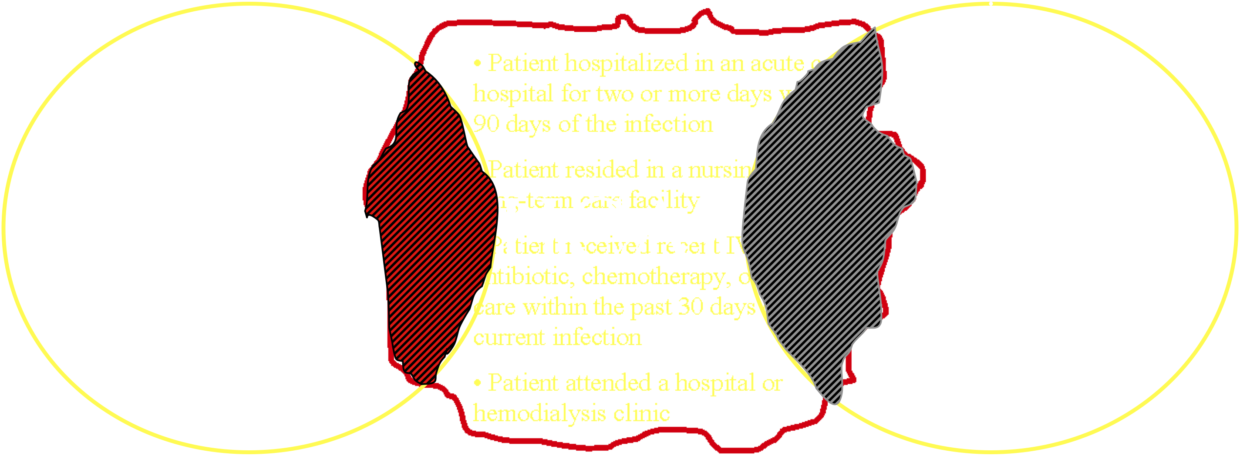
HCAP definition: pitfalls

Slide 21
The real question is:
Does HCAP accurately identify MDR?
HCAP health care acquired pneumonia
MDR multi drug resistance

Slide 22
A probabilistic approach

Slide 23
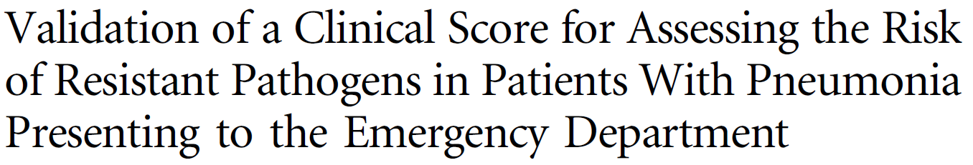


New approach: Stratify risk factors.. In the USA
Scoring system:
4: Recent hospitalization
3: Long term facility
2: Chronic Heart Disease
1: ICU admission within 24h of evaluation in the ED
ICU intensive care unit
ED emergency department
Shorr AF, et al. CID 2012;54(2):193–8

Slide 24
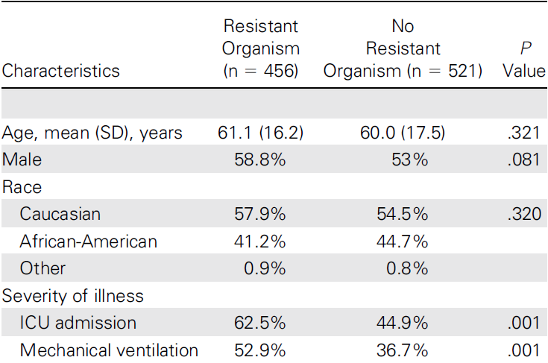
New approach: Stratify risk factors.. In the USA
cohort of patients with severe pneumonia. In fact, more than half of the patients was directly admitted to the ICU and the main pathogen isolated was methicillin-resistant S. aureus, followed by P. aeruginosa and S. pneumoniae.
Shorr AF, et al. CID 2012;54(2):193–8

Slide 25
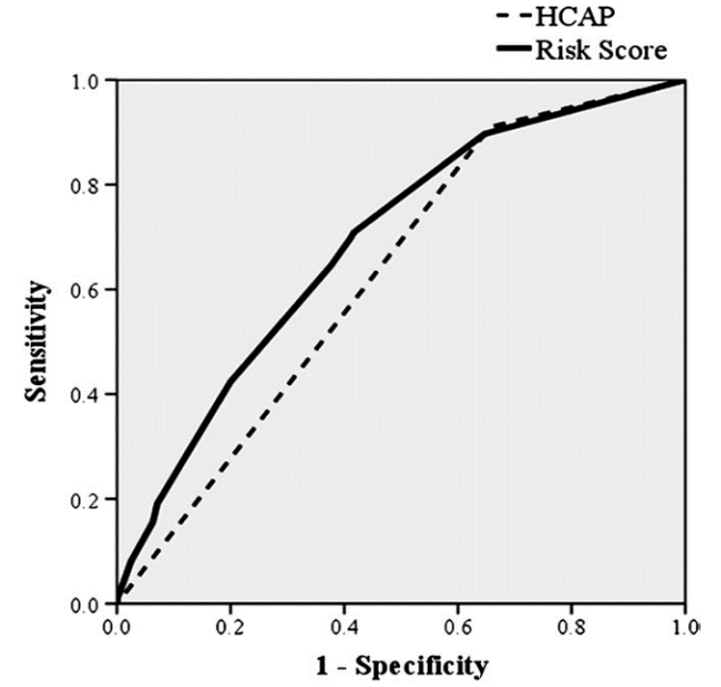
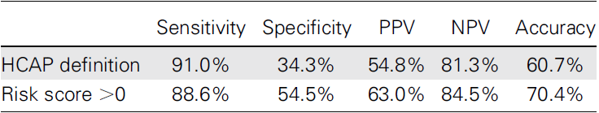
New approach: Stratify risk factors.. In the USA
HCAP health care associated pneumonia
NPV, negative predictive value
PPV, positive predictive vale
Shorr AF, et al. CID. 2012;54(2):193–8

Slide 26
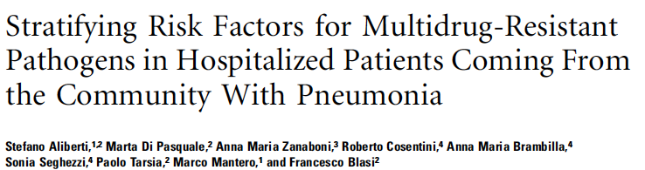
This was an observational, prospective study of consecutive patients coming from the community who were admitted to the Policlinico Hospital, Milan, Italy, with a diagnosis of pneumonia between April 2008 and April 2010.
A total of 935 consecutive patients with pneumonia were enrolled during the study period
Aliberti A, et al CID 2012;54(4):470-8.

Slide 27
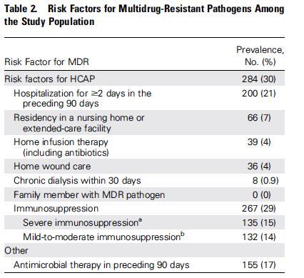
Risk Factors Analysis: MDR pathogens
MDR multi drug resustant
HCAP health care associated pneumonia
Aliberti A, et al CID 2012;54(4):470-8.

Slide 28
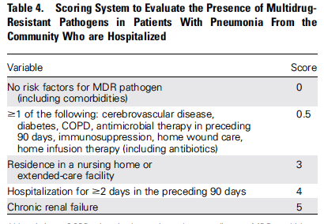
MDR multi drug resistant
COPD chronic obstructive pulmonary disease
Aliberti A, et al CID 2012;54(4):470-8.

Slide 29
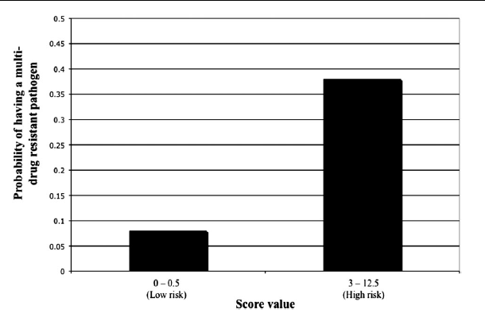
Sensitivity: 75%
Specificity: 71%
HCAP approach
Sensitivity: 78%
Specificity: 56%
HCAP health care associated pneumonia
Aliberti A, et al CID 2012;54(4):470-8.

Slide 30
Risk Factors Analysis for MDR pathogens
A probabilistic approach

Slide 31
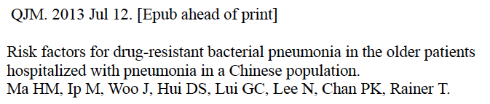
Risk Factors Analysis for MDR pathogens
A probabilistic approach
MDR multi drug resistant

Slide 32
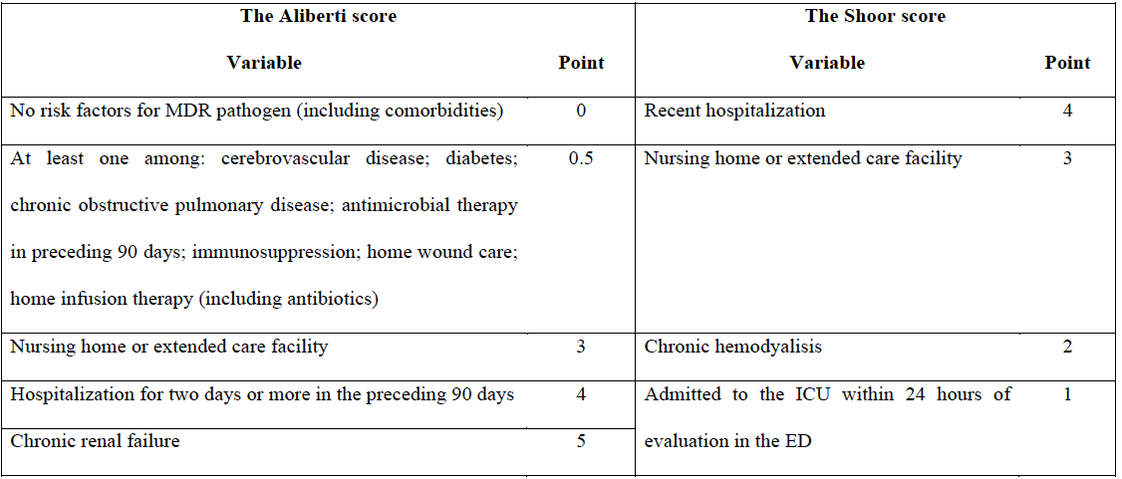
Risk Factors Analysis for MDR pathogens
A probabilistic approach...for MDR
Aliberti A, et al CID 2012;54(4):470-8.
Shorr AF, et al. CID. 2012;54(2):193–8
MDR multi drug resistant

Slide 33
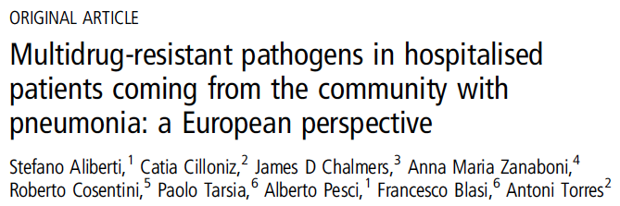
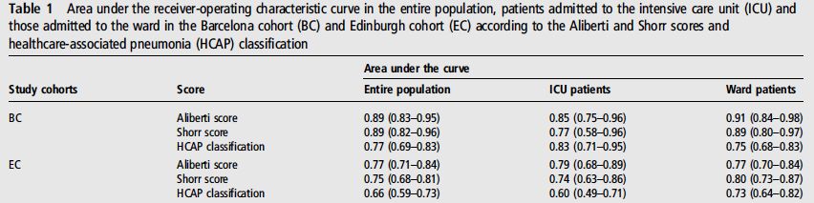
Aliberti S et al. Thorax 2013;68:997-9

Slide 34
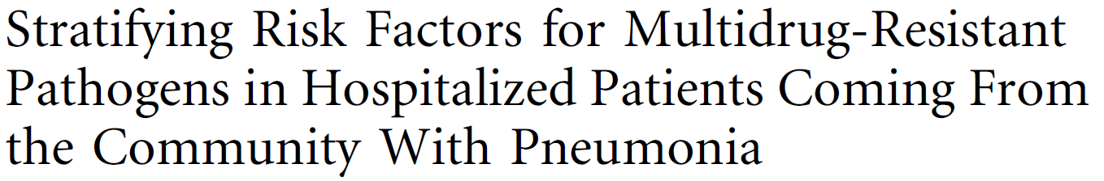
New approach: Stratify risk factors
New findings:
Different risk factors have different importance for MDR prediction
Chronic renal failure is an independent risk factor for MDR
(A window of patient’s functional status)
Patient’s targeted approach for empiric antibiotic therapy is possible
MDR multi drug resistant
Aliberti A, et al CID 2012;54(4):470-8

Slide 35
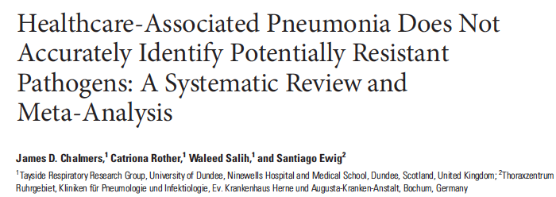
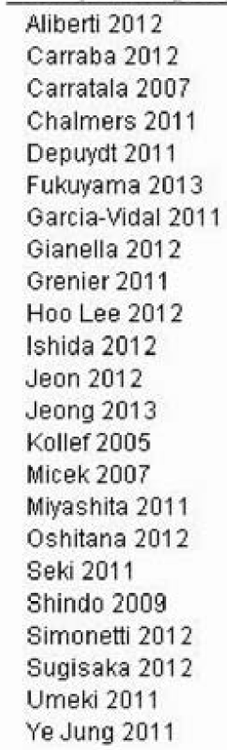
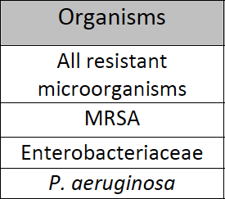
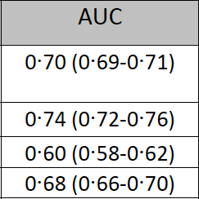
22,456 patients
Sub‐analysis by region found that HCAP performed poorly in European studies and in prospective/high quality studies.
MRSA methicillin resistant Staphylococcus aureus
AUC area under the curve
HCAP health care associated pneumonia
Chalmers JD, et al. CID. 2014;58(3)330-9.
Notes:
A systematic review and meta‐analysis of studies comparing the frequency of resistant pathogens (defined as methicillin‐resistant Staphylococcus aureus, enterobacteriaceae and Pseudomonas aeruginosa) in populations with HCAP compared to community‐acquired pneumonia(CAP). Predictive accuracy was evaluated using the area under the receiver operator characteristic curve(AUC). The frequency of pathogens in each group were pooled using a random effects model. 24 studies were included (N=22,456). Overall study quality was poor. HCAP
was associated with an increased risk of MRSA Odds Ratio (OR) 4·72 (3·69‐6·04,
enterobactericeae 2·11 (1·69‐2·63), and P.aeruginosa 2·75 (2·04‐3·72): all p<0.0001,
but these analysis were confounded by publication bias. The
discriminatory ability of HCAP for resistant pathogens was low: AUC 0·70 (0·69‐0·71)
and was lower in high quality AUC 0·66 (0·62‐0·70) and prospective studies AUC 0·64
(0·62‐0·66). After adjustment for age and co‐morbidities, mortality was not
increased in HCAP OR 1·20 (0·85‐1·70),p=0·3.

Slide 36
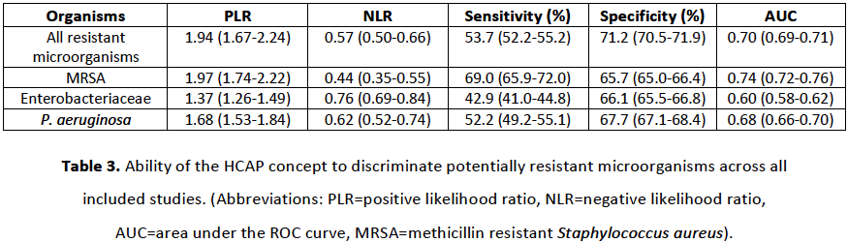
Predictive accuracy of HCAP
Notes:
So we assessed the predictive accuracy of HCAP using positive and negative likelihood ratios and the area under the curve. A test is considered to be clinically useful where there is a positive likelihood ratio of over 10, a negative likelihood ratio of less than 0.1 or an area under the curve of greater than 0.75 - and as you can see none of the analyses here reach any of those thresholds.

Slide 37
Predictive accuracy of HCAP
Notes:
All of our positive likelihood ratios are below 10,

Slide 38
Predictive accuracy of HCAP
Notes:
all of the negative likelihood ratios are above 0.1

Slide 39
Predictive accuracy of HCAP
Notes:
and none of the area under the curve values reach the 0.75 mark - with overall discriminatory ability of HCAP for predicting resistant microorganisms being low at 0.70.

Slide 40
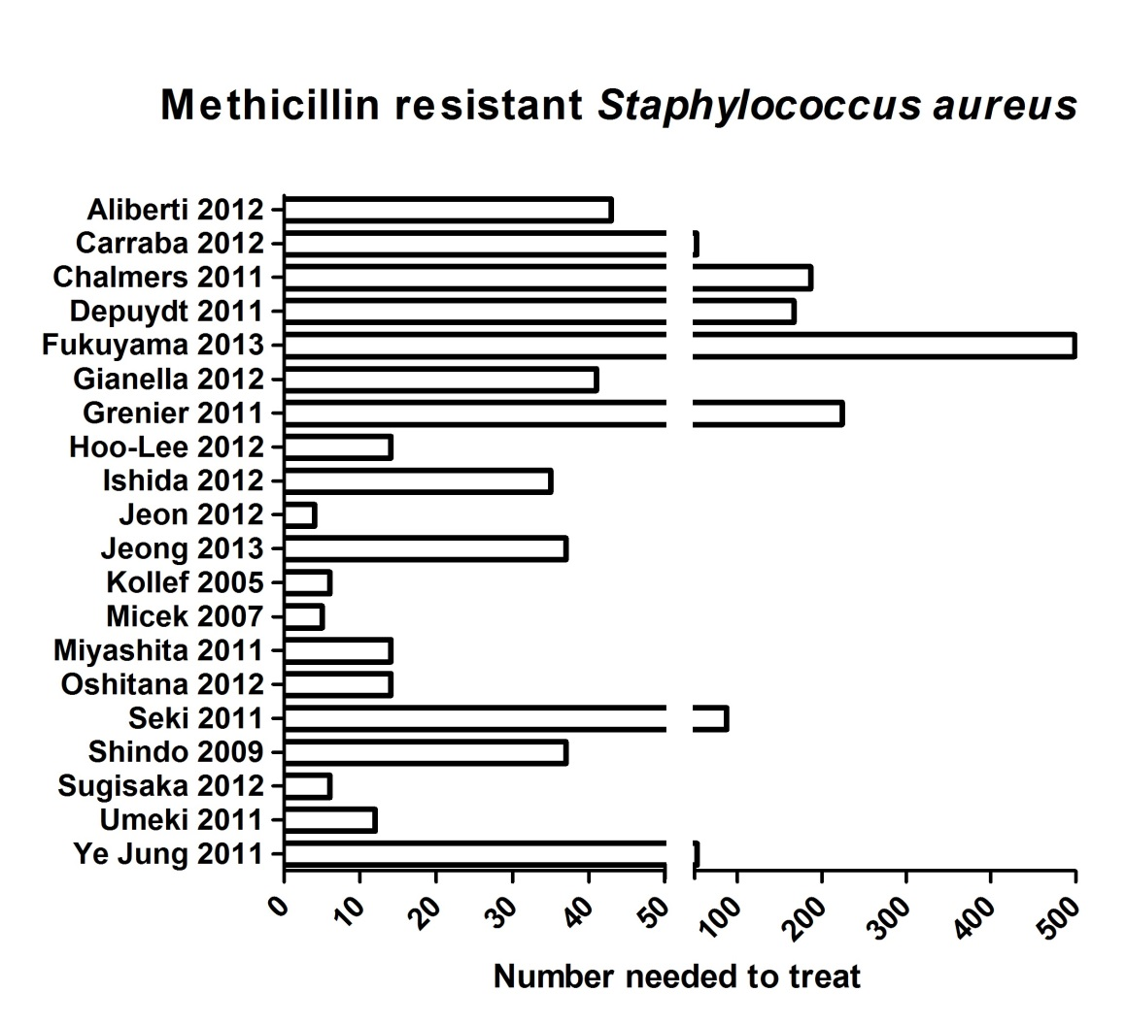
Number needed to treat
Notes:
And to put that into some clinical context for you, I then calculated numbers needed to treat. So Here we have number needed to treat values for MRSA and once again, we can see huge variation across each of the included studies. For some lower quality studies the value is very low, for example kollef, a US study, at 4 - The good quality, prospective studies, on the other hand, generally report numbers needed to treat somewhere in the hundreds. Meaning that a lot of over-treatment with broad spectrum drugs would need to be given to patients to prevent a single case of MRSA from receiving treatment.

Slide 41
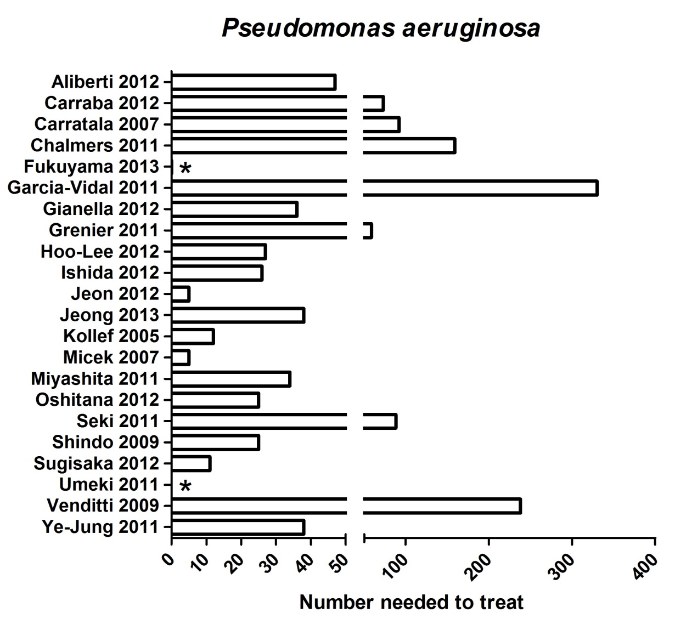
Number needed to treat
Notes:
This graph demonstrates number needed to treat values for pseudomonas, and again we see a similar pattern.

Slide 42
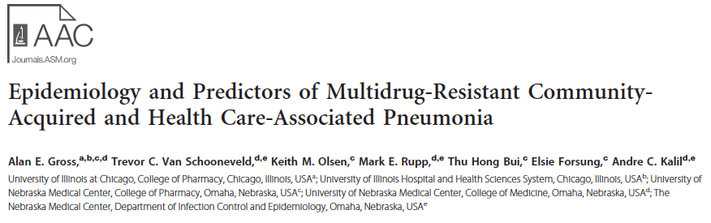
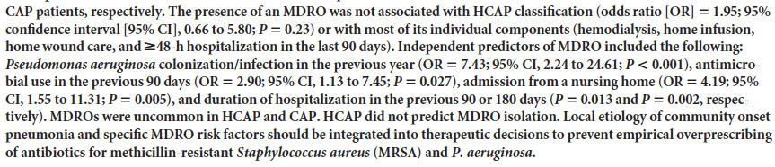

Slide 43
Empiric antibiotic therapy
HCAP healthcare associated pneumonia
CAP community-acquired pneumonia

Slide 44
Empiric antibiotic therapy
A probabilistic approach for each single pathogen
HCAP healthcare associated pneumonia
CAP community-acquired pneumonia

Slide 45

THANK YOU FOR YOUR ATTENTION !

