Slide 1


Stimulating the cGMP pathway
Marius M Hoeper
Notes:
30 min

Slide 2
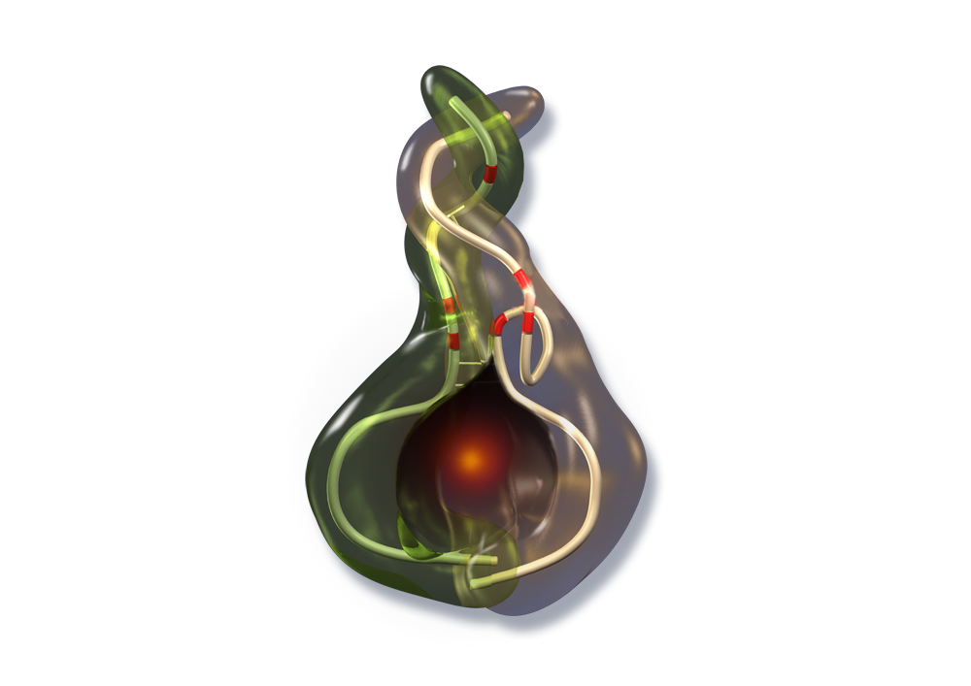

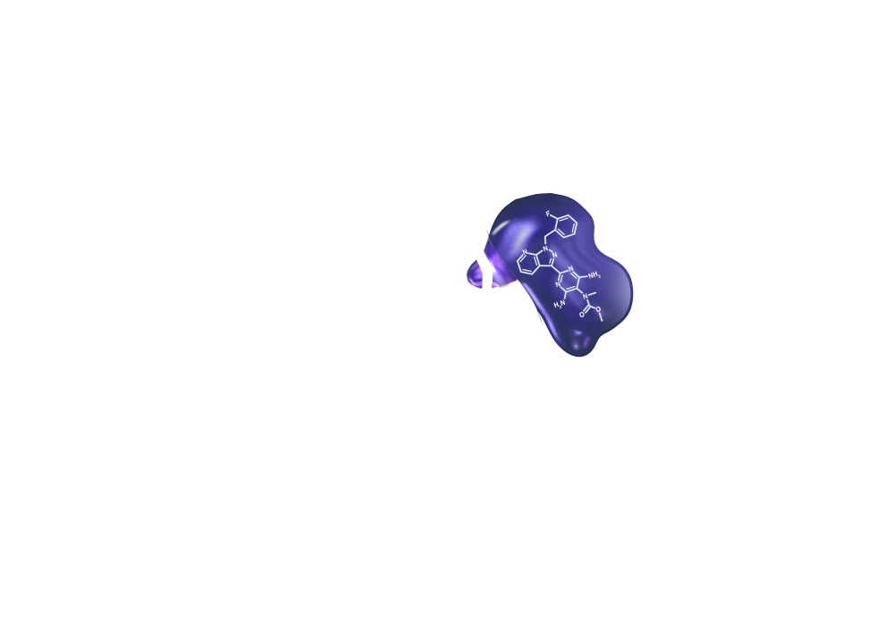




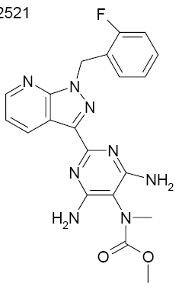
Riociguat an oral sGC Stimulator
β
α
Haem
Native sGC
Riociguat
Active site
sGC stimulator: riociguat
sGC stimulators stabilise the NO–haem complex, increasing native sGC sensitivity to NO
sGC stimulators also stimulate native sGC NO independently
cGMP, cyclic guanosine monophosphate;
GTP, guanosine triphosphate; NO, nitric oxide;
sGC, soluble guanylate cyclase

Slide 3
sGC stimulators and activators
Oxidative
stress
eNOS
O₂^{.-}
NO
L-arginine
EC
sGC-ox Fe(III) heme
sGC Fe(II) heme
sGC stimulators
sGC activators
GTP
PDE5
PDE5-Inhibitors
Cellular
response
cGMP
GMP
PVSMC

Slide 4
Riociguat phase II study:
Hemodynamic effects
All patients
CTEPH
PAH
(n = 48)
(n = 29)
(n = 19)
0
–50
–100
–150
–200
Least squares mean decrease from
baseline in PVR (dyn.sec/cm⁵)
–250
***
–300
–350
***
–400
 | Baseline mean ± SD (dyn.sec/cm⁵)
All patients | 778.0 ± 351.0
CTEPH | 732.1 ± 287.1
PAH | 846.9 ± 428.4
–450
***
–500
***p < 0.001
Bars show 95% confidence intervals
PVR, pulmonary vascular resistance; SD, standard deviation
Ghofrani HA et al. ERJ 2010; 36:792-9

Slide 5
Riociguat phase II study: Effects on 6MWD
Titration phase
100
80
Mean increase from baseline
in 6MWD (m)
60
40
20
0
0
2
4
6
8
10
12
Duration of treatment (weeks)
 | Baseline, mean ± SD (m) | Least squares mean change from baseline after 12 weeks and 95% CI (m)
All patients (n=72) | 354.4 ± 111.0 | +68.4 (51.2–85.6)***
CTEPH (n=41) | 382.9 ± 88.1 | +64.3 (44.2–84.4)***
PAH (n=31) | 316.7 ± 127.4 | +73.5 (42.7–104.3)***
***p < 0.001
Bars show standard error of the mean
6MWD, 6-minute walking distance
Ghofrani HA et al. ERJ 2010; 36:792-9

Slide 6


Riociguat Phase 3 studies
Phase 3 RCT of an sGC stimulator in PAH
Phase 3 RCT of an sGC stimulator in inoperable CTEPH
RCT, randomized controlled trial; sGC, soluble guanylate cyclase.
Ghofrani HA et al. N Engl J Med 2013; 369: 330 - 340
Ghofrani HA et al. N Engl J Med 2013; 369: 319 -329

Slide 7
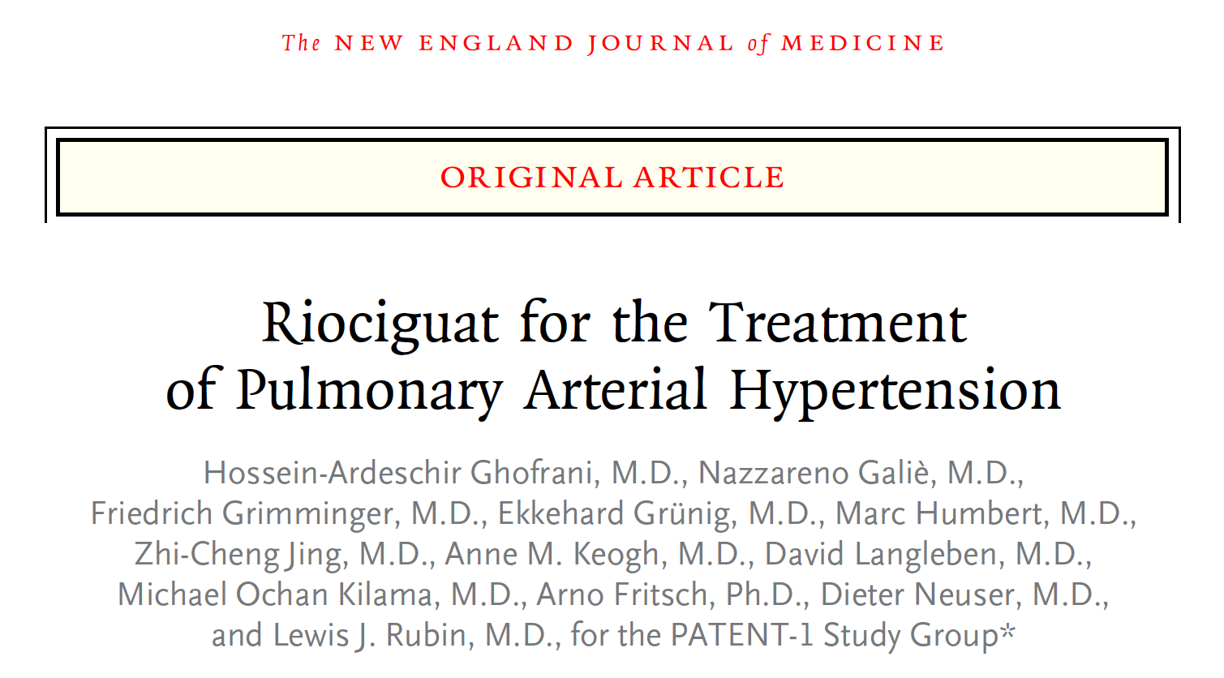


Slide 8
The PATENT study - Objective
  To evaluate the efficacy and tolerability of riociguat in the treatment of patients with PAH who were treatment naïve or on stable treatment with an ERA or non-intravenous PCA
Ghofrani HA et al. N Engl J Med 2013;369:330-40

Slide 9
The PATENT study - Design
Analysis of primary and secondary endpoints at Week 12
PATENT-2
Randomization
multiple
PATENT-1
Titration
8 weeks
Maintenance
4 weeks
8 weeks
4
Riociguat
up to 2.5 mg tid
Sham titration
Long-term open-label
phase at chronic dose
up to 2.5 mg
2
Placebo
Titrate
up to 2.5 mg tid
1
Riociguat
up to 1.5 mg tid
Titrate
up to 2.5 mg tid
Exploratory dose arm
20-week blinded phase
Ghofrani HA et al. N Engl J Med 2013;369:330-40

Slide 10
Riociguat uptitration in PATENT
  Dose was titrated every 2 weeks according to the peripheral systolic blood pressure measured at trough before intake of the morning dose
    ≥95 mmHg: increased dose
    90–94 mmHg: maintained dose
    <90 mmHg without symptoms of hypotension: reduced dose
    <90 mmHg with symptoms of hypotension: treatment discontinued for 24 hours and restarted at a 0.5 mg lower dose
2.5 mg tid
2.5 mg tid
2.0 mg tid
2 weeks
2.0 mg tid
1.5 mg tid
2 weeks
1.5 mg tid
1 mg tid
2 weeks
1.0 mg tid
2 weeks
0.5 mg tid
Ghofrani HA et al. N Engl J Med 2013; 369: 330 - 340

Slide 11
The PATENT study - Outcomes
  Primary outcome: Change in 6MWD
  from baseline at week 12
  Secondary outcomes:
    Pulmonary vascular resistance
    NT-proBNP
    WHO functional class
    Time to clinical worsening
    Borg dyspnea score
    Quality of life assessments
    Safety variables
Ghofrani HA et al. N Engl J Med 2013;369:330-40

Slide 12
The PATENT study – Inclusion criteria
  Age 18–80 years
  Symptomatic PAH (WHO group 1)
    Idiopathic PAH
    Familial PAH
    Associated PAH due to congenital heart disease (if surgically corrected)
    Associated PAH due to connective tissue disease
    Associated PAH due to portal hypertension with liver cirrhosis
    Associated PAH due to anorexigen or amphetamine use
  6MWD at baseline 150–450 m
  PVR >300 dyn∙sec∙cm^{–5} and mPAP ≥25 mmHg
  Treatment naïve or on stable treatment with an ERA or PCA
  (oral, inhaled, or subcutaneous) for ≥3 months
Ghofrani HA et al. N Engl J Med 2013;369:330-40

Slide 13
The PATENT study – Baseline characteristics
 | Riociguat (n=254) | Placebo (n=126)
Mean age, years | 51 | 51
Female, % | 80 | 78
Mean PVR, dyn∙s∙cm^{–5} | 791 | 834
mPAP, mmHg | 46.9 | 48.9
Mean 6MWD, m | 361 | 368
WHO FC I/II/III/IV, % | 2/43/55/<1 | 3/48/46/2
61%
25%
8%
6%
50%
44%
6%
Ghofrani HA et al. N Engl J Med 2013;369:330-40

Slide 14
The PATENT study – Dose after 12 weeks
Ghofrani HA et al. N Engl J Med 2013;369:330-40

Slide 15
The PATENT study – Primary endpoint
Placebo-corrected treatment effect = 36 m (95% CI: 20–52 m; p<0.0001)
40
n=235
n=233
n=241
30
n=243
*
n=254
n=247
20
n=111
Mean change from baseline
in 6MWD (m)
10
n=116
n=117
n=121
n=112
0
*
n=126
-10
Riociguat
Placebo
Observed
Imputed
*
0
2
4
6
8
10
12
Week
Ghofrani HA et al. N Engl J Med 2013;369:330-40

Slide 16
The PATENT study –
Treatment-naive vs pretreated
Primary endpoint: entire population
(n=254/126)
Naïve population (n=123/66)
+38 m
(95% CI: 15–62 m)
+36 m
p<0.0001
(95% CI: 20–52 m)
Pretreated population (n=131/60)
+34 m
(95% CI: 15–56 m)
Ghofrani HA et al. N Engl J Med 2013;369:330-40

Slide 17
The PATENT study –
Background therapy and change in 6MWD
Pretreated population
(n=131/60)
ERA population (n=113/54)*
+24 m
(95% CI: 5–47 m)
+34 m
(95% CI: 15–56 m)
PCA population (n=20/7)ª
+106 m
(95% CI: 27–176 m)
Ghofrani HA et al. N Engl J Med 2013;369:330-40

Slide 18
The PATENT study – secondary endpoints
Parameter | Riociguat vs placebo; p value
PVR | <0.0001
NT-proBNP | <0.0001
WHO FC | 0.0033
Time to clinical worsening | 0.0046
Borg dyspnea score | 0.0022
EQ-5Dª | 0.0660
LPHª | 0.0019
Ghofrani HA et al. N Engl J Med 2013;369:330-40

Slide 19
The PATENT study –
Changes in hemodynamics and NT-proBNP
Parameter | Riociguat |  | Placebo |  | Placebo-corrected LS-mean difference | Riociguat vs placebo; p value
 | Baseline | Mean change from baseline | Baseline | Mean change from baseline
PVR, dyn·s·cm⁻⁵ | 791 | −223 (−28%) | 834 | −9 (−1%) | −226 | <0.0001
mPAP, mmHg | 47.1 | −3.9 (−8%) | 48.9 | −0.5 (−1%) | −3.8 | 0.0002
CI, L/min/m² | 2.52 | +0.54 (+21%) | 2.49 | −0.02 (−1%) | +0.56 | <0.0001
NT-proBNP, ng/L | 1027 | −198 (−19%) | 1228 | +232 (+19%) | −432 | <0.0001
Ghofrani HA et al. N Engl J Med 2013;369:330-40

Slide 20
The PATENT study –
NYHA class
Functional class improvement (p=0.0033)
 | Riociguat | Placebo
Improved, % | 21 | 14
Stable, % | 76 | 71
Deteriorated, % | 3 | 14
Ghofrani HA et al. N Engl J Med 2013;369:330-40

Slide 21
The PATENT study –
Adverse events
Adverse event (treatment emergent) | Riociguat (n=254) | Placebo (n=126)
Ten most frequently reported AEs, n (%)
Headache | 69 (27) | 25 (20)
Dyspepsia | 48 (19) | 10 (8)
Peripheral edema | 44 (17) | 14 (11)
Nausea | 40 (16) | 16 (13)
Dizziness | 40 (16) | 15 (12)
Diarrhea | 35 (14) | 13 (10)
Nasopharyngitis | 26 (10) | 14 (11)
Dyspnea | 16 (6) | 14 (11)
Cough | 12 (5) | 13 (10)
Vomiting | 26 (10) | 11 (9)
AEs of special interest, n (%)
Hypotension | 25 (10) | 3 (2)
Syncope | 3 (1) | 5 (4)
Ghofrani HA et al. N Engl J Med 2013;369:330-40

Slide 22
PATENT-2 Design
PATENT-2
98% of patients from PATENT-1 study entered PATENT-2 study (n=396, 18–80 years)
Main objective to obtain long-term safety and efficacy data
8-week
blinded phase
Sham titration
Titrate
up to 2.5 mg tid
Long-term open-label
phase at chronic dose
up to 2.5 mg
Titrate
up to 2.5 mg tid

Slide 23
Change in 6MWD in PATENT-2
Former riociguat individual titration
Former riociguat capped dose
Former placebo
Observed
Observed
Observed
×
Imputed
Imputed
Imputed
×
×
60
50
40
30
20
10
0
×
×
×
Mean change from baseline
in 6MWD (m)
Sham titration/titration
Baseline
12 weeks
12 weeks
1 year
Patient-1
Patient-2

Slide 24
Results of PATENT-2
Efficacy
  Sustained improvements seen across treatment groups:
    Increased exercise capacity
    36% of patients improved by at least one FC
Safety and tolerability
  Riociguat was well tolerated with a good long-term
  safety profile
  Syncope was the most common drug-related serious AE (n=5, 1%)

Slide 25
PATENT-Plus study negativ
Rationale – To assess the safety and efficacy of a riociguat - PDE 5 inhibitor combination in PAH
Design – Placebo-controlled RCT, n=18 (2:1)
Phase 1 – blinded, 12 weeks, higher number a hypotensive episodes with combo therapy, no added efficacy
Phase 2 – Open label extension, increasing number of discontinuations for hypotension and other side-effects
Do not combine PDE-5 inhibitors and Riociguat!
Galiè N et al., presented at ATS 2013

Slide 26

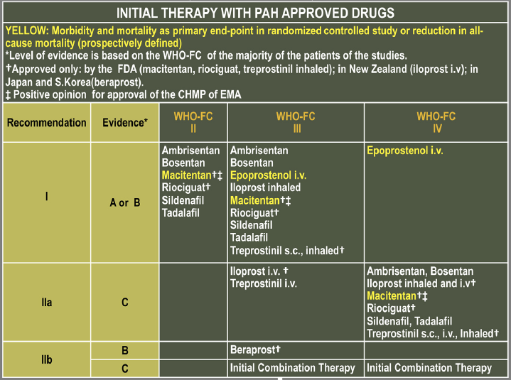
17:20 Hannover 18:35 München LH2099 10h25
€ 2200.54
€ 3785.54
6 Plätze
21:45 München 06:45+1 Dubai LH638
Galiè N et al. J Am Coll Cardiol 2013;62:D60-72

Slide 27
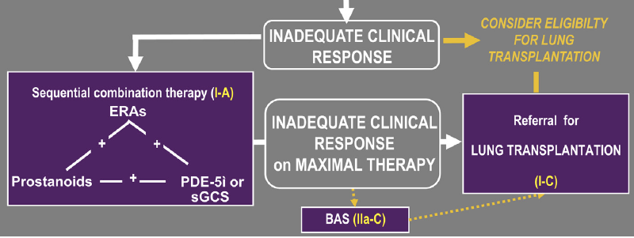
17:20 Hannover 18:35 München LH2099 10h25
€ 2200.54
€ 3785.54
6 Plätze
21:45 München 06:45+1 Dubai LH638
Galiè N et al. J Am Coll Cardiol 2013;62:D60-72

Slide 28
The RESPITE study
The RESPITE study is currently addressing the safety and efficacy of riociguat in patient with PAH demonstrating an insufficient treatment response to PDE-5 inhibitors

Slide 29
Conclusions from the PATENT studies
Riociguat demonstrated efficacy in PATENT-1
    In both treatment-naïve and pretreated PAH patients, riociguat caused significant improvements compared with placebo:
    In the primary endpoint (6MWD after 12 weeks in patients with PAH compared with placebo)
    Across clinically meaningful secondary endpoints, including PVR, NT-proBNP,
    WHO FC, TTCW, Borg dyspnea score
Riociguat was generally well tolerated with a good safety profile in patients with PAH
The efficacy benefits were improved and sustained across multiple endpoints in the long-term extension study (PATENT-2)
Riociguat should not be combined with PDE-5 inhibitors (PATENT-plus)

Slide 30
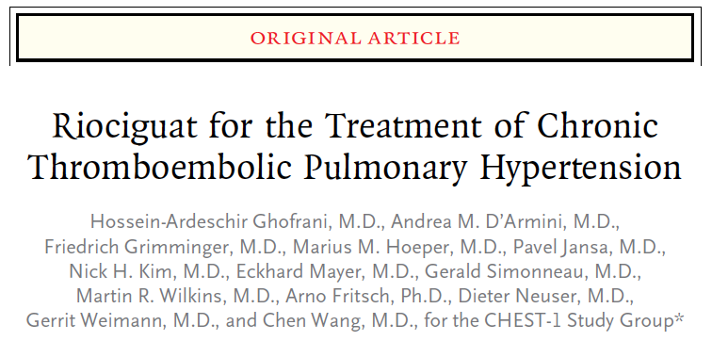
N Engl J Med. 2013;369:330-40

Slide 31
CHEST – Inclusion criteria
  Age 18–80 years
  Patients with inoperable CTEPH (WHO Group 4, independently assessed) or persisting/recurrent PH after PEA
    Inoperable in opinion of experienced surgeon, with PVR >480 dyn∙s∙cm^{–5} measured ≥3 months after start of full anticoagulation and mPAP >25 mmHg, or
    Recurrent or persistent PH following surgical treatment, with PVR >480 dyn∙sec∙cm^{–5} measured ≥6 months after surgery
  6MWD at baseline 150–450 m
  Adjudication of inoperability by either a central adjudication committee or
  preapproved regional expert endarterectomy center
    Based on a pulmonary angiogram and/or 64-slice spiral CT
    24/7 availability of operability-assessment board
  No other “PAH” drugs allowed

Slide 32
Riociguat for nonoperable CTEPH
CHEST-2
Adjudication
Randomization
CHEST-1
Titration
8 weeks
Maintenance
8 weeks
8 weeks
2
Riociguat
up to 2.5 mg TID
Sham titration
Long-term open-label phase at chronic dose up to 2.5 mg
1
Placebo
Titrate
up to 2.5 mg TID
24 week blinded phase
Ghofrani HA et al. NEJM 2013;369:330-40

Slide 33
CHEST – Patient characteristics
Characteristic | Riociguat (n=173) | Placebo (n=88)
Mean age, years | 59 | 59
Female, % | 68 | 61
Mean PVRª, dyn∙s∙cm^{–5} | 796 | 815
mPAPª, mmHg | 45.0 | 44.0
Mean 6MWD, m | 342 | 356
WHO FC I/II/III/IV, % | 2/32/62/5 | 0/28/68/2^{b}
Inoperable/persistent, % | 70/30 | 77/23
Ghofrani HA et al. NEJM 2013;369:330-40

Slide 34
Maximum dose of riociguat reached in the majority of patients
Ghofrani HA et al. NEJM 2013;369:330-40

Slide 35
Riociguat for nonoperable CTEPH
Placebo-corrected treatment effect = +46m (95% CI: 26–66m; p<0.0001)
60
n=159
Riociguat
Placebo
n=157
50
n=158
40
n=162
*
n=173
n=167
30
n=168
20
Changes from baseline in 6MWD (m)
n=86
10
n=84
n=88
n=87
n=82
n=83
0
*
n=88
-10
*
Observed
Imputed
0
2
4
6
8
10
12
14
16
Week
Ghofrani HA et al. NEJM 2013;369:330-40

Slide 36
Effects on 6MWD more pronounced in inoperable than in persistent CTEPH
Primary endpoint: entire population
(n=173/88)
Population with persistent/
recurrent PH after PEA (n=52/20)
+27 m (95% CI: -10–63 m)
+46 m
p<0.0001
(95% CI: 25–67 m)
Inoperable population (n=121/68)
+54 m
(95% CI: 29–79 m)
Ghofrani HA et al. NEJM 2013;369:330-40

Slide 37
Riociguat for nonoperable CTEPH
Parameter | CHEST- 1
PVR | p<0.0001
NT-proBNP | p<0.0001
WHO FC | p<0.0026
Clinical worsening* | p=0.1724
Borg dyspnea score* | p=0.0035
EQ-5D* | p<0.0001
Ghofrani HA et al. NEJM 2013;369:330-40

Slide 38
Effects of Riociguat on hemodynamics and NT-proBNP in CTEPH
Parameter | Riociguat |  | Placebo |  | Placebo-corrected LS-mean difference | Riociguat vs placebo; p value
 | Baseline | Mean change from baseline | Baseline | Mean change from baseline
PVR, dyn·s·cm⁻⁵ | 791 | −226 (−29%) | 779 | +23 (+3%) | −246 | <0.0001
mPAP, mmHg | 45.2 | −4.3 (−10%) | 44.4 | +0.8 (+2%) | −5.0 | <0.0001
CI, L/min/m² | 2.26 | +0.45 (+20%) | 2.19 | −0.01 (0%) | 0.47 | <0.0001
NT-proBNP, ng/L | 1508 | −291 (−19%) | 1706 | +76 (+4%) | −444 | <0.0001
Ghofrani HA et al. NEJM 2013;369:330-40

Slide 39
Effects of Riociguat on FC and clinical worsening in CTEPH
Significant functional class improvement (p=0.0026)
 | Riociguat | Placebo
Improved, % | 33 | 15
Stable, % | 62 | 78
Deteriorated, % | 5 | 7
Clinical worsening
 | Riociguat | Placebo
Number of patients with clinical worsening, n (%) | 4 (2.3) | 5 (5.7)
Hospitalization due to PH | 0 | 1 (1.1)
Start of new PH treatment | 2 (1.2) | 1 (1.1)
Decrease in 6MWD due to PH | 1 (0.6) | 2 (2.3)
Persistent worsening of FC due to PH | 0 | 1 (1.1)
Death | 2 (1.2) | 3 (3.4)
Ghofrani HA et al. NEJM 2013;369:330-40

Slide 40
CHEST-2: Objectives and design
CHEST-2
  89% patients from CHEST-1 study entered CHEST-2 study
  (N=233, 18–80 years)
  Main objective to provide long-term data on safety and efficacy
8-week
blinded phase
Sham titration
Long-term open-label
phase at chronic dose
up to 2.5 mg
Titrate
up to 2.5 mg tid

Slide 41
CHEST-2: Change in 6MWD
Inoperable: former riociguat (n=95)
Inoperable: former placebo (n=50)
Persistent/recurrent: former riociguat (n=34)
Persistent/recurrent: former placebo (n=15)
70
60
50
40
30
20
10
0
Change from baseline
in 6MWD (m)
Sham titration/titration
CHEST-1
baseline
CHEST-1
16 weeks
CHEST-2
12 weeks

Slide 42
Adverse events in CHEST-2
AE, n (rate per 100 patient-years)# | CHEST-1 |  | CHEST-2
 | Riociguat (n=173) | Placebo (n=88) | Total (n=237)
Five most frequent AEs in CHEST-2
Nasopharyngitis | 29 (56.5) | 10 (37.7) | 86 (22.8)
Dizziness | 57 (111.1) | 13 (49.0) | 61 (16.2)
Peripheral oedema | 30 (58.5) | 20 (75.3) | 61 (16.2)
URTI | 11 (21.4) | 4 (15.1) | 40 (10.6)
Diarrhoea | 27 (52.6) | 4 (15.1) | 39 (10.3)
Syncope | 4 (7.8) | 4 (15.1) | 22 (5.8)
Hypotension | 16 (31.2) | 3 (11.3) | 17 (4.5)
Haemoptysis | 4 (7.8) | 0 | 11 (2.9)

Slide 43
Conclusions from the CHEST studies
Riociguat is the first ever drug to consistently demonstrate clinical efficacy in a placebo-controlled study in CTEPH
In patients with inoperable CTEPH or persistent/recurrent PH after PEA, riociguat caused significant improvements compared with placebo:
    In the primary endpoint (6MWD after 16 weeks in patients with CTEPH)
    Across clinically meaningful secondary endpoints, including PVR,
    NT-proBNP, and WHO FC
Riociguat was generally well tolerated with a good safety profile in patients with CTEPH
The efficacy benefits were improved and sustained in the long-term extension study (CHEST-2)
Riociguat is the first drug approved for patients with inoperable CTEPH

Slide 44
The PATENT and CHEST studies
Thank you!

Slide 45
Back-up slides

Slide 46
CHEST patient disposition
RIOCIGUAT PHASE 3 STUDIES: CHEST-1
Adverse event 1 (0.2%)
Death 4 (0.9%)
Not eligible 165 (37%)
Withdrawal of consent 15 (3.4%)
Screened n=446
Randomized
and treated
n=261
Riociguat
individual titration
n=173
Placebo
n=88
Adverse event 4 (2.3%)
Death 2 (1.2%)
Lack of efficacy 2 (1.2%)
Non-compliance 1 (0.6%)
Protocol violation 2 (1.2%)
Withdrawal of consent 2 (1.2%)
Adverse event 2 (2.3%)
Death 2 (2.3%)
Lack of efficacy 1 (1.1%)
Not
completed
n=13 (8%)
Not
completed
n=5 (6%)
Completed treatment
n=160 (92%)
1 death during follow-upª
Completed treatment
n=83 (94%)
ªSafety follow-up phase: 30 days (only for patients who did not enter CHEST-2 or who stopped study medication prematurely).
Ghofrani HA et al. N Engl J Med 2013; 369: 319 - 329.

Slide 47
The PATENT study –
Effects on time to clinical worsening
 | Riociguat (n=254) | Placebo (n=126)
Number of patients (%) with clinical worsening* | 3 (1.2) | 8 (6.3)
Hospitalization due to PH | 1 (0.4) | 4 (3.2)
Start of new PH treatment | 1 (0.4) | 5 (4.0)
Decrease in 6MWD due to PH | 1 (0.4) | 2 (1.6)
Persistent worsening of FC due to PH | 0 | 1 (0.8)
Death | 2 (0.8) | 3 (2.4)
Ghofrani HA et al. N Engl J Med 2013;369:330-40

Slide 48
CHEST – Adjudication of inoperability
CTEPH diagnosis made using ≥2 imaging methods:
    V/Q scan, pulmonary angiogram (preferred), 64-slice spiral-CT, or MRI angiogram
  Operability systematically assessed during pretreatment phase in accordance with specified criteria by either an experienced surgeon
  or central adjudication committee composed of experienced surgeons
    Assessment made by 3 (of <6) committee members or a preapproved regional expert endarterectomy center
  Inoperability defined as technical inoperability based on surgical accessibility of the organized thrombi and concordance between surgically accessible vascular obstruction and PVR
  Patients were eligible if ≥1 of the 3 adjudicators assessed the case as inoperable

Slide 49
Adverse events in CHEST-1
Adverse event (treatment-emergent) | Riociguat (n=173) | Placebo (n=88)
Ten most frequently reported AEs, n (%)
Headache | 43 (25) | 12 (14)
Dizziness | 39 (23) | 11 (13)
Peripheral edema | 27 (16) | 18 (21)
Cough | 9 (5) | 16 (18)
Dyspepsia | 31 (18) | 7 (8)
Nasopharyngitis | 26 (15) | 8 (9)
Dyspnea | 8 (5) | 12 (14)
Nausea | 19 (11) | 7 (8)
Diarrhea | 17 (10) | 4 (5)
Vomiting | 17 (10) | 3 (3)
AEs of special interest, n (%)
Hypotension | 16 (9) | 3 (3)
Syncope | 4 (2) | 3 (3)

Slide 50
Deaths in CHEST-1
There were two deaths in the riociguat arm due to:
    Heart failure
    Acute renal failure
There were three deaths in the placebo arm due to:
    Cardiopulmonary failure
    Two cases of cardiac arrest
  Only the case of acute renal failure was considered to be related to study drug by the investigator

Slide 51
CHEST-2: Safety and efficacy data
Safety
Riociguat was well tolerated with a good long-term safety profile
Eight drug-related serious AEs:
    Dizziness, presyncope, syncope (n=2), psychiatric decompensation, PH, hypotension (n=2)
  The majority of AEs were considered mild to moderate (80%)
Efficacy
Improvements seen across treatment groups:
    Increased exercise capacity
    51% of patients improved by at least one FC

Slide 52
Deaths in PATENT-1
There were two deaths in the riociguat individual titration arm due to:
    Sepsis
    Hemoptysis
There were three deaths in the placebo arm due to:
    Worsening anxiety
    Worsening PAH
    Respiratory failure
  None of the deaths were considered related to study drug by the investigators
Ghofrani HA et al. N Engl J Med 2013;369:330-40

Slide 53
PATENT-2
  Objectives
  To investigate riociguat long-term safety, tolerability, and efficacy in treatment-naïve or pretreated PAH patients
Inclusion criteria
  Completed 12 weeks of treatment in PATENT-1
  No ongoing AEs from PATENT-1 considered related to riociguat treatment
Design and outcomes
  PATENT open-label extension study
  Primary outcome
    Safety and tolerability
  Secondary outcomes
    Change in 6MWD
    (up to 4 years and 10 months)
Ghofrani HA et al. N Engl J Med 2013;369:330-40

Slide 54
CHEST-2: Objectives and design
Objectives
To investigate riociguat long-term efficacy and tolerability in inoperable CTEPH or persistent/recurrent PH after PEA
Inclusion criteria
  Completed 16 weeks of treatment in CHEST-1
  No ongoing AEs from CHEST-1 considered related to riociguat treatment
Design and outcomes
  CHEST-1 open-label extension study
  Primary outcome
    Safety and tolerability
  Secondary outcome
    Change in 6MWD (up to 5 years, 2 months and 14 days)

