Slide 1
Evaluación de la respuesta a Broncodilatadores
Aspectos Prácticos
Ricardo del Olmo
Becario Hospital Clínic i Provincial
Barcelona – España
Hospital María Ferrer
Fundación CIDEA
Buenos Aires - Argentina

Slide 2
Asma sin Tratamiento de Control Adecuado vs
Asma de Difícil Control en Hospital María Ferrer
147 pacientes, 164 internaciones consecutivas
37 pacientes (25%) en grupo 1 (TRSA) (84% mujeres).
110 pacientes (75%) grupo 2 (DTTSA) y ninguno grupo 3.
Diferencias estadísticamente significativas en
“Grupo 1 Refractaria” vs “Grupo 2 Acceso Inadecuado”
  Edad (51.3±14.9 vs. 39.8±13,5 ys., P<0.0001),
  Mas de 1 internación previa (54% vs 28%, P<0.05),
  Tabaquismo activo (5.4% vs 20% P< 0.0001),
  Sinusitis (40.5% vs 19.6% P<0.05),
  Antecedentes de enfermedad psiquiátrica (40.5% vs 22%, P<0.05) and
  Prevalencia de síntomas de RGE (63.9% vs 46% P<0.05).
  Mujeres de grupo 1 (TRSA) con mayor edad (P<0.05) y IMC (P<0.05) que grupo 2 (DTTSA).
  Sin diferencias en nivel educativo, edad de inicio del asma, Rinitis Alérgica, , nivel de ac. Láctico o FeNO.
  Sin diferencias en VEF₁ (%) al ingreso
ERSCongress Barcelona 2013

Slide 3
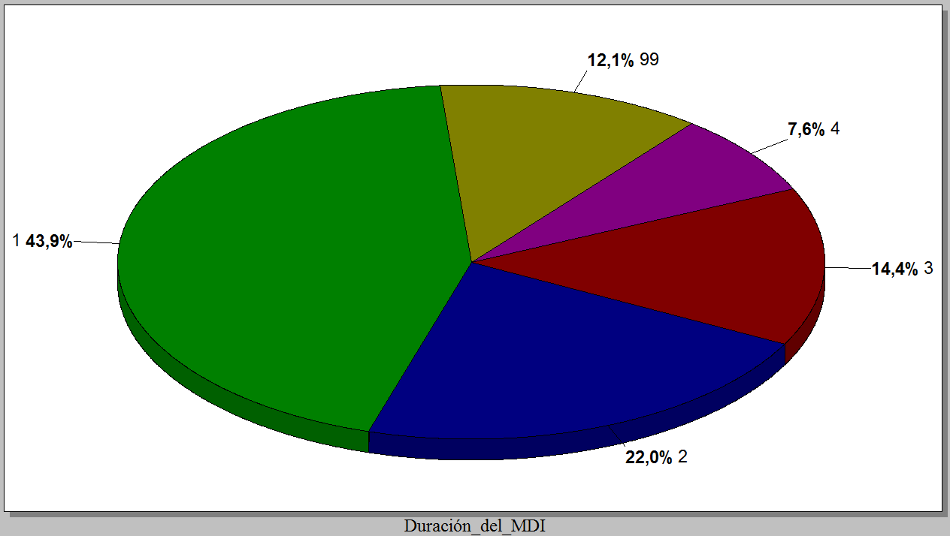
Uso de Salbutamol como Rescate
43,9% usan 400 dosis al mes
(13 disparos al día)
Sin datos
Más de 2 meses
Menos de 15 días
1-2 meses
15-30 días

Slide 4
La espirometría en Asma de Difícil Control
Control vs No control
  Impacto en la calidad de vida: ACQ consistentemente > 1.5 o ACT < 20 durante evaluación de 3 meses
  Exacerbaciones frecuentes: 2 o mas en el año previo, con uso de corticoides sistémicos > 3 días en c/evento
  Exacerbaciones graves: 1 hospitalización o Ingreso a UCI o Asistencia Respiratoria en el último año
  Deterioro funcional: VEF₁ < 80% (con ↓VEF₁/CVF) al disminuir medicación
UNO de ellos significa Pérdida del Control

Slide 5
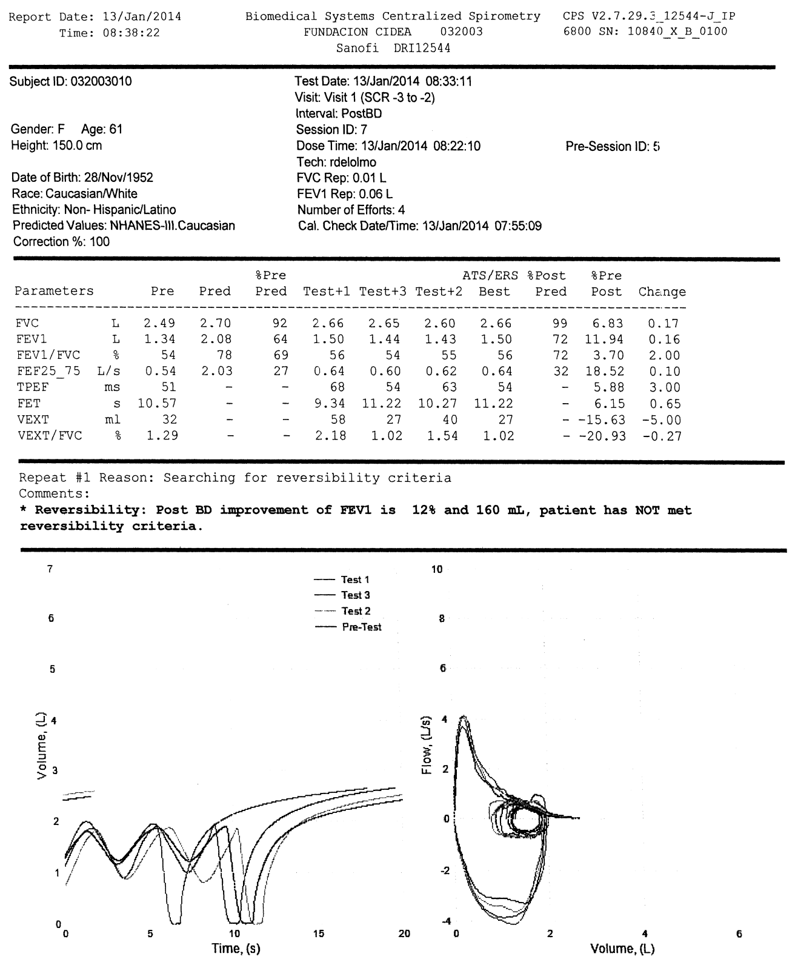
Más allá de la normativa,
¿Qué consideramos como
respuesta + a BD?

Slide 6
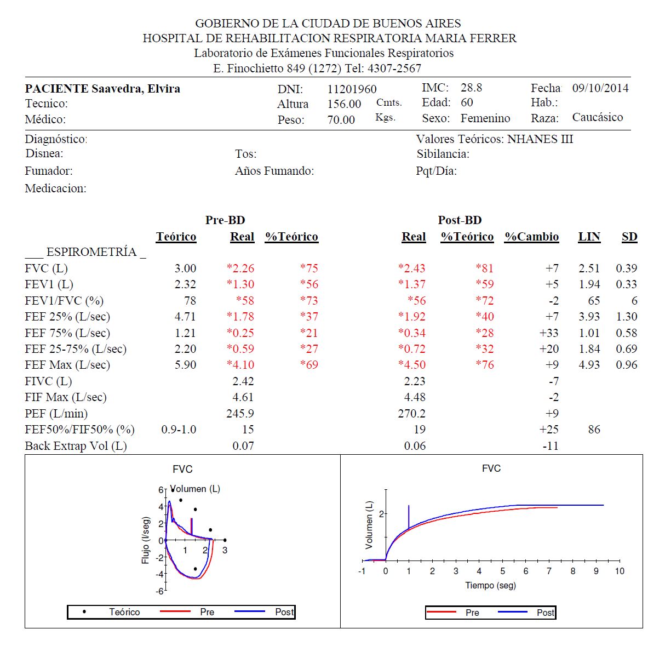

Slide 7
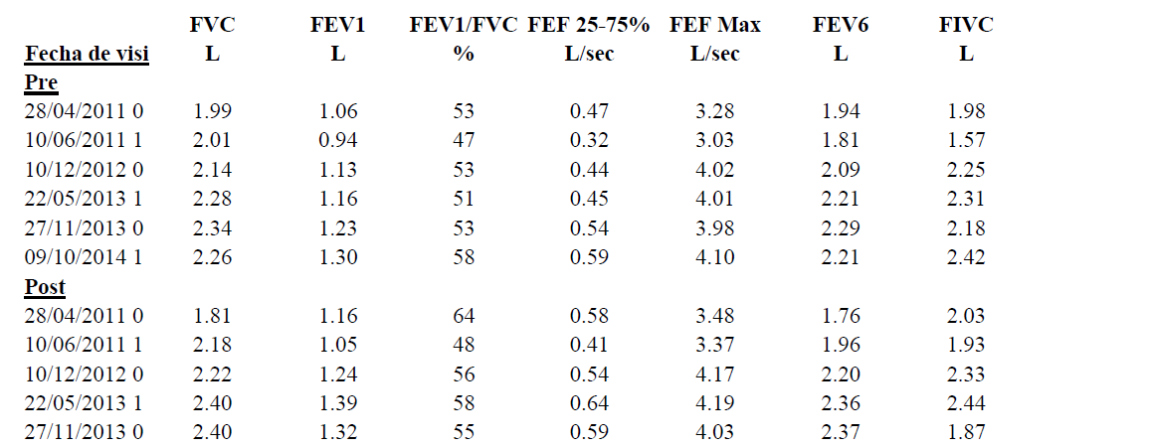
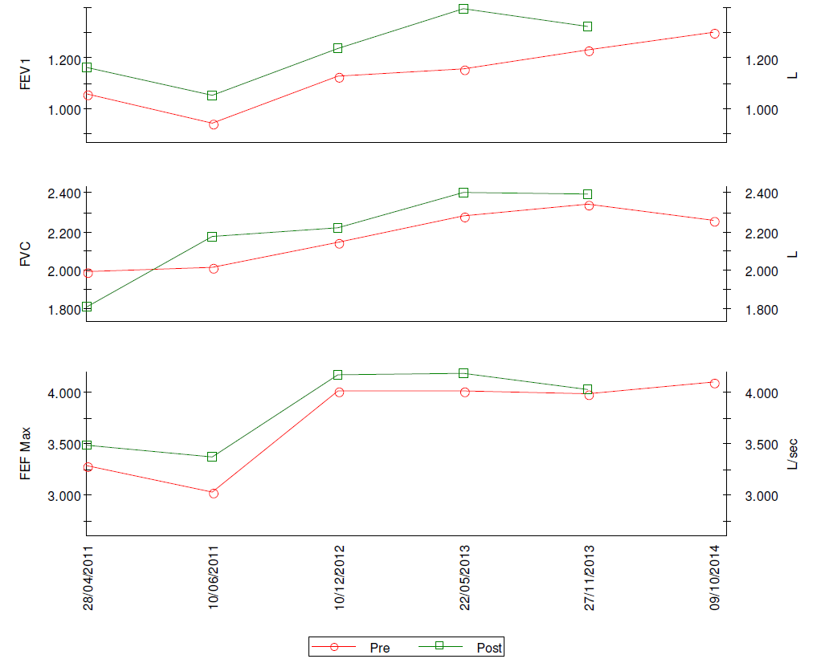

Slide 8
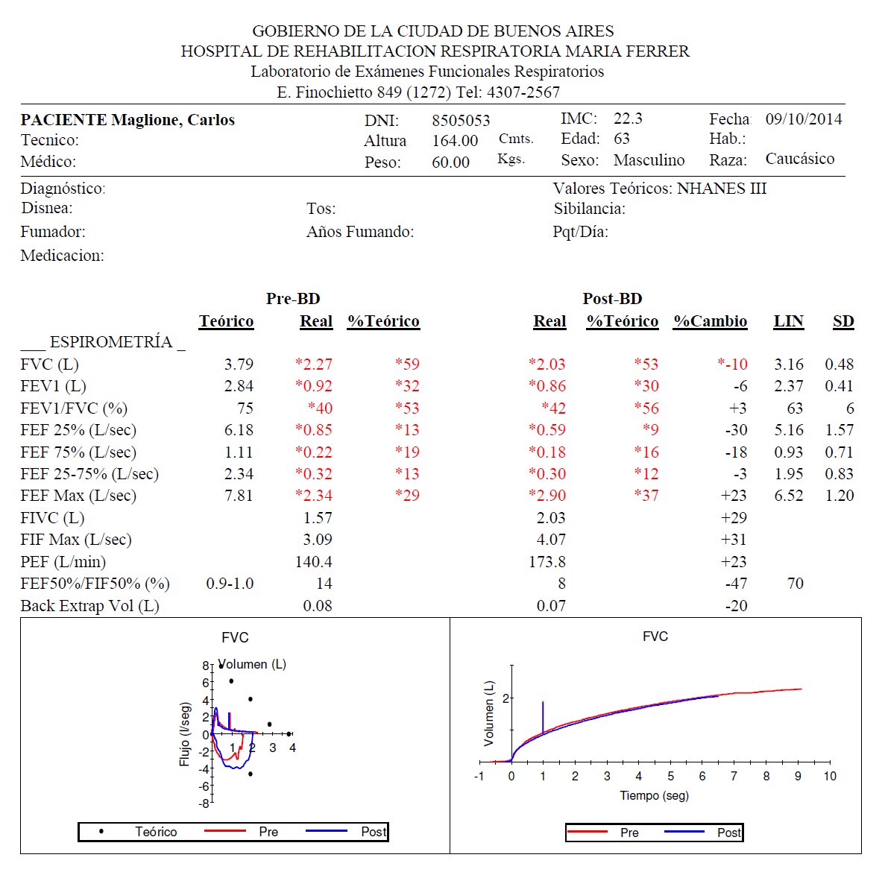

Slide 9
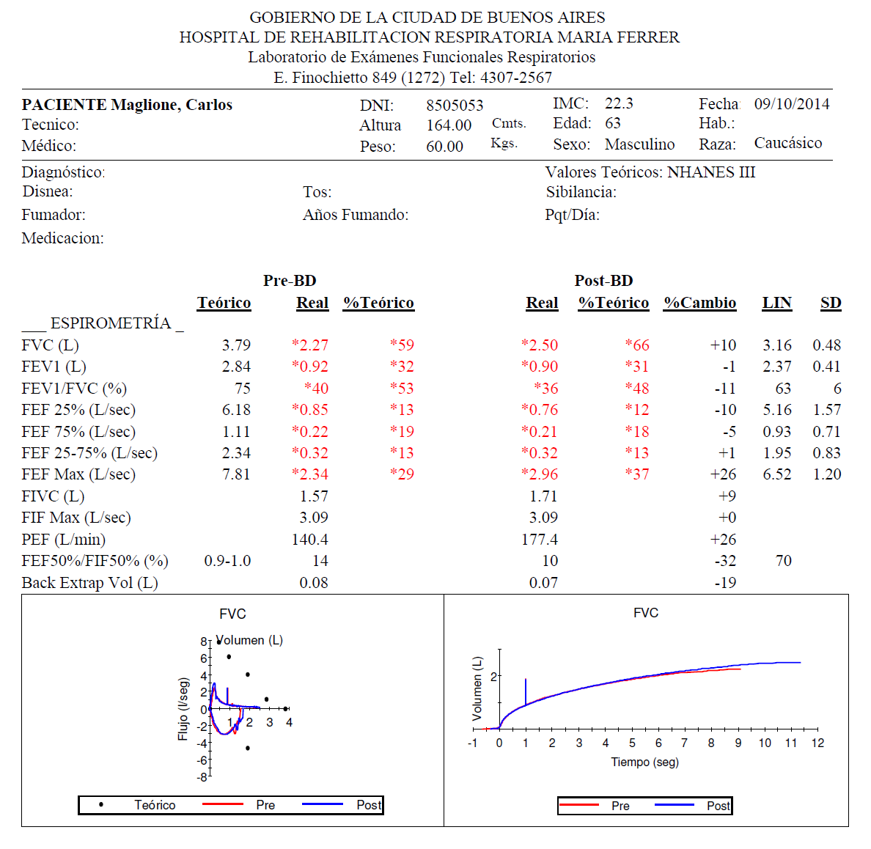
La influencia del
tiempo espiratorio

Slide 10
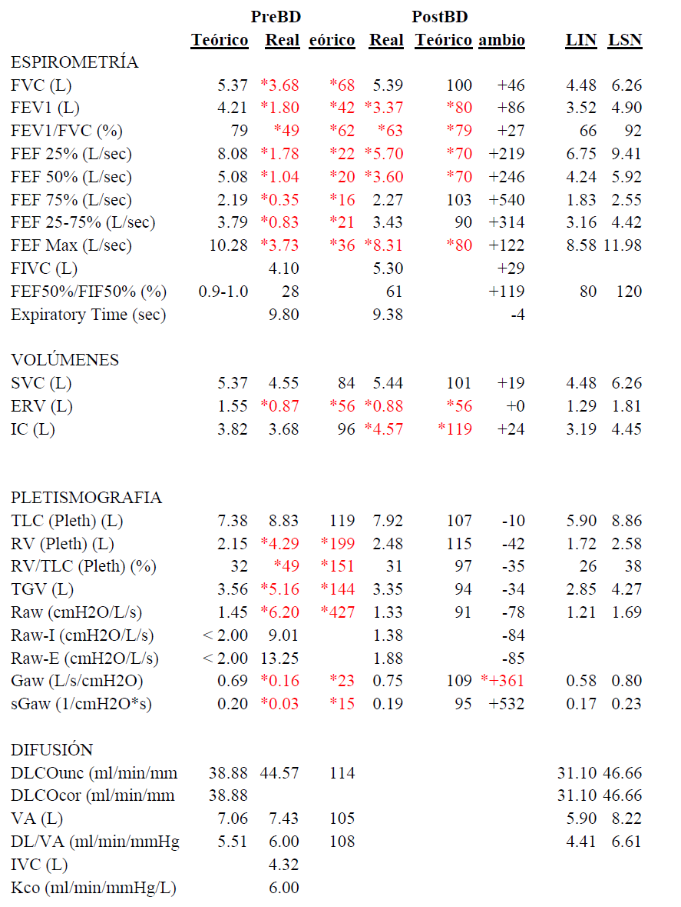
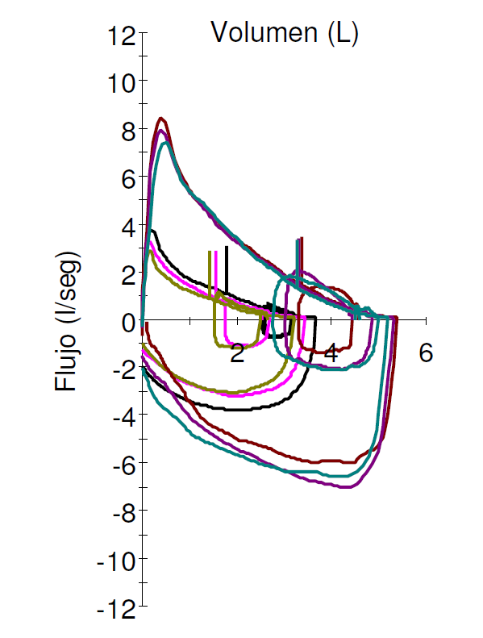
Respuesta a Tiotropio en Asma de Difícil Control
Sexo masculino, 47 años, FP+SM 1000 y Omalizumab

Slide 11
Bronchodilator response (BR) on COPD
Rodríguez Moncalvo, JJ; del Olmo, R
52 patients (33 male) 59,2+/- 8,7 year
Tobacco 46 +/- 33 pack/year
FVC 67 ± 17,7 % 2,46 ± 0,72 (L)
FEV₁ 40,4 ± 17 %
1,17± 0,49 (L)
TLC ≥ 120% on 31%
RV ≥ 130% on 65%
GOLD stage
    Mild 4%
    Moderate 42%
    Severe 37%
    Very severe 17%
BR spirometry
  FEV₁ 12%
  FVC 23%
  FEV₁ + FVC 38%
  Total 73%
BR plethismograph
  VC 63%
  IC 58%
  RV 71%
  FRC 42%
AAMR 2007

Slide 12
Hiperinflación dinámica en pacientes con EPOC
Flujo
6
Cap. Inspiratoria
EELV
Sano
4
EPOC leve/moderado
2
TLC
VR
0
Capacidad inspiratoria
Hiperinflación Dinámica
-2
-4
-6
0
1
2
3
4
Volumen

Slide 13
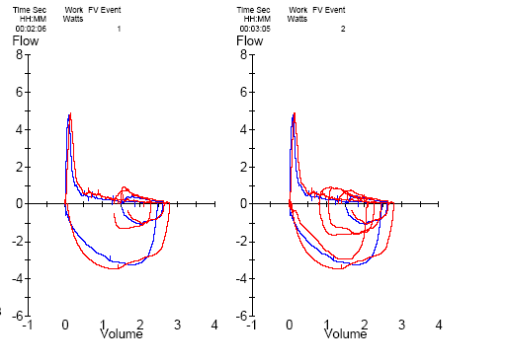
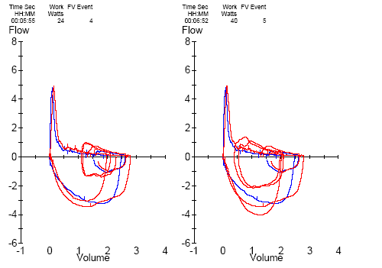
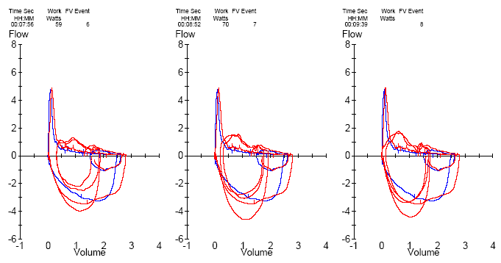
± 4 litros
± 3 litros
R del Olmo, JJ R Moncalvo EPOC. 2004

Slide 14
Tiotropium reduce la intensidad de la disnea en ejercicio vs placebo
Tiotropium
Placebo: Exercise
Recovery
Placebo
Maximal
10
V
er
y
, very severe
Tiotropium: Exercise
Recovery
8
V
ery severe
†
Severe
6
Dyspnea intensity (Borg scale)
†
Somewhat severe
†
Moderate
4
†
Slight
†
2
V
ery slight
Nothing at all
0
†
0
2
4
6
8
10
12
14
16
18
20
Exercise time (mins)
*p<0.05, †p<0.01 difference between groups
Maltais et al. Chest 2005
Notes:
2.25 h After Dosing: Dyspnea intensity during exercise was significantly decreased with tiotropium compared with placebo on all test days (p 0.002 vs placebo on day 0; p 0.001 on days 21 and 42); adjusted mean dyspnea intensity during exercise on day 42 was 4.60 0.16 Borg units in the tiotropium group, compared with 5.65 0.16 Borg units in the placebo group.
8 h After Dosing (Day 42): The adjusted mean dyspnea intensity during exercise was 5.54 0.17 Borg units with tiotropium, compared with 6.51 0.18 Borg units with placebo (p 0.001).
Reference
Maltais F, Hamilton A, Marciniuk D, Hernandez P, Sciurba FC, Richter K, Kesten S, O’Donnell D. Improvements in symptom-limited exercise performance over 8h with once-daily tiotropium in patients with COPD. Chest 2005; 128: 1168-78.

Slide 15
Tiotropium incrementa el tiempo de resistencia vs placebo
900
†
†
800
Tiotropium 18 μg
*
Placebo
700
2.25h after dosing on Days 0, 21 and 42
600
Endurance time (sec)
500
400
300
–5
Baseline
0
21
42
Days
*p<0.05, †p<0.01
Maltais et al. Chest 2005
Notes:
2.25 h After Dosing: In the tiotropium group, there was an increase in ET after the first dose of trial medication (day 0), with a further increase after 3 weeks of treatment (day 21) that was maintained after 6 weeks (day 42). In the placebo group, ET increased slightly after the first dose of trial medication but decreased toward baseline values after 3 weeks and 6 weeks of treatment (days 21 and 42). At all time points, ET was significantly increased in the tiotropium group compared with the placebo group.
In both the tiotropium and placebo groups, ET at 8 h after dosing was significantly decreased compared with ET at 2.25 h after dosing.
Reference
Maltais F, Hamilton A, Marciniuk D, Hernandez P, Sciurba FC, Richter K, Kesten S, O’Donnell D. Improvements in symptom-limited exercise performance over 8h with once-daily tiotropium in patients with COPD. Chest 2005; 128: 1168-78.

Slide 16
Indacaterol mejora la Capacidad Inspiratoria vs open-label tiotropium y placebo (single dose)
Peak
Indacaterol 150 µg
Open-label tiotropium 18 µg
Placebo
300
270
0.3
240
0.2
210
180
0.1
150
Pre-dose average increase in inspiratory capacity (L)
IC: mL increase versus placebo
120
0
90
60
–0.1
30
0
–0.2
–30
Pre-dose
30
60
120
180
240
Time point after initial dose (min)
**p<0.001, Values are LSM, 95% CI
Rossi et al. Respir Med 2012
Notes:
Reference
Rossi A, Centanni A, Cerveri I, Gulotta C et al. Acute effects of indacaterol on lung hyperinflation in moderate COPD: a comparison with tiotropium. Respir Med 2012 Jan;106(1):84-90.

Slide 17
Indacaterol disminuye la disnea vs tiotropium en Semana 12
Indacaterol 150 µg o.d.
Tiotropium 18 µg o.d.
Difference
0.58 (p<0.001)
57.9%
2.01
Odds ratio 1.49 (p<0.001)
1.43
Change from baseline in TDI total score
Patients (%) with clinically important
change in TDI total score
50.1%
TDI = Transition Dyspnea Index
TDI = Difference of ≥1 is considered a clinically important improvement (dotted line)
Buhl et al. Eur Respir J 2011
Notes:
TDI total scores showed a significantly greater reduction in dyspnea with indacaterol than with tiotropium.
The analysis of the proportions of patients with a clinically relevant improvement in TDI total score showed that patients receiving indacaterol were significantly more likely (odds ratio 1.49) to achieve a clinically relevant improvement in dyspnea.
Baseline dyspnea index (BDI) scores were 6.8 in both treatment groups.
Reference
Buhl R, Dunn LJ, Disdier C, Lassen C, Amos C, Henley M, Kramer B. Blinded 12-week comparison of once-daily indacaterol and tiotropium in COPD. Eur Respir J 2011; 38(4): 797-803.
17

Slide 18
Las pruebas funcionales “inestables”…

Slide 19
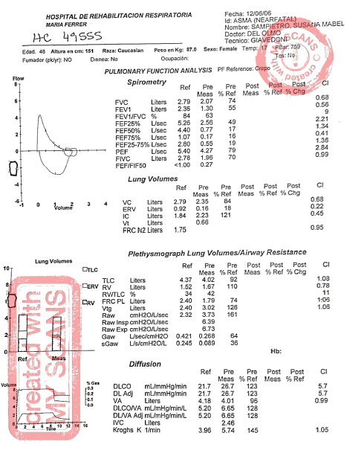

Slide 20
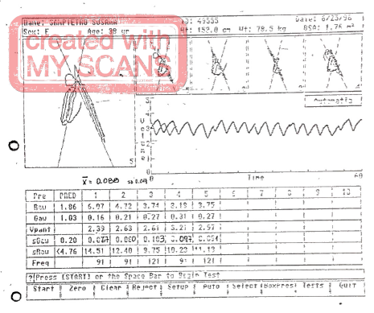

Slide 21
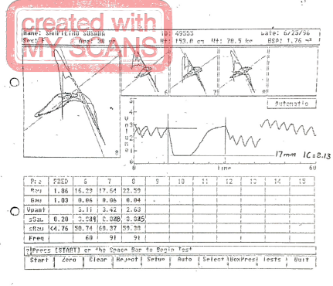

Slide 22
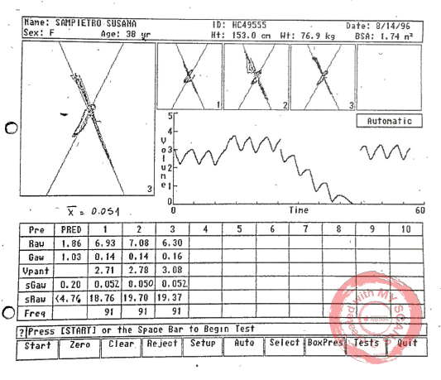

Slide 23
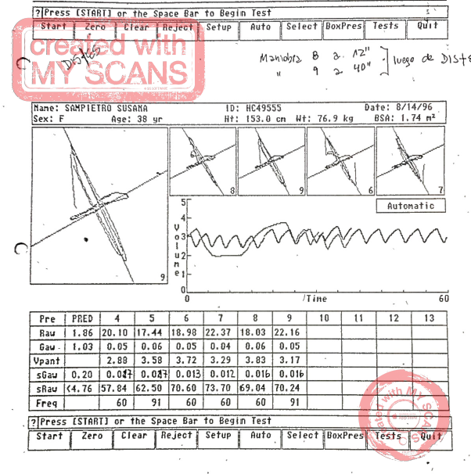

Slide 24
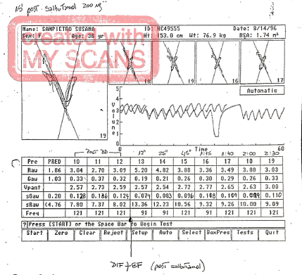

Slide 25
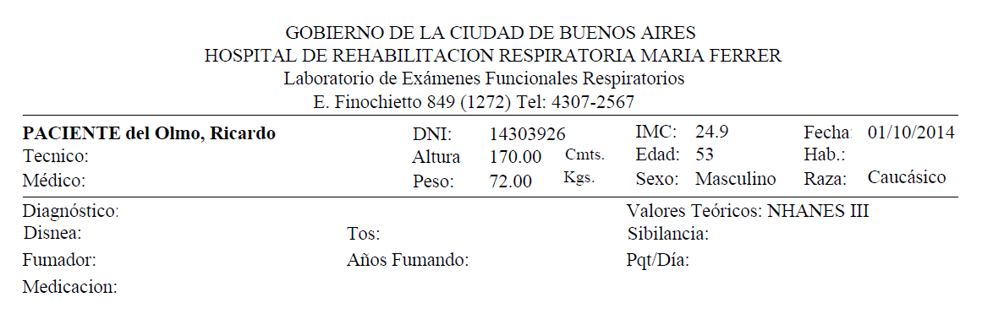
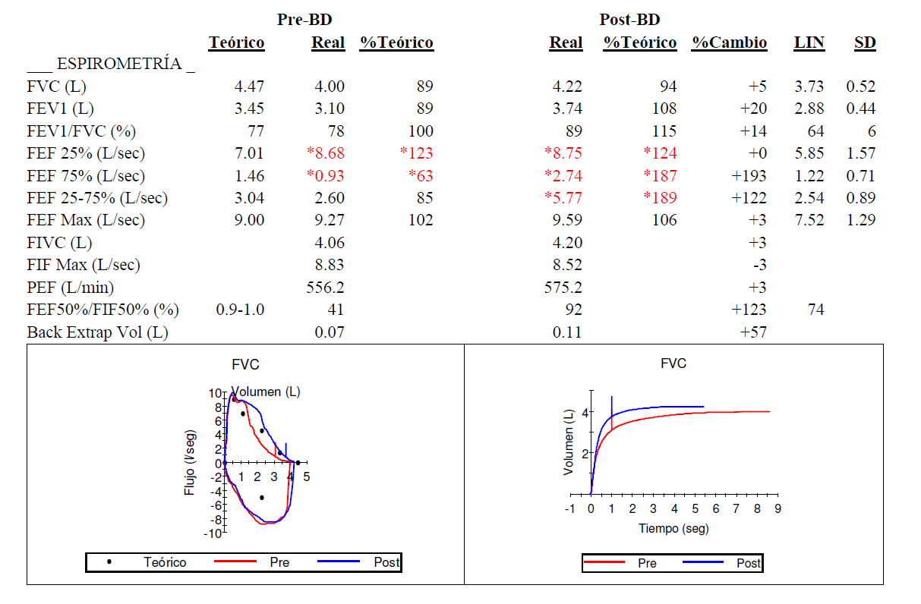

Slide 26
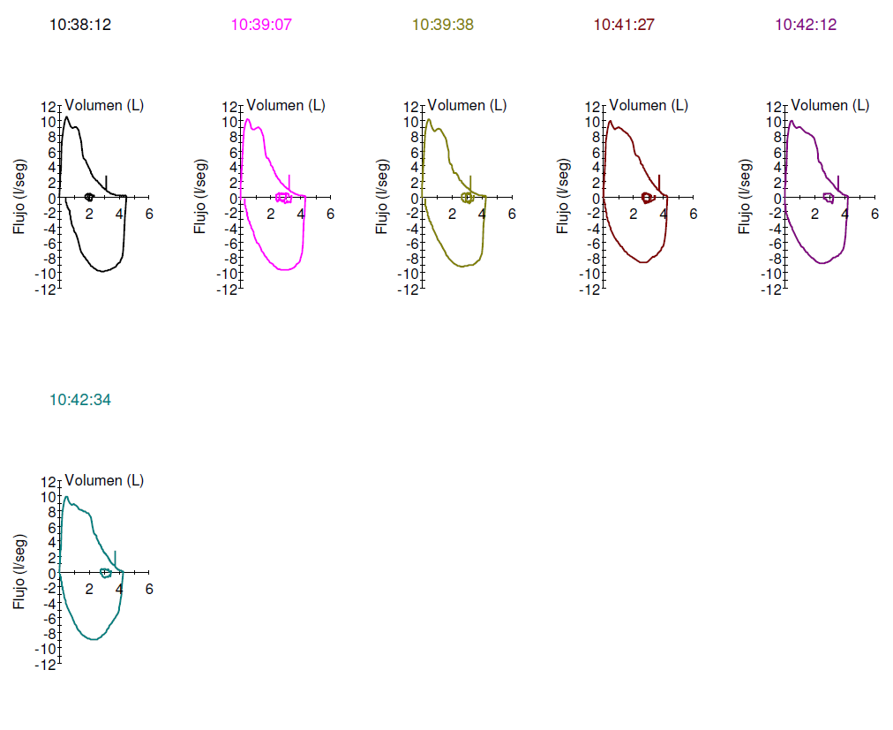
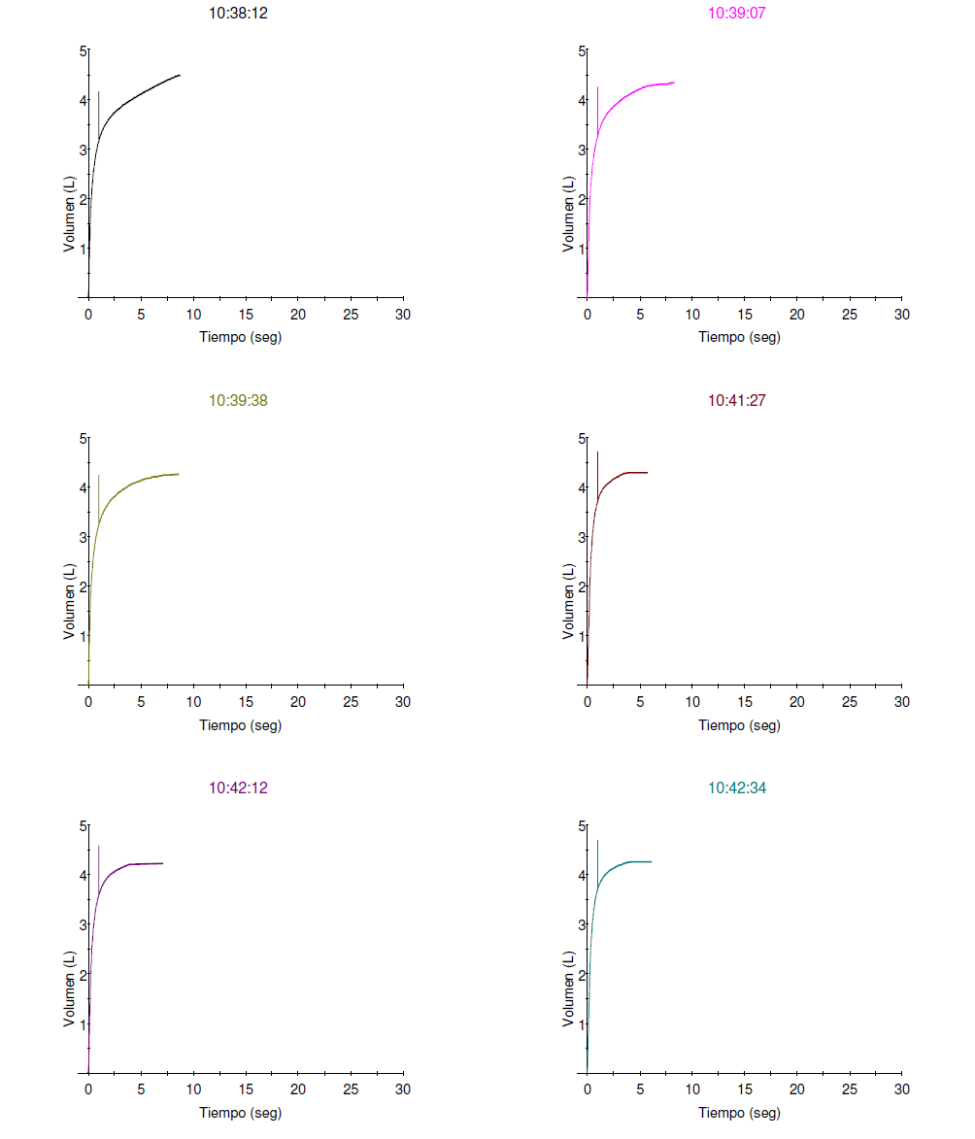

Slide 27

Considerar opciones de evaluación diferentes

Slide 28

Augusto
Mi horizonte hoy…

